Slide 1



CHTA Market Place Conference
Insights to Actions - MasterCard Advisors
Lindsay St. Lawrence

Slide 2



Big Data Expertise
  Differentiation starts with consumer insights from a massive worldwide payments network and our experience in data cleansing, analytics and modeling.
WAREHOUSED
10 petabytes
5+ year historic global view
Rapid retrieval
Above-and-beyond privacy protection and security
MULTI-SOURCED
38MM+ merchant locations
22,000 issuers
WHAT CAN
2.2B
GLOBAL
CARDS
43B
&
CLEANSED, AGGREGATD, ANONYMOUS, AUGMENTED
1.5MM automated rules
Continuously tested
TRANSFORMED INTO
ACTIONABLE INSIGHTS
Reports, indexes, benchmarks
Behavioral variables
Models, scores, forecasting
Econometrics
TRANSACTIONS/YEAR
MEAN TO YOU?

Slide 3
About MasterCard Advisors
Transaction
Data Analytics
Information Tools
Data-Driven
Consulting
Marketing
Services
Solutions
TRANSLATING SPEND DATA INTO INSIGHTS AND RESULTS

Slide 4

Advisors Can Help Drive Performance
Of Caribbean Tourism Markets With Deep Insights
1.Know
Identify & Analyze the Opportunity
3.Measure
Track Results
Spend category expansion
Spend segmentations
Origination Market deep-dive
Track spend increases for campaign periods
Track ROI for marketing and segment development
2.Act
Strategic Actions
Develop Peak seasonality marketing targets
Use data to target category spend by country

Slide 5
Seasonality of Travel to the Caribbean
Total Caribbean market
  Travel peaks during the winter and early spring (Dec-April). It is at its lowest in September, and overall lower during hurricane season.
June 1, 2013 – June 30, 2014 vs. July 1, 2014 – June 30, 2015
Note:
              All analysis is subject to Data Usage & Privacy laws by origination Market and Benchmarking Requirements

Slide 6
Top 10 Origination Markets based on Spend Index
Total Caribbean market
  In aggregate, visitors from the US spent ~79x more in the Caribbean than the global spend average over the past 24 months. GBR and Switzerland carry the highest Average Spend per Account.
July 1, 2014 – June 30, 2015
Note:
              All analysis is subject to Data Usage & Privacy laws by origination Market and Benchmarking Requirements

Slide 7
Origination Markets Ranked by Average Spend per Account
Total Caribbean market
However, visitors from Switzerland and the UK spend on average over $200 or ~1.3x more per account than average visitors.
Average Spend per Account for Top 10 origination Markets
Note:
              All analysis is subject to Data Usage & Privacy laws by origination Market and Benchmarking Requirements
July 1, 2014 – June 30, 2015

Slide 8
YoY Spend Growth for Top 10 Origination Markets
Total Caribbean market
The US, the international spend leader in the Caribbean, shows comparatively slower spend growth compared to Venezuela, Switzerland, and Italy. Avg spend growth = 13.3%
YoY Growth for Top 10 Origination Markets
By Spend
Spend Leader
Average YoY Growth (13.3%)
June 1, 2013 – June 30, 2014 vs. July 1, 2014 – June 30, 2015
Note:
              All analysis is subject to Data Usage & Privacy laws by origination Market and Benchmarking Requirements
Notes:
Average YoY spend growth among top origination markets based on spend is 13.3%
The US shows below average spend growth; only 3 other top ten origination markets based on spend show slower or negative growth.
Venezuela's YoY spend growth is almost 3x above the top ten origination market average, while Switzerland and Italy are about ~2x above the average.

Slide 9
Average Length of Stay for Top Ten Origination Markets
Total Caribbean market
  Length of stay does not directly correlate with spend per account.
  UK and Switzerland with the highest average spend per account, and mid-range average stays, while the Netherlands carry the longest stay, but only an average spend level.
Average Stay
(6.7 days)
Spend and Transaction Leader
July 1, 2014 – June 30, 2015
Note:
              All analysis is subject to Data Usage & Privacy laws by origination Market and Benchmarking Requirements
              *Length of stay based on transaction data. One-time transactors were excluded from this formula.
Notes:
Average length of stay among the top origination markets by spend is 6.7 days and average spend by account is $654.4.
The US is the top origination market by spend and transactions, but comes in second for length of stay (~2 days longer than average) and spend by account ($165 above average among top origination countries).
Visitors from the Netherlands spend ~3 days longer than the average international visitor, but only spend close to the per account average.

Slide 10
Average Spend per Day* Top Ten Origination Markets
Total Caribbean market
Visitors from Switzerland and GBR spend the greatest per day of visit (most valuable travelers to tourism spending (~$140 per day average)
The travelers from Italy and the Netherlands spend the least per day of stay (<$75 per day).
CHE over index to spending with Hotels
France over index to spending with Other
Italy over index to spending with Car Rental
GBR over index to spending with Retail & Dining
July 1, 2014 – June 30, 2015
Note:
              All analysis is subject to Data Usage & Privacy laws by origination Market and Benchmarking Requirements
              *Length of stay based on transaction data. One-time transactors were excluded from this formula.
Notes:
Average length of stay among the top origination markets by spend is 6.7 days and average spend by account is $654.4.
The US is the top origination market by spend and transactions, but comes in second for length of stay (~2 days longer than average) and spend by account ($165 above average among top origination countries).
Visitors from the Netherlands spend ~3 days longer than the average international visitor, but only spend close to the per account average.

Slide 11
Cross Category Spend by Origination Market
Total Caribbean market
  Hotels are a consistently large component of travel spend across countries.
  South American originations (Venezuela & Brazil) have the highest percentage of retail spend.
Travel-Related Cross Spend Categories for Top origination Markets in Destination Market
Category Skew (over index vs. the average of top 10)
July 1, 2014 – June 30, 2015
Note:
              All analysis is subject to Data Usage & Privacy laws by origination Market and Benchmarking Requirements

Slide 12
ORIGINATION MARKETS Profiles

Slide 13
Origination Market Profile: United States
USA
  Despite leading in spend and transaction across the Caribbean market; growth is slightly lower than the top origination market averages. Seasonality peaks are in March/April.
YoY Growth (Spend) | YoY Growth (Transactions) | YoY Growth (Unique Stays) | Avg. Length of Stay (Days) | Average Spend per Account | Average Transaction Value
10.6% | 20.8% | 18.7% | 8.4 | $819 | $127

Slide 14
Origination Market Profile: United Kingdom/GBR
GBR
  GBR visitors are top with spend per account in the Caribbean. Similar to the US, the GBR is experiencing slightly below average YoY growth, but has more defined and a longer seasonal trend (Dec-March).
YoY Growth (Spend) | YoY Growth (Transactions) | YoY Growth (Unique Stays) | Avg. Length of Stay (Days) | Average Spend per Account | Average Transaction Value
11.8% | 17.7% | 15.3% | 7.0 | $1,019 | $254

Slide 15
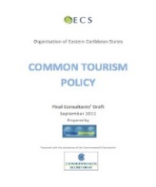
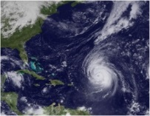
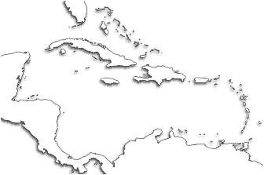
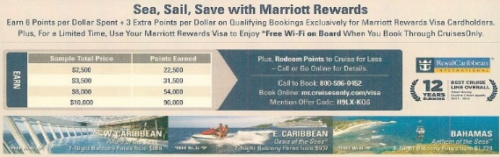
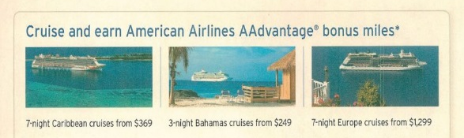
Travel Influencers
  YOY Origination Market Economics (USA, CAN, GBR)
  Favorable Trade Policy
Currency Gains on BSD (11/2015)
  Destination Market Events
  Weather
Spending Growth (10/2015)
USD
Chase Marriott Rewards
Canada Retail
  Travel Industry Expansion
Citi American Airlines
CARIBBEAN
2015 Cruise News: Growth continues as new routes and bigger ships seek to meet demand
JetBlue launches nonstop service to Antigua from New York
interCaribbean Airways starts flights to Santiago de Cuba
Larger Ships Prompt Expanded Caribbean Cruise Ports
  Airline & Hotel Marketing Campaigns
Notes:
UK Travel Dec +1.4%; 3 month average +0.4%
Can Dec retail +2.6%; 3 month average +1.1% (accelerating)

Slide 16



Critical Factors Driving Loyalty And Revenue Growth For Travel Merchants
The customer experience is the most critical
Segment and personalize by the customer and their behavior
CUSTOMER LOYALTY
Predict vs. respond to market dynamics
Notes:
Within the competitive landscape, there are many critical factors to drive loyalty. I’ve identified 3 that we believe are critical

Slide 17

Travel Propensity Model Case Study – JetBlue
Model Scored to JetBlue Customer Database
Case study
Situation
Issue: JetBlue needed a structured and consistent strategy for engaging the right customers with relevant messages at a proper frequency who:
  Have a high propensity to travel to the Caribbean/Central America in the next quarter
Approach
  Used MasterCard Travel Propensity model
  Scored the Propensity model to JetBlue’s Customer file through
  MasterCard Customer Data Enhancement capability
  JetBlue used the Propensity model in conjunction with Customer Loyalty/
  Share of Wallet to prioritize a customer segment for a targeted message
  and promotion (JetBlue-deployed campaign)
Results
>40% LIFT in email conversion
vs. BAU control
DOUBLE-DIGIT increase in ticket size

Slide 18

Learn more at:
www.mastercardadvisors.com
Contact:
John Munoz
John_Munoz@mastercard.com

