Slide 1

Members Only Portal
How To Edit/Update
Individual Profiles
December 2017

Slide 2
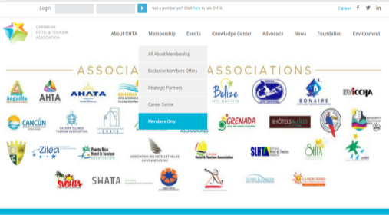
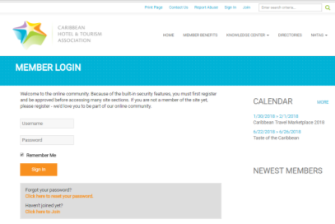
Getting to the NEW Members Only Portal
To Access the Members Only Portal:
http://www.caribbeanhotelandtourism.com
Click on Members Only menu option under the Membership Menu Item
You will be prompted to logon with the username and password that were sent via email. Please note the old username/password will no longer work but you can modify your password to make this something easy to remember.
Step 1
Step 2

Slide 3
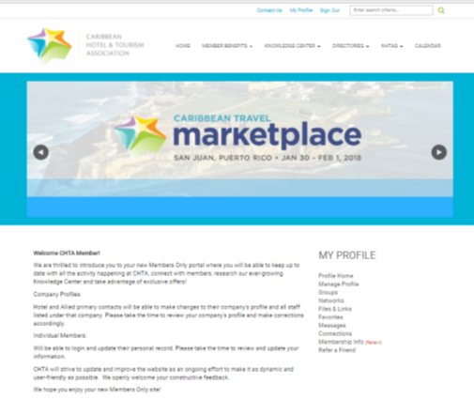
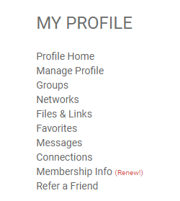
Managing Your Profile
The menu bar on the right, will lead you to the pages necessary to view and manage your member profiles. At launch, we will only focus on :
Profile Home
Manage Profile
Please note that the other links on this Menu will be explained at a later date and may not be fully functioning at launch.

Slide 4
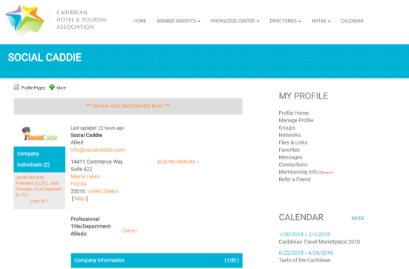

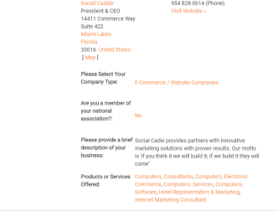
YOUR MEMBER PROFILE
Your member profile will show all contact information for your company and can be found on the Member Directories .
Tips before editing:
If you are a Master Account contact, consider adding your company logo as the “headshot”. If you are an individual under a company member account, add a professional picture of yourself!
Make sure to include full contact details, address, phone, email. The address may seem repeated if your offices are also headquarters—please fill in both sections.
If you are a Master Account, you may be prompted to renew your membership dues for 2018. If you are prepared to do so, you can submit payment via credit card online. Membership dues are due on January 1, 2018 and are a requirement for attending any CHTA event.

Slide 5
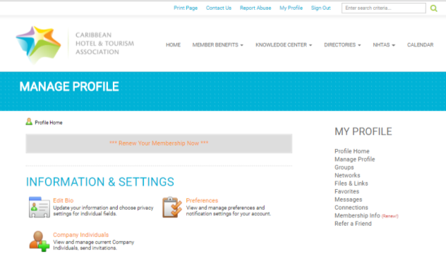
MANAGE PROFILE
When you click on Manage Profile on the right menu bar, you will be directed to a dashboard where you can access various features that help manage your membership with CHTA.
Note that at launch, we will only be utilizing INFORMATION & SETTINGS.
The sections CONTENT & FEATURES and COMMUNITY will be activated at a later date.

Slide 6
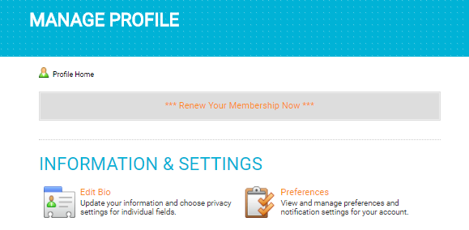
Under INFORMATION & SETTINGS:
Edit Bio: Clicking here will allow you to modify any of the information that will be on display for members on the directories and also allows us to have the most updated information about your company.
  If you click on the option to Renew Membership (Master Accounts only), the first step will always be to update your member profile.
Preferences: At launch, there is no additional information needed here.

Slide 7
Thank You!
Questions?
membership@caribbeanhotelandtourism.com
+1 305 443 3040

