Slide 1

March 14, 2018

Slide 2




PRESENTS
Mike Cowles
Chief Commercial Officer
Dan Skodol
VP, Revenue Analytics

Slide 3
Who Is Rainmaker?
Rainmaker is the Hotel Revenue & Profit Optimization Cloud
What Do We Do?
We partner with hotels, resorts and casinos to help them outperform.
Our integrated solutions maximize profit from every segment of the business.
Notes:
Out perform
Integrated
Hotel Revenue Optimization Cloud
Our market leading solutions help hotels, resorts and casinos maximize the profit of every guest, from every revenue stream, through every channel.
Our integrated solutions help hotels, resorts and casinos maximize the profit of every guest, from every revenue stream, through every channel.
profit and revenue optimization
Our integrated solutions maximize profit from every segment.
every guest, from every revenue stream, through every channel.
Rainmaker a single platform for hotels to compete more aggressively for guest’s business, better manage and prioritize data, and ultimately track and measure success

Slide 4
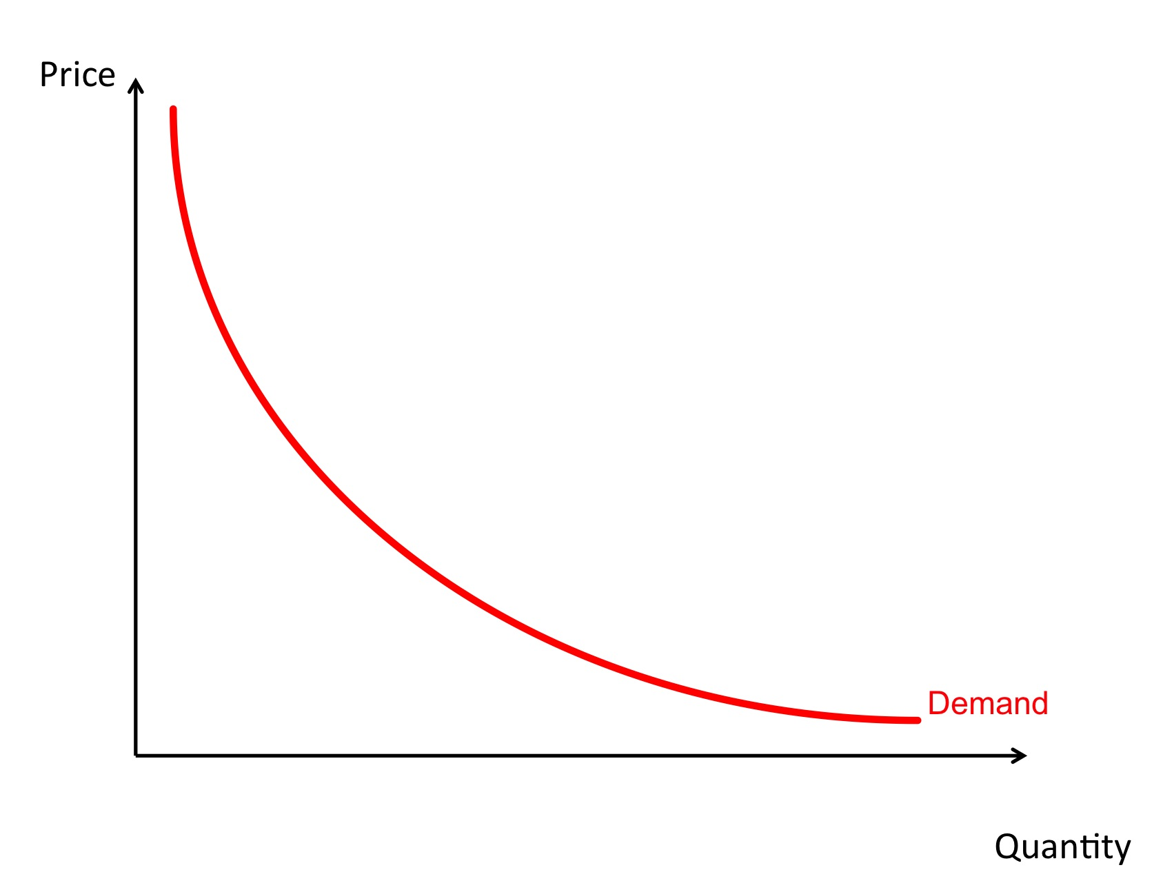
It’s all About Supply and Demand
But neither Hotel Supply or Hotel Demand are homogeneous concepts with simple curves
Discrete units of Supply can vary in many ways:
  Suites vs. Rooms
  Ocean View vs. Garden View
  Other amenities
And Demand comes in many flavors as well:
  Different booking channels (costs)
  Known repeat customer, or known demographic
  Propensity to spend (ancillary and/or gaming)
  Propensity to consume (all inclusive)

Slide 5
Your Demand Needs to be Segmented
In practice you will sell portions of your Supply at varying prices to different segments of your Demand over time
In order to maximize revenue and profit you need to understand your relatively static Supply and your very dynamic Demand
With an appropriate segmentation and forecast by segment you can optimize how you price and when you make Supply available to the most valuable Demand segments

Slide 6
Segmentation Considerations
Business segments don’t always translate into RM segments
Ensure there is enough volume of bookings to forecast effectively
Segmentation can capture different:
  Booking patterns
  Values
  Length of stay distributions
  Seasonality

Slide 7
Examples
Segment by booking channel
  OTA
  Tour
  Direct
Segment by value
  High/medium/low
  Appropriate for ancillary spend situations (e.g. casino)
  Capture individual costs/profit
Segment by geography
  North America
  Europe
  Asia, etc.
These can be combined

Slide 8
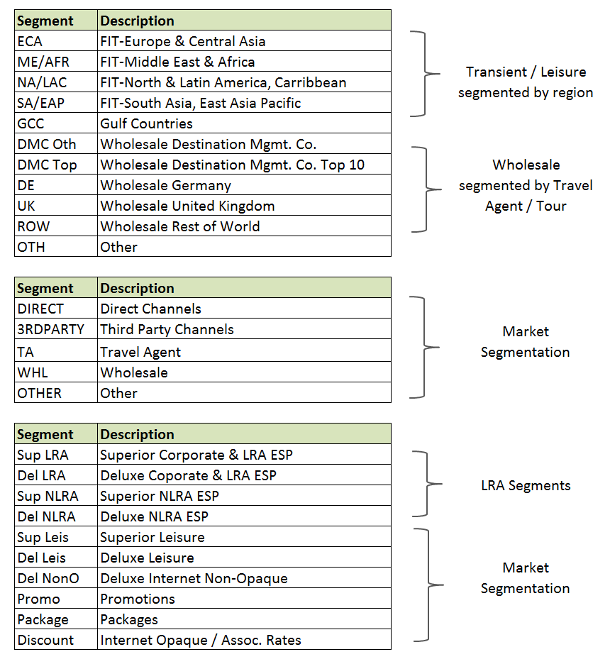
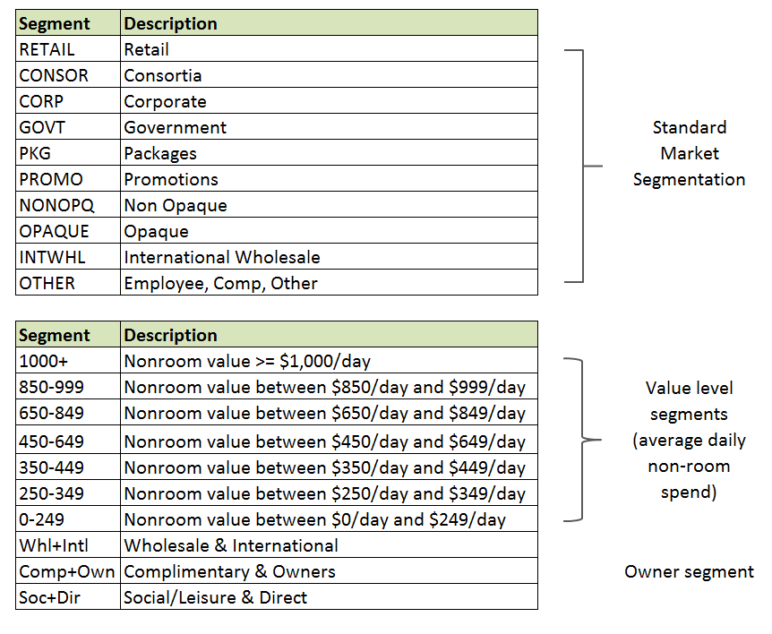
Segmentation Examples
Notes:
Segmentation is very flexible within GuestREV and GroupREV
A property may choose to use:
Existing Market Segmentation as defined in the PMS/CRS or Sales & Catering system
Elect to have Rainmaker perform a detailed analysis to identify the optimal segmentation for forecasting and pricing
Regardless of the segmentation option selected for forecasting, optimization and reporting
Demand is further segmented dynamically behind the scenes
Algorithms, such as CHAID decision tree, are used to identify the optimal segmentation for forecasting and pricing

Slide 9
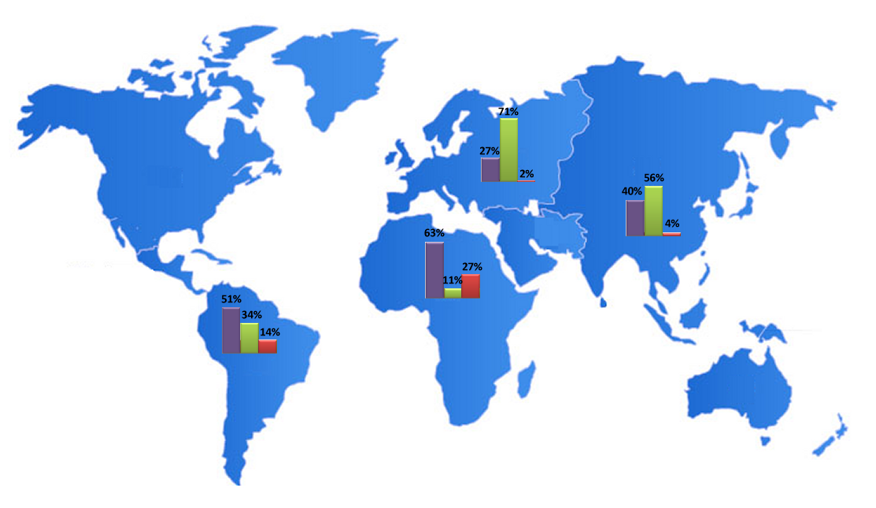

Segmentation Examples
ECA
ECA
SA/EAP
NA/LAC
ME/AFR

Slide 10
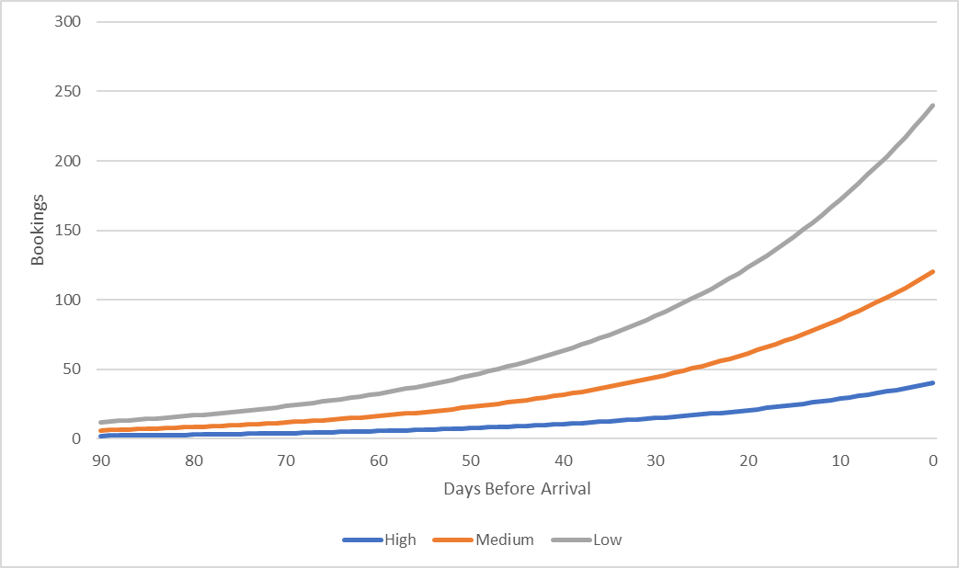
Yielding your Property
Ideally, fill your rooms going from highest-value segment to lowest-value segment
Hotel capacity
Take just enough low value guests to fill remaining rooms
There is enough room for all of your high/med value guests

Slide 11
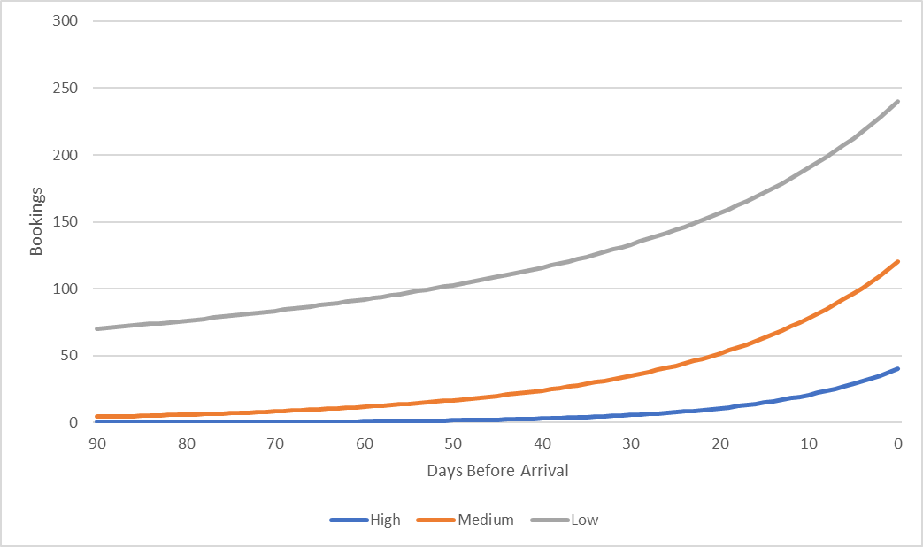
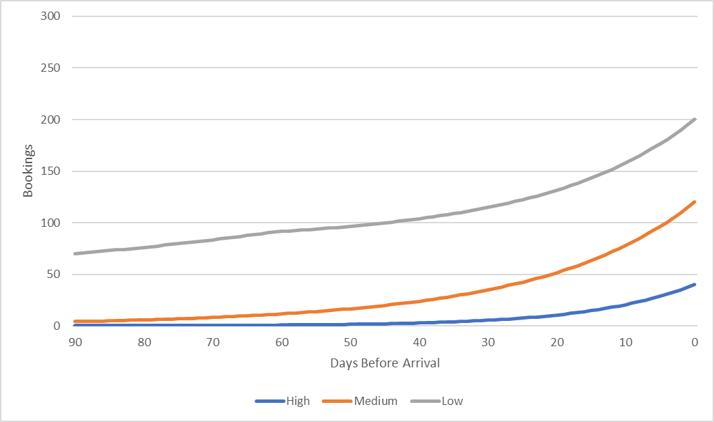
Importance of Forecasting
The challenge: Guests do not book in the order of their value!
In fact, lowest-value guests often book earliest
Decision on how many of these guests to accept should be based on a forecast of future demand
Goal: Know how many rooms to preserve for your highest-value, most profitable guests
Put controls in place to preserve remaining rooms for higher value segments
“Limit” of 80 low-value guests is reached 60 days out

Slide 12
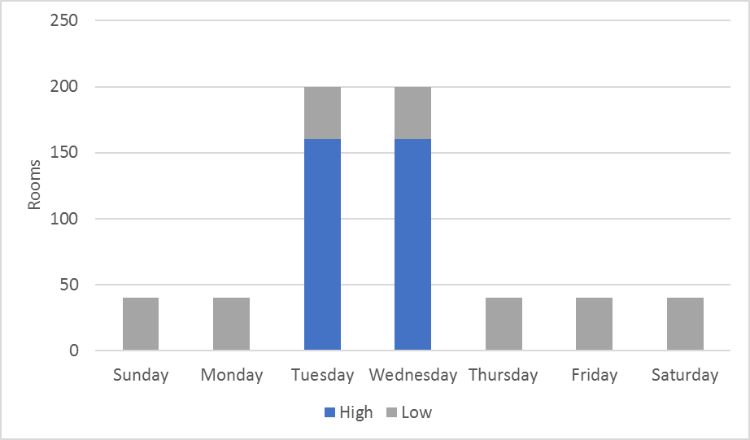
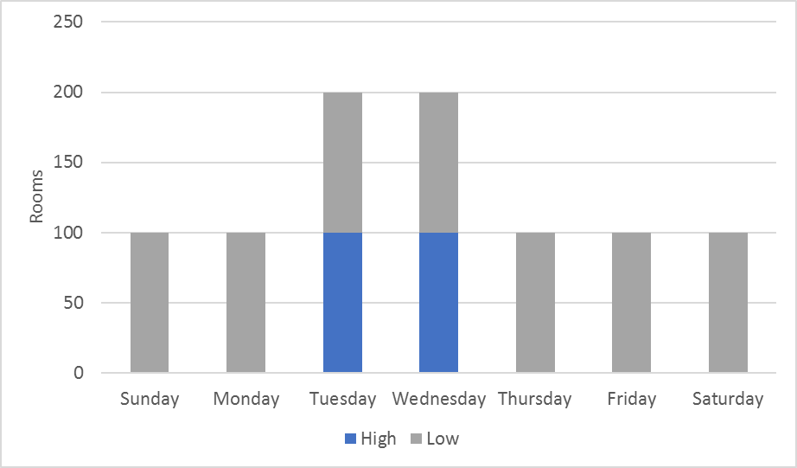
Length of Stay
Length of stay is a crucial dimension for yielding
Segments may have different length of stay distributions that are important to measure
Be wary of the effect on your revenue performance!
$100/nt
$250/nt
Revenue Result = $108,000
Revenue Result = $120,000

Slide 13
Five Data Tips
Tap into as many of your operational systems as possible
Help your customers help you
Not all revenue is created equal
Understand channel costs as thoroughly as possible
Draw inferences where data may be missing

Slide 14
Today’s Hospitality decision makers are faced with more variables
and a constant need to act quickly.
Rainmaker offers the best data and superior user interfaces to deliver the information, insights and support needed to make better, fast decisions.
Notes:
We have a suite of revenue management apps that cover the range of hotel RM and analysis.
Our apps do the heavy lifting, processing vast amounts of data, so that you get to make better, fast decisions that drive your profitability.

Slide 15
PRESENTS
Mike Cowles
Chief Commercial Officer
mcowles@letitrain.com
Dan Skodol
VP, Revenue Analytics
dskodol@letitrain.com

