Slide 1


Slide 2
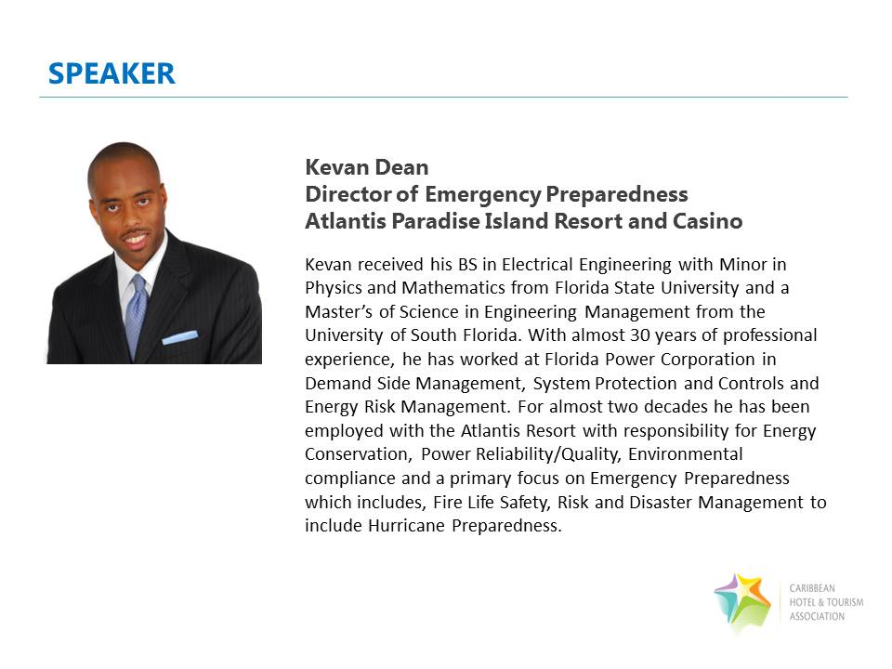

Slide 3
CHTA Storm Prep Series: Proactive Property Protection
Prepared By: Kevan N. Dean
Director of Emergency Preparedness, Atlantis Resort, Nassau, Bahamas

Slide 4
Proactive Property Protection
Introduction
The Hurricane Season
How To Prepare
Four Phases of Emergency Management
Leadership - HERP Crises Manager
Teamwork - HERP Crises Management Team (CMT)
BEFORE, DURING AND AFTER THE STORM
Helpful HERP Support Documents
Recap and Questions

Slide 5
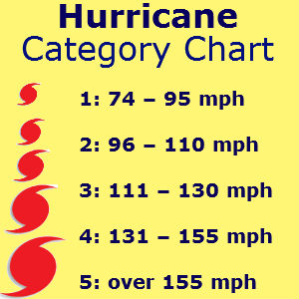
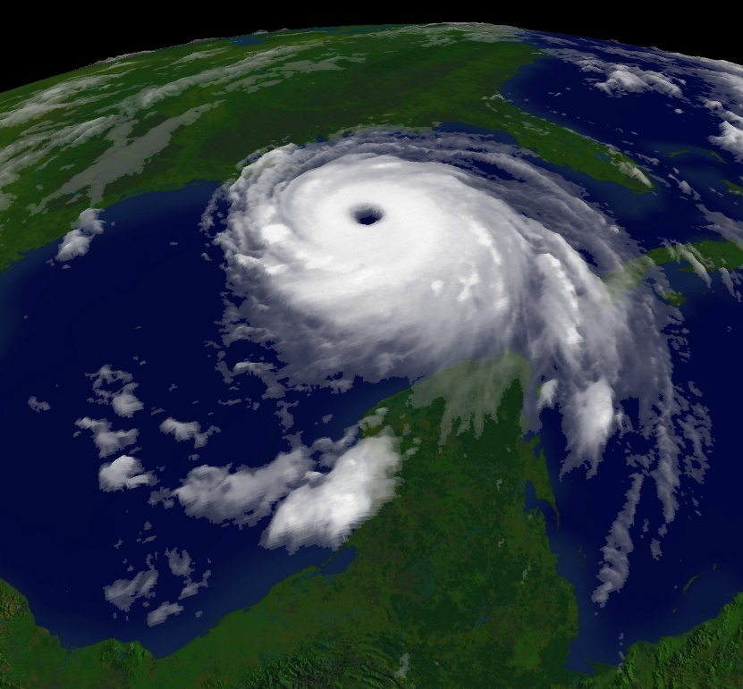
About Hurricanes
Hurricane Season starts June 1st and ends November 30th.
Hurricane Categories

Slide 6
(Watches and Warnings)
Tropical Storm Watch: An announcement that tropical-storm conditions are possible within the specified area.
Hurricane Watch: An announcement that hurricane conditions are possible within the specified area. Because outside preparedness activities become difficult once winds reach tropical storm force,
watches are issued 48 hours in advance of the anticipated onset of tropical-storm-force winds.
Tropical Storm Warning: An announcement that tropical-storm conditions are expected within the specified area.
Hurricane Warning: An announcement that hurricane conditions are expected within the specified area. Because outside preparedness activities become difficult once winds reach tropical storm force,
warnings are issued 36 hours in advance of the anticipated onset of tropical-storm-force winds.

Slide 7
How To Prepare
  While it must be understood it is impossible to predict or plan for every conceivable type of emergency. A Hurricane Emergency Response Plan will provide basic information to safely and successful meet the overall objectives of your operations.
  Hurricanes are unique events that fortunately allow you time to prepare but your reaction time weighs heavily on how effectively you prepare.
  The Key is to have a plan
  IMPORTANT – Plans are great but execution is what counts.

Slide 8
Developing a “Hurricane Emergency Response Plan” (HERP)
The Goal:
  The HERP goal is to ensure that comprehensive plans, process and procedures are in place to respond to Hurricanes and by default, other Emergencies.
  The HERP plan will also identify key roles and responsibilities of individuals and departments or groups of team members.
  This HERP plan will seek to respond to basic emergencies and follows the four phases of emergency management which include:
    Mitigation/Prevention
    Planning
    Response
    Recovery

Slide 9
MITIGATION/Prevention
Mitigation/Prevention
MITIGATION
The action of reducing the severity, seriousness, or painfulness of something.
PREVENTION
The action of stopping something from happening or arising on of stopping.
  Key Points/Examples
  Mitigation - If a room is susceptible to flooding, then take the precaution to place sandbags to restrict water intrusion.
  Prevention - If it is necessary, build a barrier wall in the room to prevent water intrusion or relocate the contents of the room completely in an effort to eliminate the risk if determined to be critical enough.

Slide 10
Planning
Mitigation/Prevention
Planning
Planning - The process of thinking about the activities required to achieve a desired goal. It involves the creation and maintenance of a documented plan.
Key Points:
Ensure that you stage appropriate assets in advance.
Ensure that you have human resource support Before, During and After a hurricane event.

Slide 11
Response
Mitigation/Prevention
Planning
Response
Response: How quickly and effectively we react to a change in circumstance or situation.
Key Point:
Make sure you have the right compliment of volunteers in the right work assignments.
Consistently communicate with Employees and Guest about impacts where appropriate.
Note: The more accurate information you are able to provide the less anxiety, confusion, you are likely to have.

Slide 12
Recovery
Mitigation/Prevention
Planning
Response
Recovery
Recovery: The actions required to return to a normal state of operation.
Key Points:
Storms tend to stress areas that are not normally stressed both physically in your facility and emotionally.
Take the time to fully access the readiness of your property and staff and in some cases your support services and systems.
One way to achieve this to ensure that you have the right TEAM in place.

Slide 13
LEADERSHIP - Crises Manager (CM)
The Crises Manager has the overall responsibility for the plan. The responsibility include but is not limited to:
  Developing and maintaining the written HERP
  Taking security measures to protect employees and property
  Integrating your HERP with any existing general emergency plans covering the building or work area occupied;
  Training designated employees in emergency response that could be associated with a hurricane emergency such as: Fire and Medical emergencies
  Ensuring that our facility meets all local fire, health, security, and building codes and regulations.
  Oversee policy or process revisions or creations
  Managing and actions and responsibility of the Crises Management Team (CMT)

Slide 14
TEAM- Crises Management Team (CMT)
The CMT is comprised of designated departmental representatives which are to assist in the successful execution of the plan under the varying emergency conditions. This may include but is not limited to:
  Ensure that Policy and Procedures are in agreement with department’s Standard Operating Procedure.
  Review and test the plan at various steps of implementation to improve the Response effectiveness and shorten the Recovery time.
  Keeps in constant communication with the Crises Manager
  Assist with the overall execution of the plan

Slide 15
The Plans Success Require Teamwork
CRISIS MANAGER
PUBLIC RELATIONS
FINANCE
ENGINEERING
HUMAN RESOURCES
INFO
TECH
CONSULTANT & OTHERS
SECURITY
F&B MANAGER

Slide 16
Before the Storm
Before The Storm
  Review your country plan in relationship to your company plan
  Establish an effective communication plan
  Complete a photo/video inventory of your property prior to the season.
  Review updates and revision from previous season to ensure that they are still applicable in your current operations
  Test all Emergency Equipment and review critical parts, supplies (water, batteries, etc.) and equipment inventory.
  Raise any electrical or valuable items off the floor.
  Turn off or unplug lights and other electrical equipment.
  Remove pictures from walls and wrapped in plastic.
  Power down all computers and office equipment where applicable cover with plastic
  Move staff equipment in the exterior offices to the interior.
  Secure all exterior doors and windows. Remember any breech may result in significant damage.
  Back Up all critical files and documents
  Retrain volunteers to ensure that they understand their roles and responsibilities.
  Establish a Emergency Operating Center
  Identify a Post Storm Relief Team

Slide 17
During the Storm
During the Storm
  Employees should monitor the condition from a safe shelter and limit movement.
  Operations should stay in content communication with their HERP Crises Management Team Leader and provide frequent update. Where possible, stay in communication with members of your team that may not be on property.
  HERP Crises Manager should be in communication with the appropriate Emergency Services, Government Agencies, Airlines and Tourism Organizations and Team Members.
  Identify any service limitations as a result of the limitation in advance have a documented work around.
  Be ready to mobilize teams to safely react to changing conditions

Slide 18
Evacuation and Sheltering
Identify a safe location for both Employees and Guest to Shelter if required.
Determine the most effective evacuation process for you:
    Floor Evacuation
    Building Evacuation
    Office Evacuation
Review your organizations policy on compensation and rates in advance.
Provide clear instructions to guest on the evacuation process and expectation.
Ensure that shelters are as comfortable of an experience as possible.
Establish a registration and check in and staging process or procedure,
Makes sure all guest/employees are registered and accounted for,
Clearly communicate Shelter Rules and Restrictions

Slide 19
After the storm
Safety is the first priority damage assessment team must identify hazards that threaten employee or guest safety.
The Assessment should include identification of damage to critical infrastructure necessary to provide basic life support to employees and guests remaining on the premises. Initial reports to the Crisis Management Team should include estimated downtime.
  Electrical systems and equipment (e.g., transformers, switchgear, diesel gen., power transmission lines, etc.)
  Water pumps and storage tanks
  Sanitary facilities (sewage treatment plant, sewage holding tanks and pumps, etc.)
  Propane storage tanks and piping systems
  Telecommunications systems (telephone, data and satellite communications, etc.)
  Roads and bridges
Resist giving the “All Clear” for guest to return to their rooms and into the resort until you have completed your damage assessments and system testing.
Personnel Issues
  Be alert for signs of stress that could result in workplace violence. Provide rest breaks for workers who appear overly angry, melancholy or agitated.

Slide 20
Helpful HERP Support Documents
  Information, Forms and Documents
    Record of Change Log
    Evacuation Registration and Relocation
    Pre Storm Assessment
    Damage Assessment Form

Slide 23
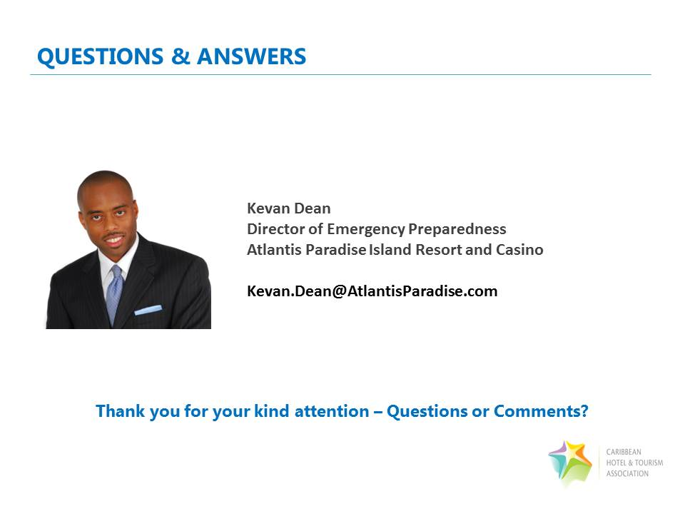
Questions

