Slide 1

CHTA Annual Industry Performance
and Outlook Study
January 2019

Slide 2

CHTA Industry Performance and Outlook Study
In January, 2019 the Caribbean Hotel and Tourism Association conducted its fourth annual Industry Performance and Outlook survey. This was undertaken to assist the organization with gaining a better understanding of the state of the tourism economy, its outlook, and the degree to which a number of factors impact or may affect the tourism industry.

Slide 3
SUMMARY OF RESULTS
Assessing Hotel Performance in 2018 vs. 2017, outlook for 2019:
Overall 2018 Global Economy, New and Upgraded Accommodations , Additional Airlift, Greater Marketing Investments Fueled Continued Growth
Optimistic About 2019 but Increasing Concerns About Global Economy
Increased Capital Investments Reported by 61 Percent of Hotels
Three Years of Rising CapEx and New Hotels on Stream Increased ADR
New Hires Reported by 47% while 44% Maintain Existing Levels
76% Report Increased Revenue with 29% Indicating It Was Significant
More Hotels Report 2018 Net Profit; 80% vs. 20% Expecting Net Loss
Residual Impact of 2017 Hurricanes Still Affecting Several Destinations
Concerns About Negative Perception in the Marketplace, Need For Greater Marketing Investments

Slide 4

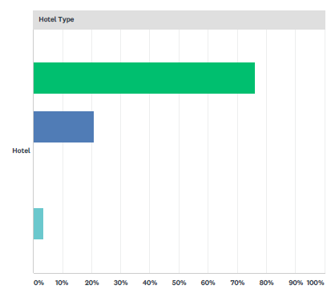
CHTA Industry Performance and Outlook Study
Survey Respondents….
76% Independent
21% Chain
3% Shared Ownership

Slide 5
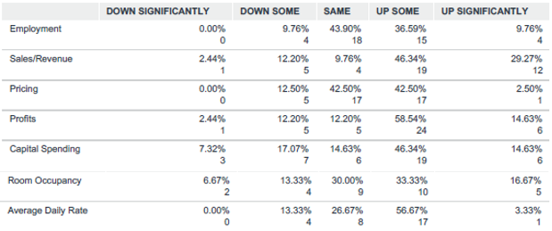


CHTA Industry Performance and Outlook Study
Business Performance in 2018 vs. 2017

Slide 6

CHTA Industry Performance and Outlook Study
Causes for Business Performance in 2018 vs. 2017
Where Performance is Down Significantly…
1. | Residual Effect Of 2017 Hurricanes
2. | Airlift Availability and Cost
3. | Global Uncertainty
Where Performance is Up Significantly…
1. | Capital Investments Paying Off
2. | Marketing Investments
3. | Recovered from 2017 Hurricanes

Slide 7
CHTA Industry Performance and Outlook Study
Top Ten Most Important Issues Affecting Caribbean Tourism
Global Economic Uncertainty – i.e. Consumer Confidence, Brexit, Potential Recession
Insufficient Marketing by Destinations and Region
High Airfares
Need for Improved Local Business Environment
Labour Related – availability of qualified workers….productivity
Increasing Global Competition
Perception of Safety and Crime
Overall Negative Perception of Region
High Cost of Doing Business
Lingering Impact of 2017 Hurricanes

Slide 8
CHTA Industry Performance and Outlook Study
LOOKING AHEAD TO 2019
Despite Areas of Concern, Overall Outlook Remains Positive

Slide 9
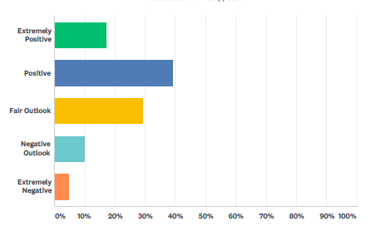
CHTA Industry Performance and Outlook Study
Tourism Outlook for 2019
17% Extremely Positive
39% Positive
29% Fair
10% Negative
5% Extremely Negative

Slide 10
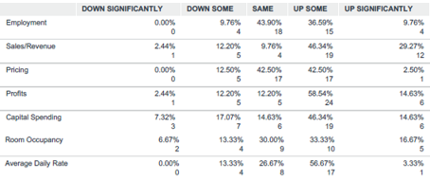

CHTA Industry Performance and Outlook Study
Expected Business Performance in 2019 vs. 2018

Slide 11
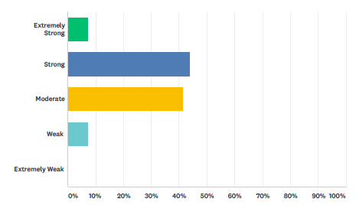
CHTA Industry Performance and Outlook Study
Strength of the Tourism Economy
in the Caribbean Today
7% Extremely Strong
44% Strong
42% Moderate
7% Weak
0% Extremely Weak

Slide 12
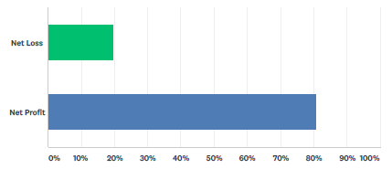
CHTA Industry Performance and Outlook Study
Net Profits are Anticipated in 2018
20% Net Loss
80% Net Profit

Slide 13
Key Takeaways….
Four Consecutive Years of Capital Improvements Showing Results
Strong Tourism Performance Sparks Growth in Employment, Government Revenue, Hotels Reporting Net Profit
CapEx Investments and Fresh Product Key to Growth in ADR
Unprecedented Growth in Airlift for 2019 Cause for Continued Optimism
Hurricane Impacted Destinations Rebounding
Optimism Continues Into 2019….but Caution Underscored by Growing Global Economic Uncertainty, Brexit, External Factors

Slide 14
CHTA Industry Performance and Outlook Study
THANK YOU

