Slide 1
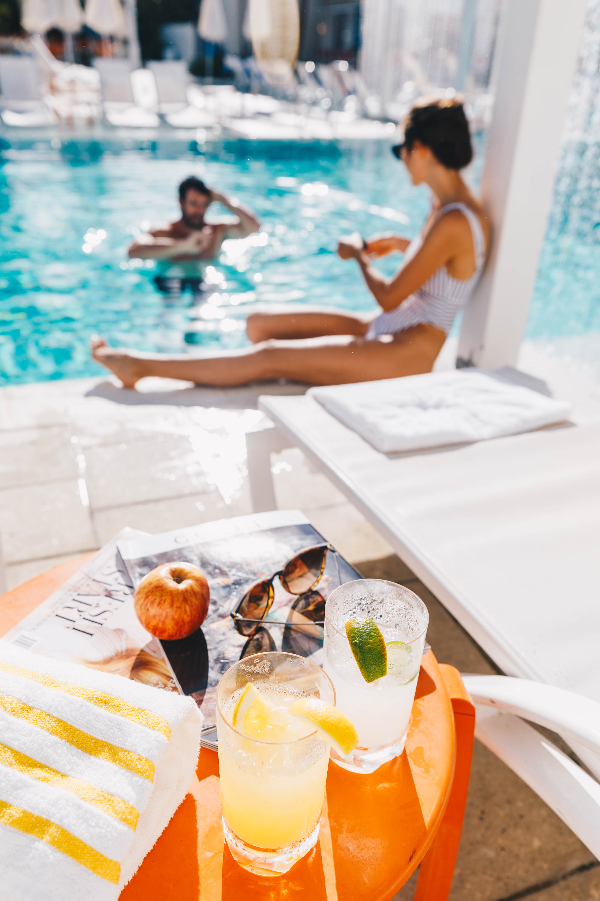
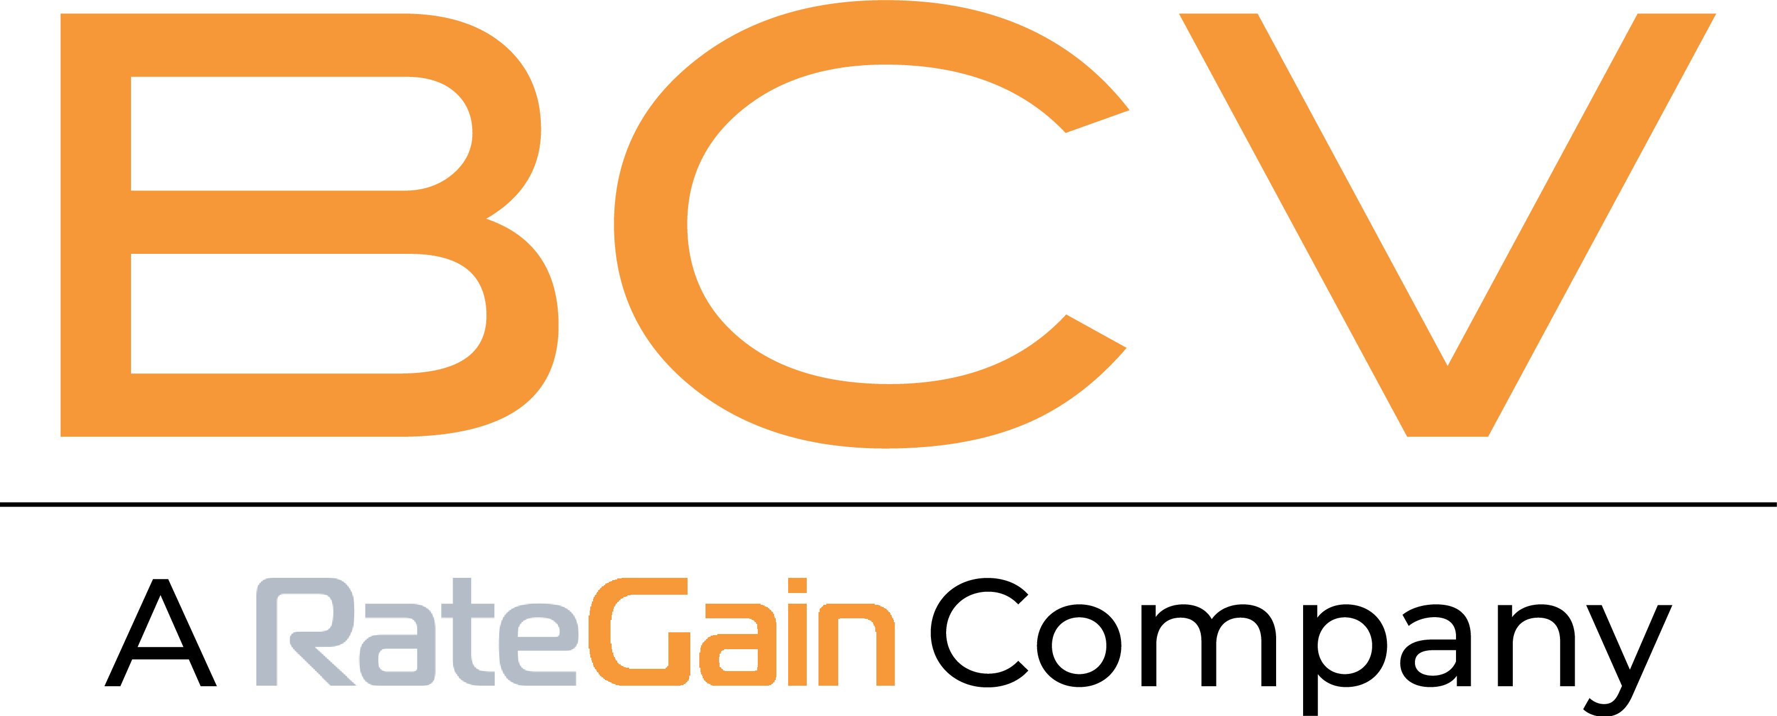

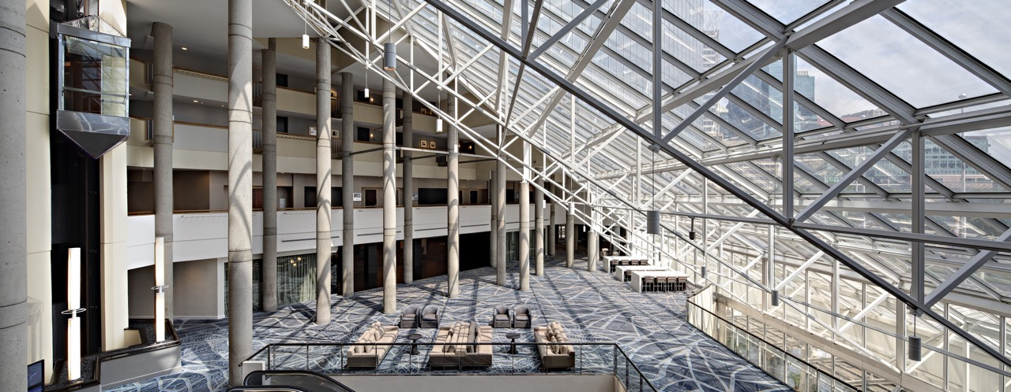
MAXIMIZING GUEST EXPERIENCE ON SOCIAL MEDIA

Slide 2
WHO WE ARE
BCV, A RATE GAIN COMPANY, IS THE HOSPITALITY INDUSTRY’S PREMIER, AWARD-WINNING PROVIDER OF TECH-ENABLED SOCIAL MEDIA SOLUTIONS TO OVER 300 HOTEL CLIENTS
Our comprehensive social media solution allows us to: drive revenue, tell your hotel’s story & manage your hotel’s reputation 24/7
Targeted
Content Marketing
Customized Social Media Strategy
Original Content Creation
Advanced Targeting Capabilities
Conversion Tracking
Operations
Support
24/7 Monitoring Capabilities
Driving Guest Engagement
Unique Guest Profiles
Reputation Protection & Enhancement
Analytics &
Reporting
Property Performance Reporting
Competitive Set Analysis
Advanced Analytics
Proprietary Data Insights

Slide 3
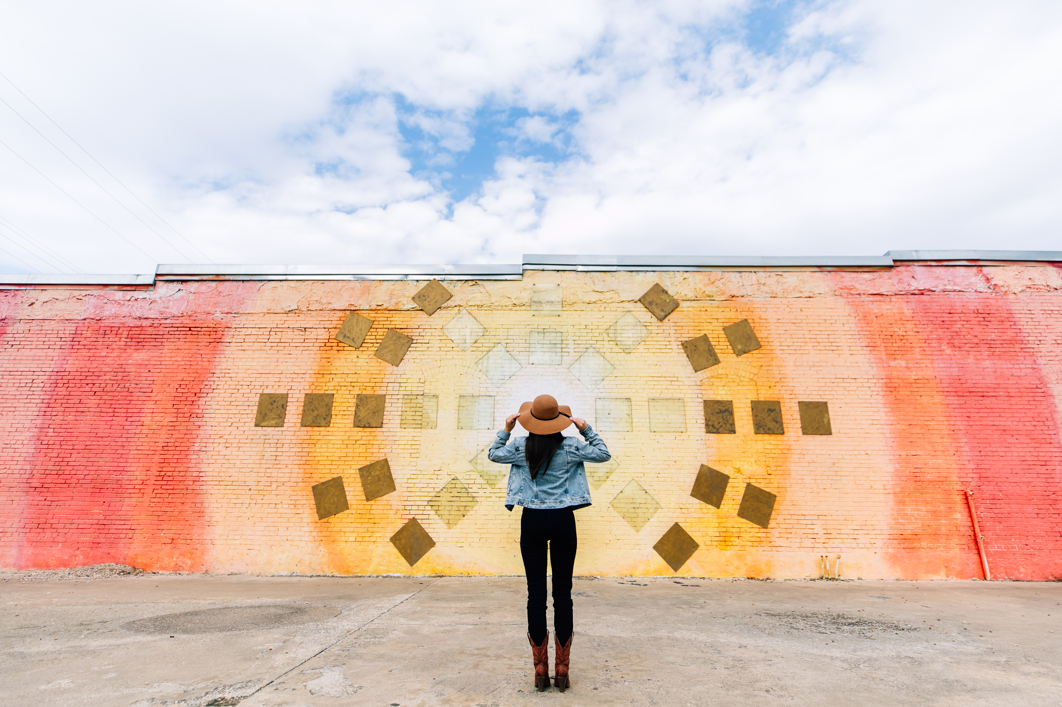
SOCIAL MEDIA LANDSCAPE

Slide 4
SOCIAL MEDIA ACTIVE USERS
2.3 BILLION
MONTHLY
ACTIVE USERS
1 BILLION
MONTHLY
ACTIVE USERS
330 MILLION
MONTHLY
ACTIVE USERS
EVERY 60 SECONDS ON FACEBOOK: 510 COMMENTS ARE POSTED, 293,000 STATUS’ UPDATED, AND 136,000 PHOTOS UPLOADED
INSTAGRAM USERS UPLOAD AN AVERAGE OF 60 MILLION PHOTOS TO THE PLATFORM EVERY DAY
TWITTER APPEARS TO GENERATE THE MOST CUSTOMER SERVICE OPPORTUNITIES AND AROUND 500 MILLION TWEETS PER DAY

Slide 5
SOCIAL MEDIA IN HOSPITALITY
80%
33%
72%
84%
OF TRAVELERS TURN
TO SOCIAL MEDIA WHEN PLANNING
A TRIP
SWITCHED HOTELS AFTER SOCIAL MEDIA RESEARCH
OF TRAVELERS POST
TO SOCIAL NETWORKS WHILE ON VACATION
OF USERS MENTIONING A BRAND EXPECT A REPLY WITHIN ONE HOUR
Notes:
52% say social media inspire travel plans // 33% change hotel based on social media (https://visual.ly/community/infographic/travel/impact-social-media-travel-and-hospitality-industry)
84% of consumers expect companies to respond within 24 hours after posting on social media, while 72% of Twitter complainants expect a response within an hour. (*https://www.socialmediatoday.com/social-business/consumer-expectations-rising-social-customer-care-report)
72%of travelers post to social networks while traveling (https://www.smartinsights.com/social-media-marketing/social-media-mobile-technology-impact-travel/)
80% of travelers use social media (Facebook) when planning a trip (http://www.dcsplus.net/blog/the-importance-of-social-media-in-todays-travel-industry)

Slide 6
ENGAGING GUESTS ON SOCIAL MEDIA

Slide 7
BUILDING A SUCCESSFUL STRATEGY
IDENTIFY OBJECTIVES
Start by outlining your marketing objectives
BUILD YOUR CONTENT STRATEGY
Identify social vision, tone of voice and content priorities
MEASURE SUCCESS
Identify benchmarks to measure against by end of year
Select the platforms that best suite your hotel based on budget, user behavior and guest demographics
SELECT SOCIAL PLATFORMS
Identify advertising campaigns
AMPLIFY WITH PAID SEND

Slide 8


SELECT THE RIGHT SOCIAL PLATFORMS
FACEBOOK
INSTAGRAM
TWITTER
Core marketing, communications and guest service social hub | Visual storytelling platform Content such as behind-the-scenes events, UGC & influencers | Primarily a guest service platform Focus on 1:1 conversations
83% of women 75% of men (of all people using the internet) | 500 million daily active users | 22% of men 15% of women (of all people using the internet)
Best place to reach GEN X | 90% of IG users are under 35 | 36% of adults between 18-29 are on Twitter
75% of users spend 20 minutes or more on Facebook every day | 53% of Instagram users follow brands and businesses | Customer service interactions have increased 250% in the last two years

Slide 9
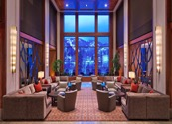

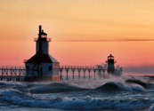
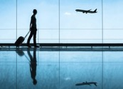
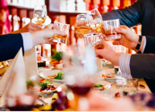
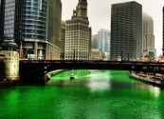
BUILD A CONTENT STRATEGY
PROPERTY SHOWCASE
Views
Rooms
Seasonal Décor
BRAND CAMPAIGNS
Meetings/Weddings
Wellness
DESTINATION
Local hotspots
Property Location
Nearby attractions
FOOD & BEVERAGE
New Menu Items
Specials/Unique Local Specialties
Events/Tastings/ Classes
HOLIDAYS & TRENDS
Local festivals
Nearby events
Trending and relevant news
OFFERS & PROMOTIONS
Packages
Seasonal offers
Room rates

Slide 10
REACH YOUR TARGET AUDIENCE WITH PAID SPEND
AS FACEBOOK’S AD REVENUE GROWS EACH YEAR, THEY ALSO GROW THEIR CAPABILITIES.
Best practices to get the most out of paid spend:
300+
Targeting Categories
3 Platforms
40+
Ad Types
Always support organic content
Spend $5 minimum per day per campaign
Plan budgets annually, but select campaigns based on need periods
12
Placements

Slide 11
ENGAGING GUESTS THROUGH SOCIAL MEDIA MONITORING

Slide 12
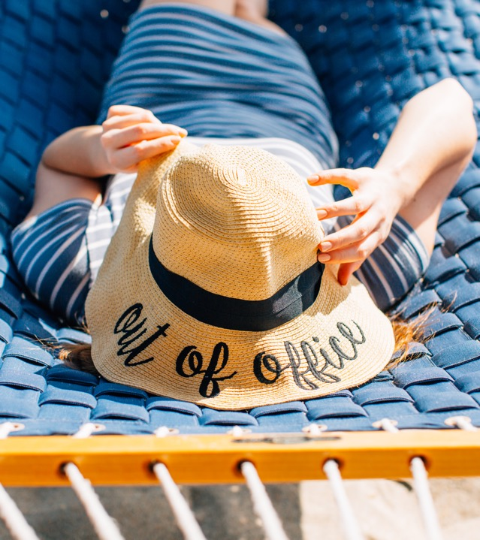
COMMUNITY
MANAGEMENT
KEY COMPONENT OF ANY SOCIAL STRATEGY
65%
Of social media users expect a brand to respond with 2 hours
Of social media users expect a brand to respond within one hour if they are complaining
72%
Notes:
At BCV we position our response protocol upon internal and external data, based on known consumer behaviors.
The fact that the majority of consumers expect a response in 2 hours means that is where we have set our benchmark.

Slide 13
DIFFERENT MESSAGE TYPES
BCV RECOMMENDS MONITORING THE SOCIAL SPACE 24/7
PLATFORM
KEY AREAS TO MONITOR
Comments on posted content
Wall posts
Private messages
Facebook reviews
30%
84%
Comments on posted content
Posts using property hashtag
Geo-tagged content
Of users say that they would switch to a competitor if a brand ignores them on social media
Of users mentioning a brand expect a reply within one hour
Replies to content
@mentions
Keyword search for hotel name
Direct Messages

Slide 14
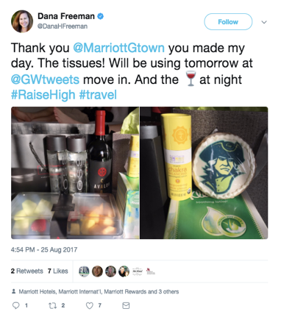
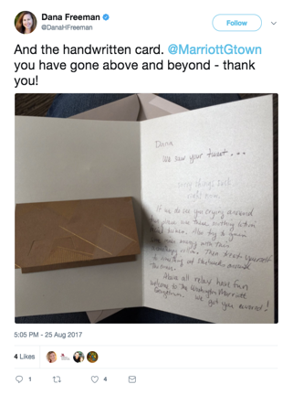

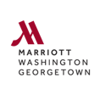

INFLUENCER ON PROPERTY
DC friends - if you see me around town this weekend crying like a baby, it’s because I am dropping my oldest off at @GWTweets @MarriottGtown
Wishing the best of luck to your oldest at college, Dana! When will you be arriving?
I will see you tomorrow - we are staying with you this weekend (and again in October)

Slide 15
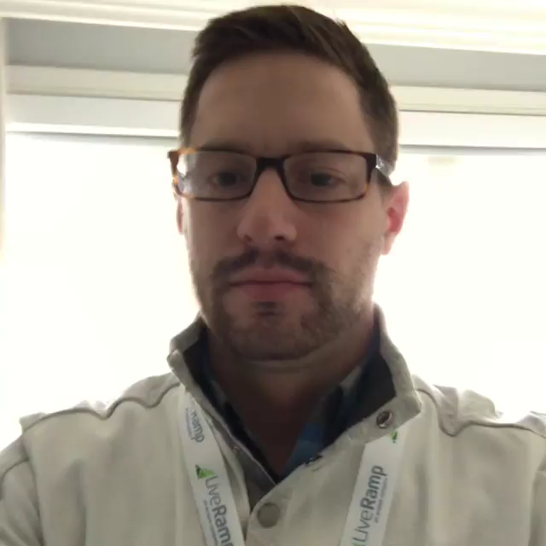
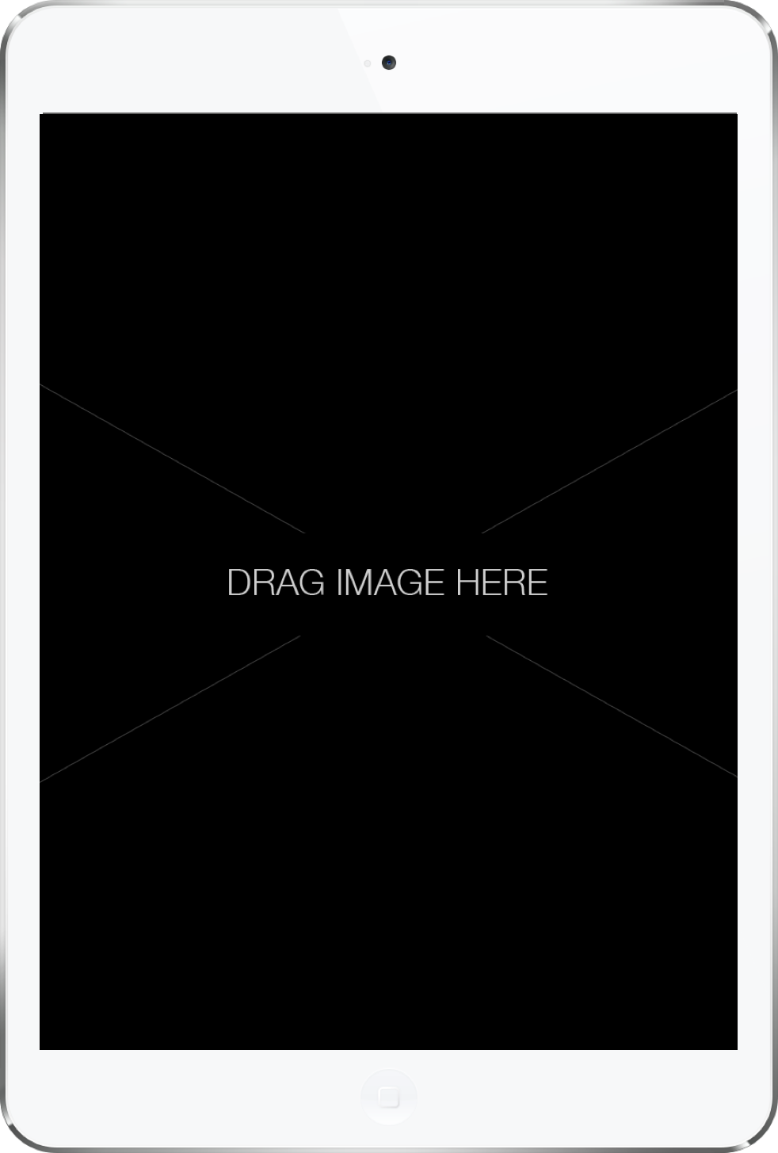
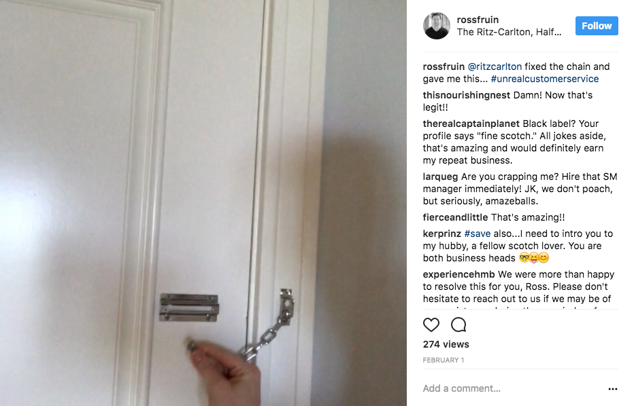
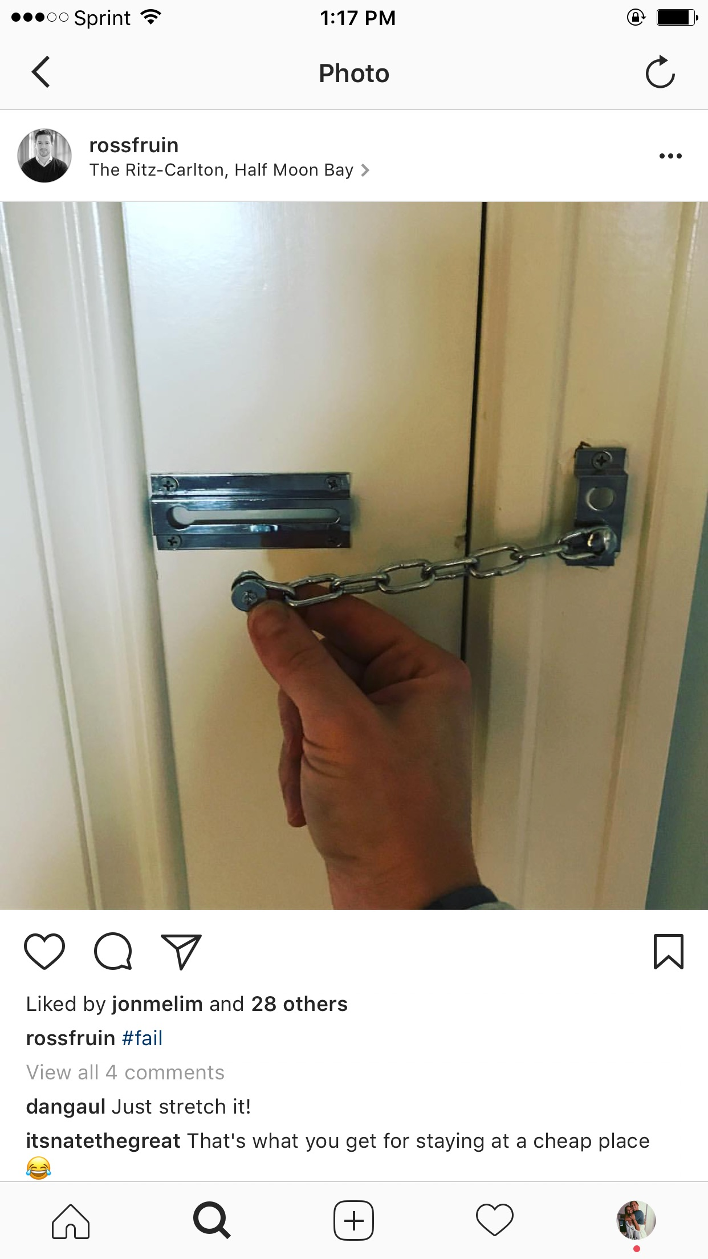
REPUTATION PROTECTION

Slide 16
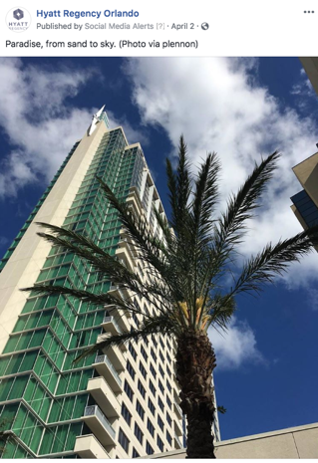


NEGATIVE SITUATION MITIGATION
HYATT REGENCY ORLANDO
CONVERSATION CONTEXT
Interaction Type: Negative Mitigation
Najoua initially commented on the property’s Facebook post that she was currently there, but the hotel was not what it used to be.
On behalf of the property, BCV replied to Najoua, asking for her to send a private message with more details.
BCV sent a “Negative Message Alert” to the property, who in turn reached out to Najoua.

Slide 17
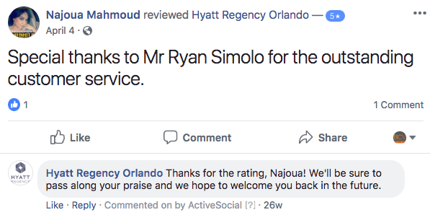
NEGATIVE SITUATION MITIGATION RESULTS
HYATT REGENCY ORLANDO
Najoua proceeded to praise the property’s customer service, noting “Thank you for getting back to me, the housekeeping manager called me in my room and asked to see me, will talk to her once back to the hotel. I appreciate that! Thanks a lot ”
Najoua then deleted her initial negative comment on the property’s Facebook post and posted a 5 star review

Slide 18
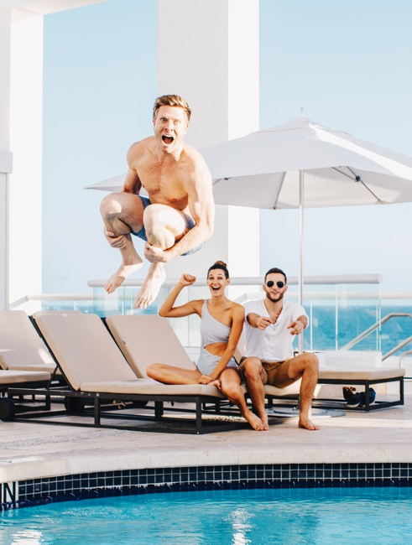
MONITORING:
KEY TAKEAWAYS
Respond to majority of messages in a timely manner (within one to two hours is recommended)
Match the level of effort
Implement a process to serve both negative and positive interactions
Escalate and involve where appropriate

Slide 19
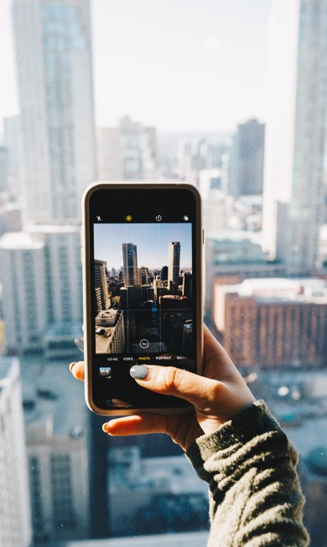
IN SUMMARY
SOCIAL MEDIA IS A PROMINENT PIECE OF GUEST EXPERIENCE
STRATEGY:
  Identify key objectives and content priorities for reaching your guests and stick to them
  Social media advertising is essential in order to engage the right guests for your property
  Leverage social targeting opportunities to drive the most opportunity; including use of Facebook Pixel
CONTENT:
  Plan content in advance
  Diversify the types of content you share with your community
MONITORING:
  Implement a process to serve both negative and positive interactions
  Respond in a timely manner (within two hours)
  Ensure interactions are authentic and meaningful

Slide 20
QUESTIONS?
LET BCV transform your SOCIAL MEDIA guest EXPERIENCE from great to legendary
EMAIL:
mblanco@bcvsocial.com
PHONE:
(786) 454-5992
LEARN MORE:
www.bcvsocial.com

