Slide 1



Caribbean Hotel & Tourism Association jnugent-hill@tropical.com
Tips for a Business Continuity Plan

Slide 2


Emergency Management & Business Continuity Planning ??

Slide 3
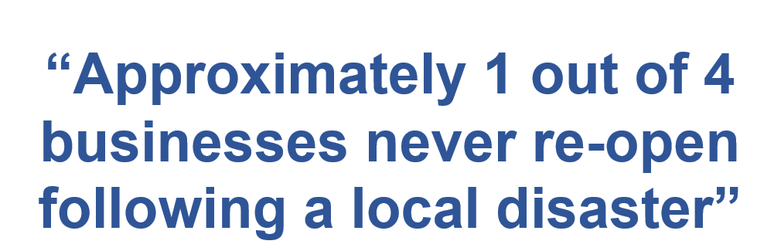
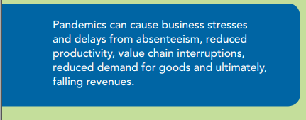
Disasters – Hurricanes & Pandemics

Slide 4
… the Perfect Storm- How to Control the Outcome…
What is a Business Continuity Plan (BCP)
What’s disaster management?
What’s resiliency by your industry standard ?
Do you know who is in charge?

Slide 5
1st Things First
Conduct Risk Assessment (RA)
Conduct Business Impact Analysis (BIA) to the risks identified
Develop the BCP with the business processes in mind most vulnerable – be IT, Human Resources, Supply chain, business location, etc.
Test the plan and fill the gaps from the exercise

Slide 6
Characteristics of a Basic BCP
Workable – ask your fist line staff for input
Cost effective – in relation to being caught unprepared and long down time
Easy to maintain – keep it simple & flexible
Sample Plans – check your local Disaster Management Agency or CHTA & CDEMA’s websites, CDC sites
-
Business Continuity Planning Process Diagram - Text Version
Credit- FEMA.gov

Slide 7
A few things to consider…
Breakdown in communication is often very difficult barriers to overcome- rumors & bad info spread quickly – so public-private partnerships a must
In pandemic cases - be in the know ! Get informed - stay close to public partners – build up trust
Handling conflicts and avoiding unnecessary confrontations – Be transparent – Share the Facts
Strength by industry associations CHTA is encouraged

Slide 8
…the Perfect Storm…
Define the moment – it’s what you do next that counts
Know your critical business processes – Must do a risk analysis – it’s the first thing
Establish your crisis management procedures and train the individuals responsible in advance – plan for the worst- case scenarios
The media can be your best friend or your worst enemy - tips on communication strategy
Have a media strategy – you control the talking points
Social media isn't just a text message or Facebook alone- all messages are equal opportunity for social media to get access to- and remember it lives on in the cyber world

Slide 9
Crisis Communication tips
HOW we communicate - type of medium used i.e., print media versus social media
Identify WHO must be a part of the communication team – and train them !
Know WHAT needs to be said about the crisis/event and stick to it (create talking points) and change it only when the situation warrants it
Know WHEN to communicate with stakeholders including the general public

Slide 10
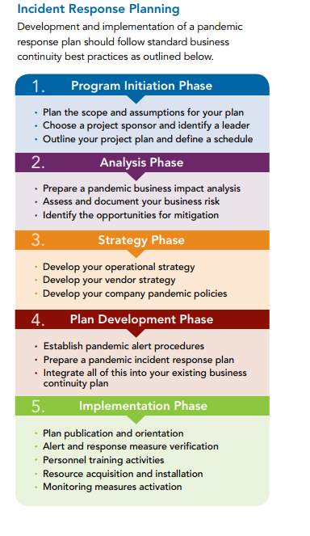
Recommendations for Response Planning
“Preparing a BCP for a pandemic cannot be done in isolation- you must factor in the whole community – pandemic spreads!”
Content Credit-2019White Paper by MIR3,Inc. “Pandemic Business Continuity”…

Slide 11
Summary…
Prepare and prepare ! !
Exercise your BCP with staff/suppliers
Build culture of preparedness – for when seconds count
Take Care Of Your Staff and They Will Take Care Of Your Business
Hurricanes, Pandemics, Cyber hackers, earthquakes, volcanoes and even the Media collides causing a Perfect Storm ! Be ready.

Slide 12

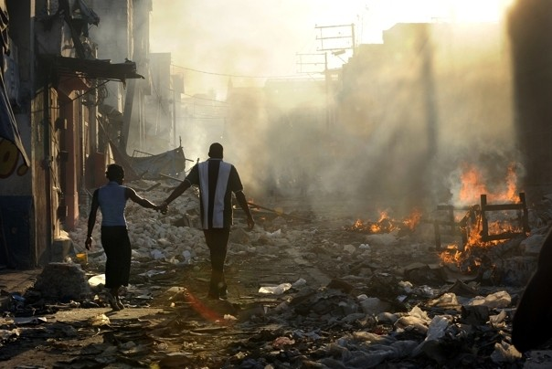
The Cost Is Too High To NOT Have A BCP!!!
HAITI - EARTHQUAKE 2010

