Slide 1
CARIBBEAN HOTEL & TOURISM ASSOCITION
NAVIGATING INSURANCE AHEAD OF THE NEW HURRICANE SEASON
STORM PREP - A SHORT CHECK LIST
^{SMITH ORLOFF & ASSOCIATES}
Loss Consultants to the Caribbean

Slide 2

International Insurance Loss Consultants
Tel: 340.690.4880 / Email: smith@smithorloff.com

Slide 3


SPEAKERs
STANLEY SMITH, CPA
Principal
Smith Orloff & Associates

Slide 4
STORM PREP – GENERAL COMMENTS
Know Your Property
Inspect and verifying your property’s condition before hurricane season arrives and fix or replace building areas that can allow significant damages, such as roofing conditions and especially window deficiencies and the like, which can allow wind driven rain damages, a typical exclusion. With prior loss experience plan on protecting your property and if possible store plywood for board ups and sand bags for flooding.
Help Your People
If your business is affected by a storm, it’s almost certain that your employees and their families will be too. Before a storm, help employees prepare, including plans on getting them to safety. During and after a storm, stay connected with them and be ready to support with humanitarian assistance, including guidance on how they can manage their own insurance claims.

Slide 5
STORM PREP – GENERAL COMMENTS
Business Continuity Plan & Supply Chain Network
A storm could affect your operations, your suppliers’ operations, and critical infrastructure, including power, telecommunications, roads, airports, and seaports. Know the specific locations of your suppliers — and their suppliers — so you can better ensure business continuity. Also consider alternate suppliers and shipping methods to prevent or limit disruptions to your supply chain.
Understand your Insurance Coverage & claims processes
Every storm can cause its own unique damage and bring with it questions about property policy coverage, but based upon past loss experience identify your high-risk areas and before a storm arrives check your coverages. Make sure you understand key definitions, sub-limits for flooding and other coverage areas and other terms in your policy.
Due to varied terms and conditions in insurance policies, polices should be fully vetted prior to hurricane season addressing sums insured and coverages for known problem areas, and especially those areas open to possible interpretation by insureds, insurers, and legal counsel.
For larger properties establish a framework and protocols with your broker/ insurers for filing a claim after the storm passes.

Slide 6
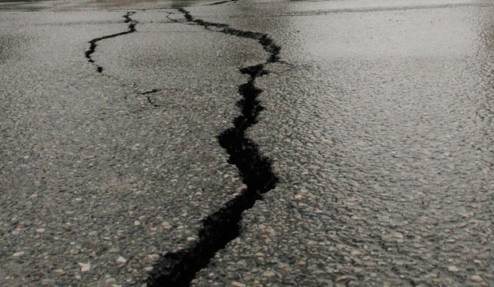
CRITICAL AREAS OF INSURANCE FOR ANY HOTEL

Slide 7
Overview
Understanding and Making Sure That Insurance Coverage
Is Appropriate & Avoid Pitfalls Before The Loss Occurs
To Facilitate A Policy Review - Typical Policy Sections {detailed in subsequent slides}
Covered Property & Business Interruption (including Extra Expense)
Limits of Coverage
Covered Perils
Policy Conditions / Coverages

Slide 8
Understanding and Making Sure
That Insurance Coverage Is Appropriate and Avoiding Pitfalls Before The Loss Occurs
Covered Property
Building
Contents (Equipment, Furniture, Stock/Inventory)
Fixtures & Fittings
Business Interruption and Extra Expense
Limits of Coverage
Covered Perils (the Risks Being Insured)
All Risk vs. Named Peril
Windstorm, Flood, Earthquake, Volcanic Action
Wind Driven Rain (a typical exclusion)
Collapse
Subsidence & Land Slippage

Slide 9
Policy Conditions / Coverages
Replacement Cost vs. Actual Cash Value (and right to depreciate)
Holdbacks / Buyouts
Averaging Clause / Coinsurance (underinsured)
Agreed Value Endorsement
Automatic Reinstatement
Public Authority / Ordinance / Code Upgrade
Loss of Off-Premises Power & Water
Professional Fees - Architects & Engineers in Reconstruction
Foundations, Walkways, Roads & Landscaping
Consequential Business Interruption
Extended Business Interruption Coverage
Deductibles For Windstorm, Flood, Earthquake, Volcanic Action (separate sums insured per building)
Debris Removal Limitations
Appraisal vs. Arbitration Clause

Slide 10
Business Interruption Loss & Extra Expense
Establishing the Limit of Insurance
  Net Income Plus Continuing Expenses
  Ordinary Payroll Expense Exclusion
  Address Costs to Stay In Business & Mitigate- Extra Expense
    Have a Plan
Preparing and Presenting the Claim
Restoration Period

Slide 11
Policy Cost Containment Considerations
Use of higher percentage deductibles
Address what the risks of damage are to different property
Evaluate damages from prior storms to see what might not need to be insured for windstorm or other catastrophic losses
At same time address updated replacement costs to see if any property segment is over-insured or in the alternative under-insured to avoid being penalized

Slide 12
QUESTION & ANSWER

