Slide 1
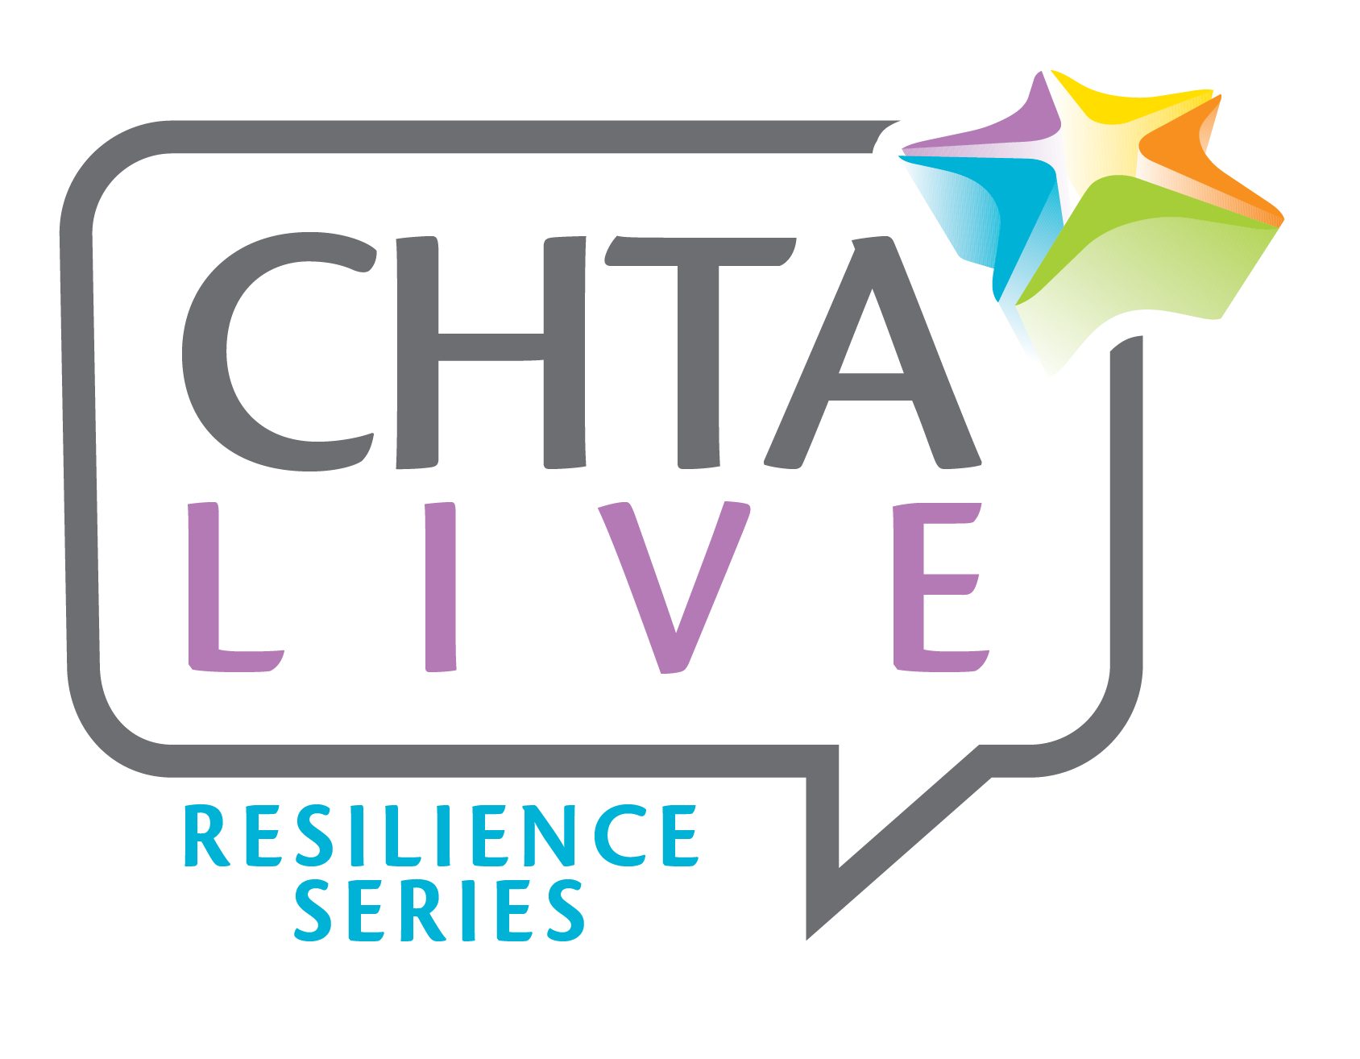

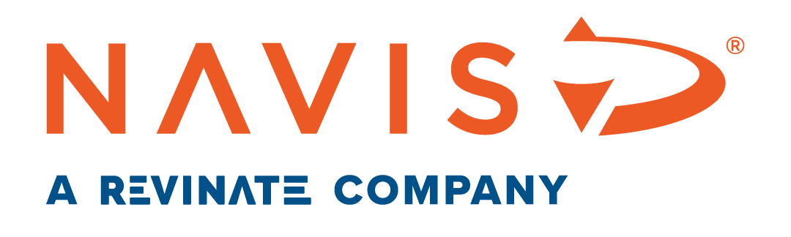
Direct Booking Strategies
That Increase Revenue
Moderator: Sanovnik Destang, Executive Director, Bay Gardens Resorts
Panelists:
Michael Stark, Senior Enterprise Sales Consultant, NAVIS a Revinate Company
Oliver Janke, Account Director, US South East & Caribbean, Preferred Hotels & Resorts
Marc Liu, Head of Strategy, ELMNTL
Gitti Hernández, E-Commerce Manager, Casa De Campo

Slide 2
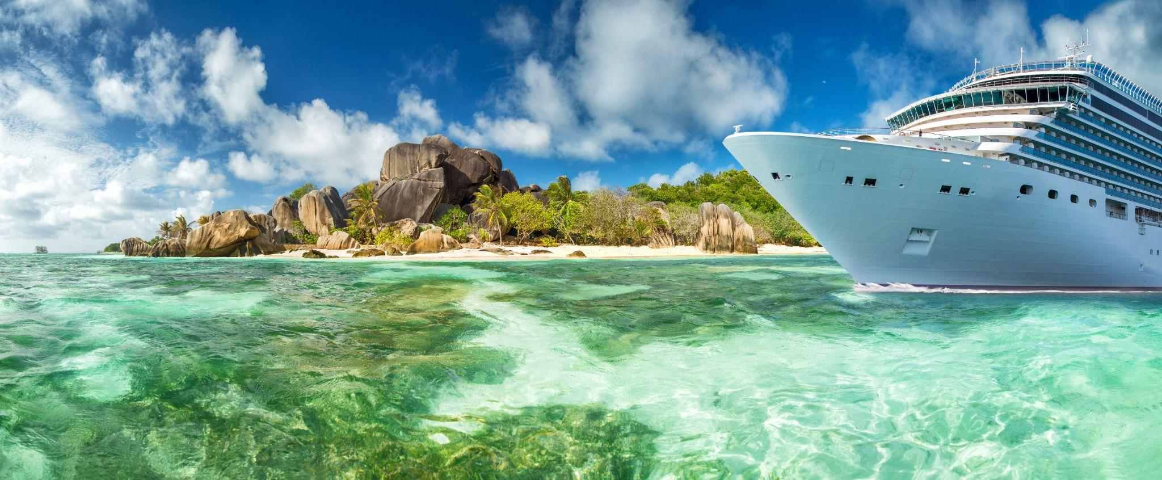

Effective management with tour operators
Notes:
OLIVER
5-7 minutes
Long established history in the Caribbean
One needs to look at the distribution landscape more as a portfolio, how do you optimize revenue production across the portfolio to maximize RevPar – you never want all eggs in one basket, much like an investment portfolio – Example Hotel in Bermuda / UK Business / Iceland Volcano’s
Direct Booking conversation is based on Lowest Cost of acquisition
TO’s will tend to not only have a lower cost of acquisition as it relates to the transaction but also higher stay value and different TO’s offer business from different geographic regions in which they specialize. Let’s illustrate the Transaction cost … TO V Expedia
Now, Talking understanding of Constrained V Unconstrained Demand – In the Traditional Contracted Net Fixed Rate approach it is extremely Important to understand your Constrained Demand as you are working with a Fixed Net Rate. Typically the closer you get to the arrival date the more your rates increase, so how much do you want to take at that Net Rate to optimize your RevPar? Here the TO’s have struggled as Revenue Directors will start to yield the business or send total close outs while HELLO, Expedia is still selling to LRA.
The solution to overcome this is working with Dynamic Connected Rates to your CRS – TO Rates float with your prevailing BAR + Reduces the Opportunity of rogue sites exploiting you which is often blamed on TO’s.
Oliver – you mentioned it, this issue of rogue sites undermining your rate parity? We see this all the time and it’s a real problem.. Any suggestions to mitigate this?
Reselling has always been the model of TO’s, the Bed Banks, nothing has changed there…
Real change occurred when Marriott struck a deal with Expedia to move everything onto the Exp Aff Net – EAN
Have no doubt your Expedia Rates are running down the very same distribution pipes to 1000’s of re-sellers – offer your deal on Expedia and off it goes to the network
Best a hotel can do is be very careful what you offer Expedia and work with TO’s in a dual model of Contracted Net Fixed Rate [ the traditional model ] and Dynamically Connected Rates – Explain challenge with Traditional

Slide 3
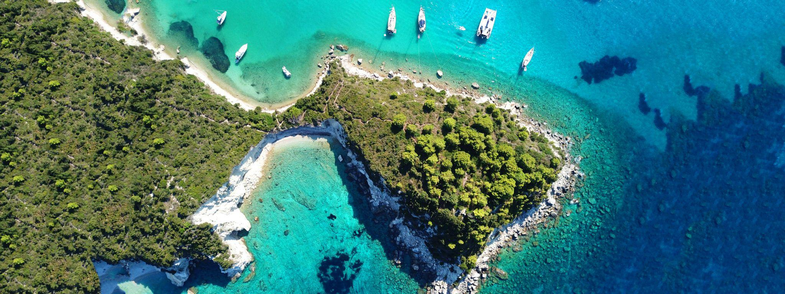
Understanding your true competition
Notes:
Oliver
5-7 minutes
it’s not local other properties; its island based. Seeing how to compete effectively knowing this is the case
I would say it goes even beyond “Island Based” but rather “Region”, for example a Resort In Anguilla should likely play close attention to what is happening in St Barth and St John during US peak Travel season, while also monitoring like comp hotels in Antigua and Barbados for European trend.

Slide 4
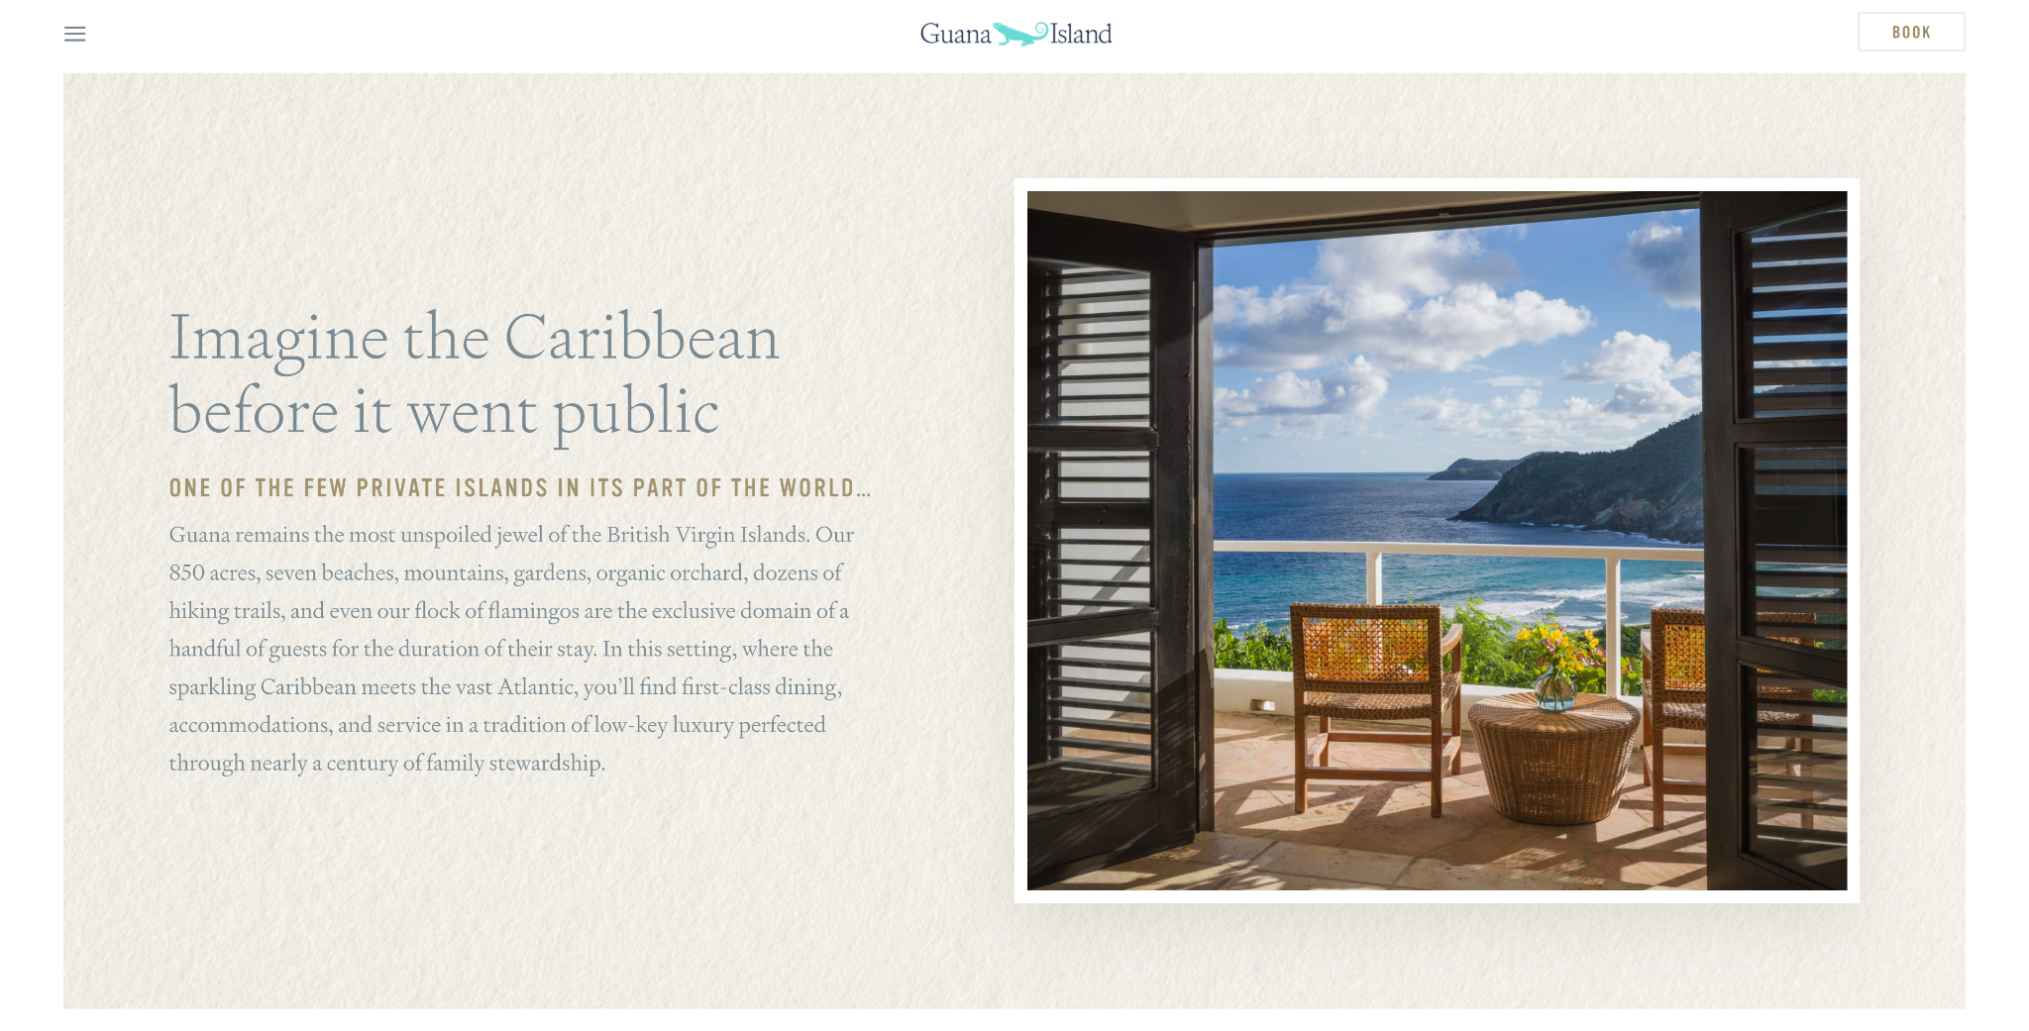
Storytelling and brand strategies
LEAN INTO YOUR BRAND
Notes:
MARC
5-7 minutes

Slide 5
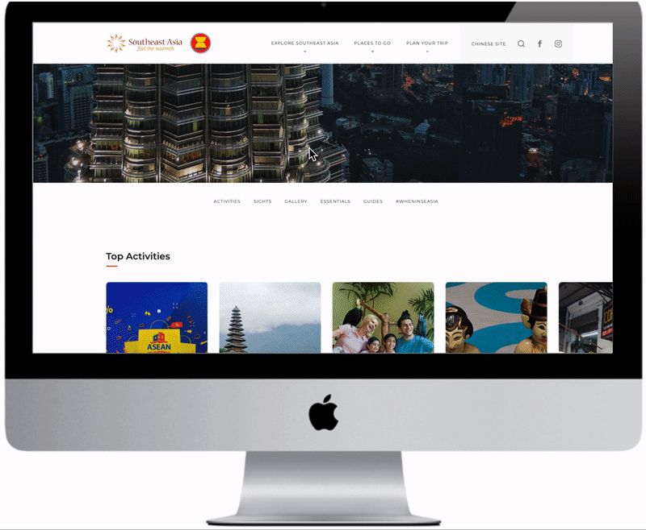
Storytelling and brand strategies
CREATE FRESH CONTENT FOR YOUR PORTION OF THE CUSTOMER JOURNEY - DESTINATIONS / DREAMING
Notes:
MARC
5-7 minutes

Slide 6
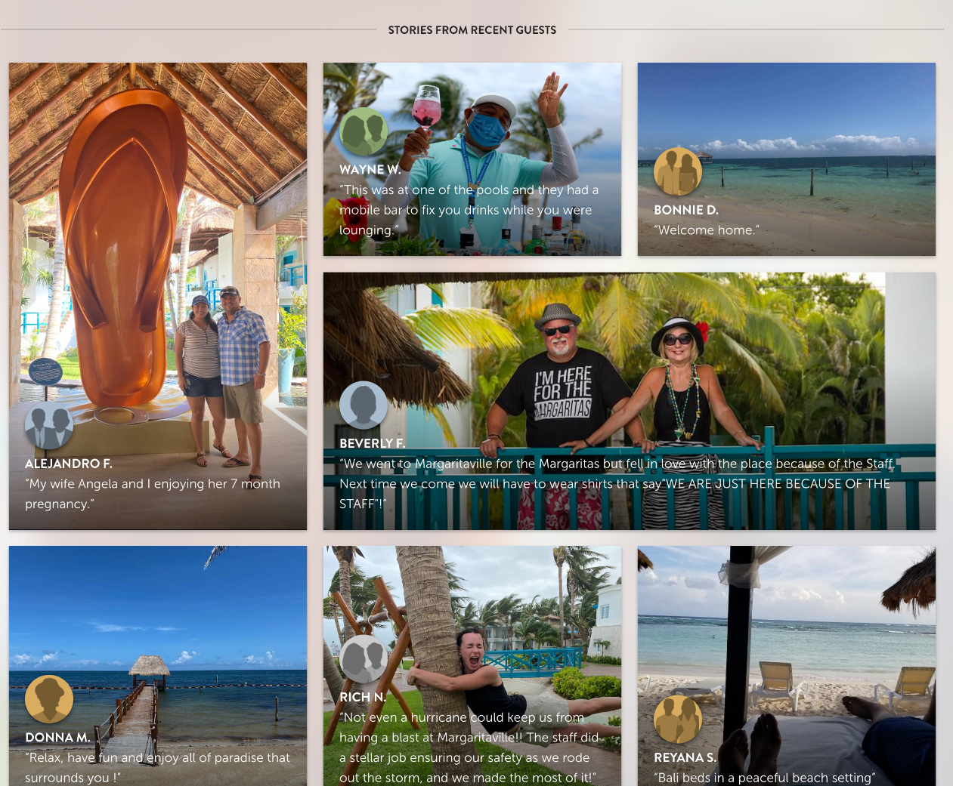
Storytelling and brand strategies
CREATE FRESH CONTENT FOR YOUR PORTION OF THE CUSTOMER JOURNEY - HOTELS / ADVOCACY
Notes:
MARC
5-7 minutes

Slide 7
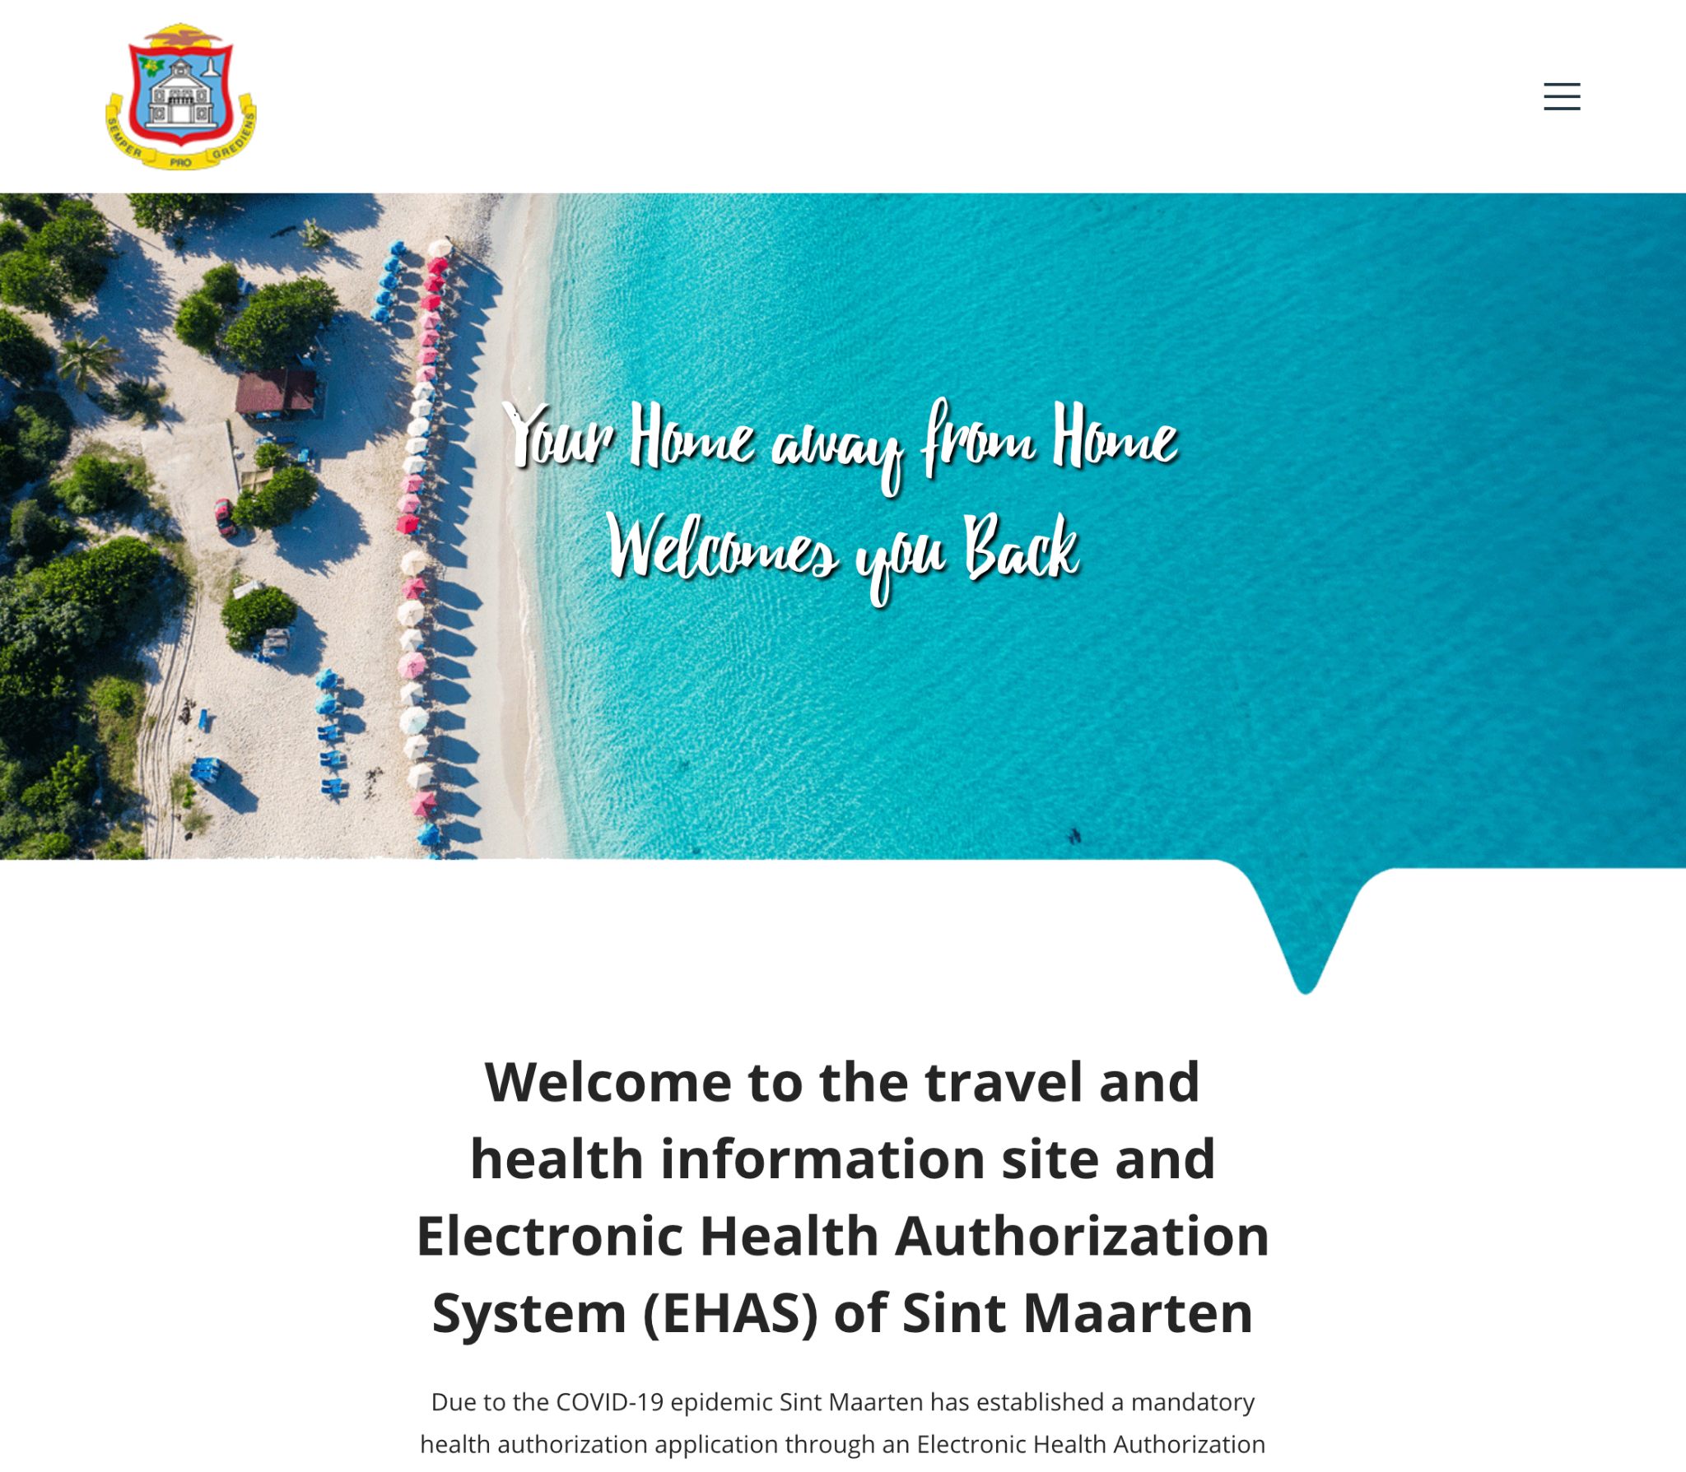
Storytelling and brand strategies
TRANSPARENCY RE: COVID MEASURES AND CONDITIONS
Notes:
MARC
5-7 minutes

Slide 8
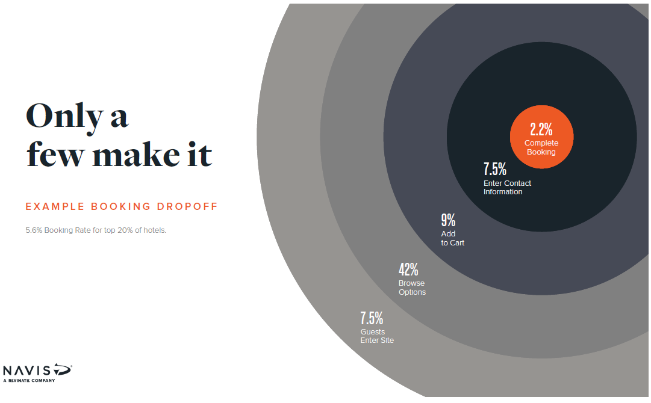
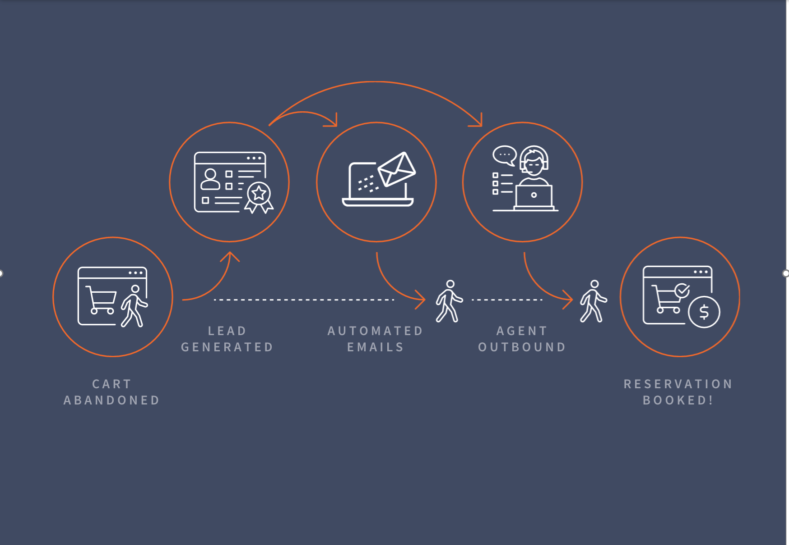
Retargeting on your Web site
Notes:
MICHAEL/MARC
10 minutes
Michael: Using tools like Shopping Cart Abandonment re-targeting “white glove” solutions on your Web site to ensure those lookers book on your site, not the OTA https://naviscrm.com/solutions/shopping-cart-abandonment/ - Without a robust lead capture tool on your booking engine you are missing an important opportunity to capture infomration about potential future guests. This leaves us wasting scarce marketing dollars attracting guests who then bounce 84% of the time. Consider the friction one faces on most hotel booking engines, getting a clear idea of the choice made, and just before clicking the last button - that second thought of, “Have I made the right choice? Should I look around for a better deal, is this REALLY the room I need/want?”
Don’t leave your valuable potential guests to work this out on their own! Capture the information and nurture a relationship with them to ensure both they get exactly the experience they want and you dont miss a booking opportunity. You can leverage this opportunity to generate actionable leads for both email automation retargeting and reservations team concierge follow up.
Spending more money on travel - This year, the global online travel market is expected grow to $818 billion compared to$629 billion in 2017¹
More time thinking about travel - Americans spend 24 full workdays a year daydreaming about vacation²
More time researching travel - The average consumer spends over 4 months researching where to go on vacation³
More travel touch points - Over 700 digital travel touch points over 5 months⁴
Source: 1. https://www.salecycle.com/blog/featured/digital-trends-travel-industry-12-fascinating-stats/
2. https://www.travelandleisure.com/trip-ideas/yoga-wellness/daydreaming-about-vacation
3. https://www.yieldify.com/wp-content/uploads/2019/06/Travel-Report-Infographic-FINAL.pdf
4. https://www.thinkwithgoogle.com/marketing-resources/micro-moments/travel-booking-trends-book-it-moments/
Marc: Best practices for Web site design & optimization, segmentation on funnel stage, interest, etc. to push to bookers

Slide 9
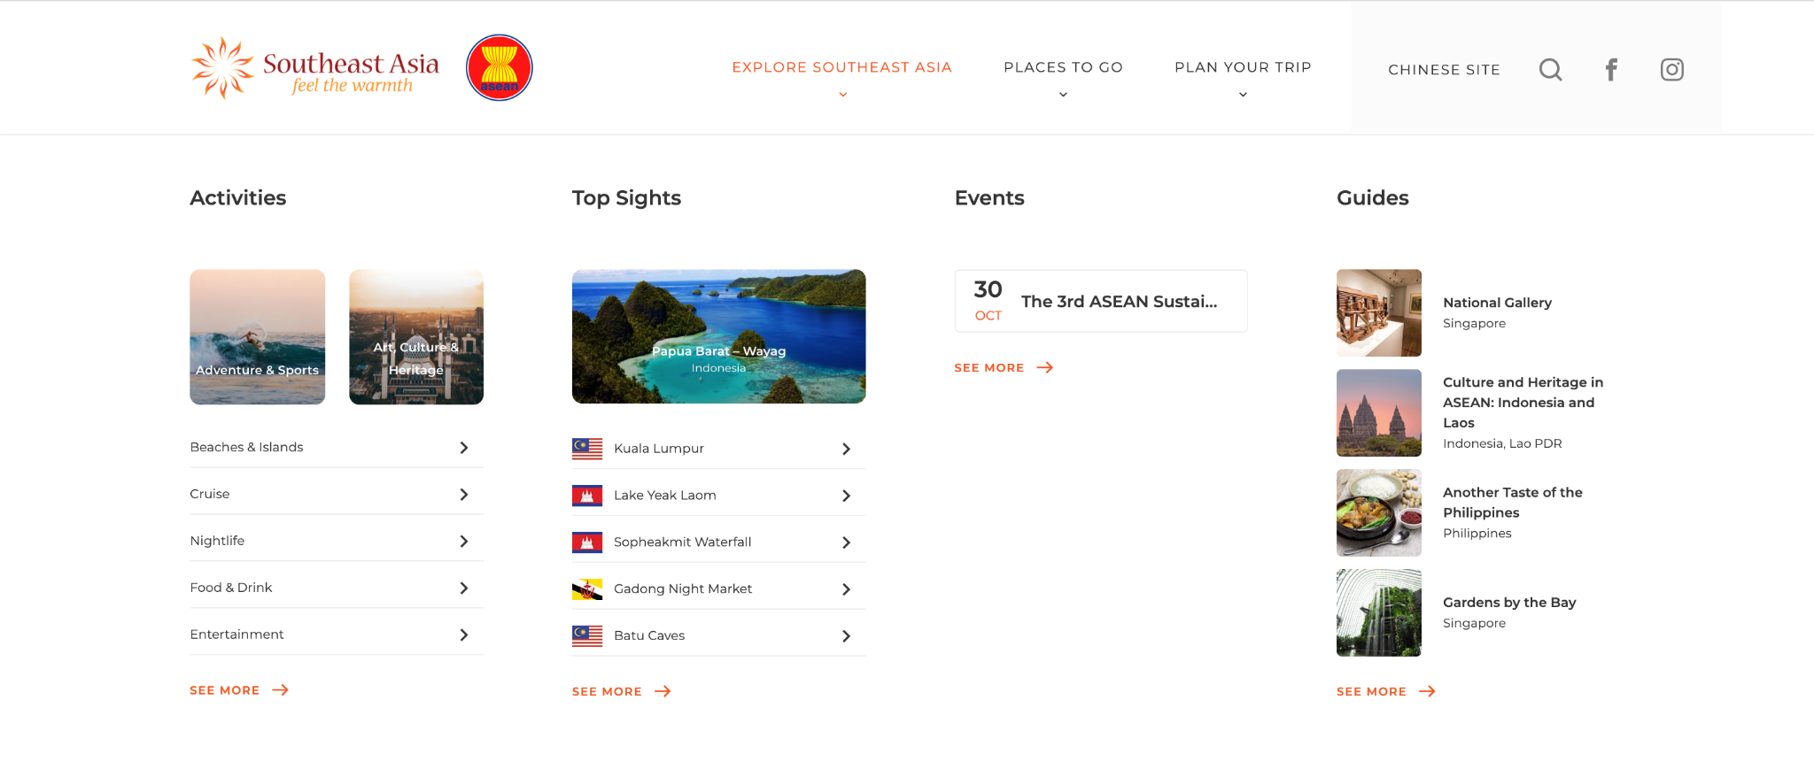
Best Practices For Websites
CREATE CONTENT TO BUILD AND SEGMENT AUDIENCES
Notes:
MICHAEL/MARC
10 minutes
Michael: Using tools like Shopping Cart Abandonment retargeting is a first step, but even more fundamental… I challenge each of you to take a moment and pull up your website on your mobile, tablet or even your computer for a moment. Where is the phone number? Where is the option to chat with a live reservations agent? Is it at the bottom? Hidden in the footer? Book Now - Chat - Call Now should all be prominently displayed at the top or even as a floating option dynamic on the mobile site.
Marc: Best practices for Web site design & optimization, segmentation on funnel stage, interest, etc. to push to bookers

Slide 10

Order takers into revenue generators
Notes:
Michael
5-7 minutes This is a topic we here at NAVIS and myself personally have much passion about. Let’s talk about why with proper training, tools and techniques, your call centers and reservations teams can be your best sellers vs. order takers who simply rely on rates dates and space. Ask yourself how you are tracking the conversion performance of your reservations teams now? Do you have an accurate metric to gauge the true performance of your agents on bookable calls now? In our experience there are several key points in most reservations calls with potential guests where conversion is negatively impacted when missed, 1. Using the Powerful Opening (proper greeting, name, phone number, email), 2. Personalizing the conversation, 3. Making personal recommendations, 4. Customizing the offer to the guests needs/wants, and unfortunately all too often… 5. ASKING for the reservation. Do you use call recordings and trackable coaching sessions with a consistent scoring template to help your agents consistently nail each of these and other points on every call? If not - our data shows your conversion rate is 5-10% lower than it could be AT LEAST.
Additionally, when a call is not converted the first time and the guest hangs up. What data do you have? Can you track how often this happens? Who the guests was? When they inquired to stay, at what rate and why they didn’t book? These are all key insights you need to ensure your team is optimally performing and you are capturing more of your direct booking opportunities and your guests are receiving the highest level of service.
Lasty, incentify the desired behavior. With the proper sales enablement tools you can incentify your agents for specific increase in conversion goals and watch your direct booking revenues soar - WITHOUT having to create any more demand than you already have. It is important to note here - our research shows 48% of in season call demand is for off peak nights and out of season, if you arent tracking true not booking reasons and volume you may not realize this, your shoulder seasons are simply waiting for you to build them up - from demand you already have but are losing now.
https://naviscrm.com/solutions/reservation-sales/

Slide 11
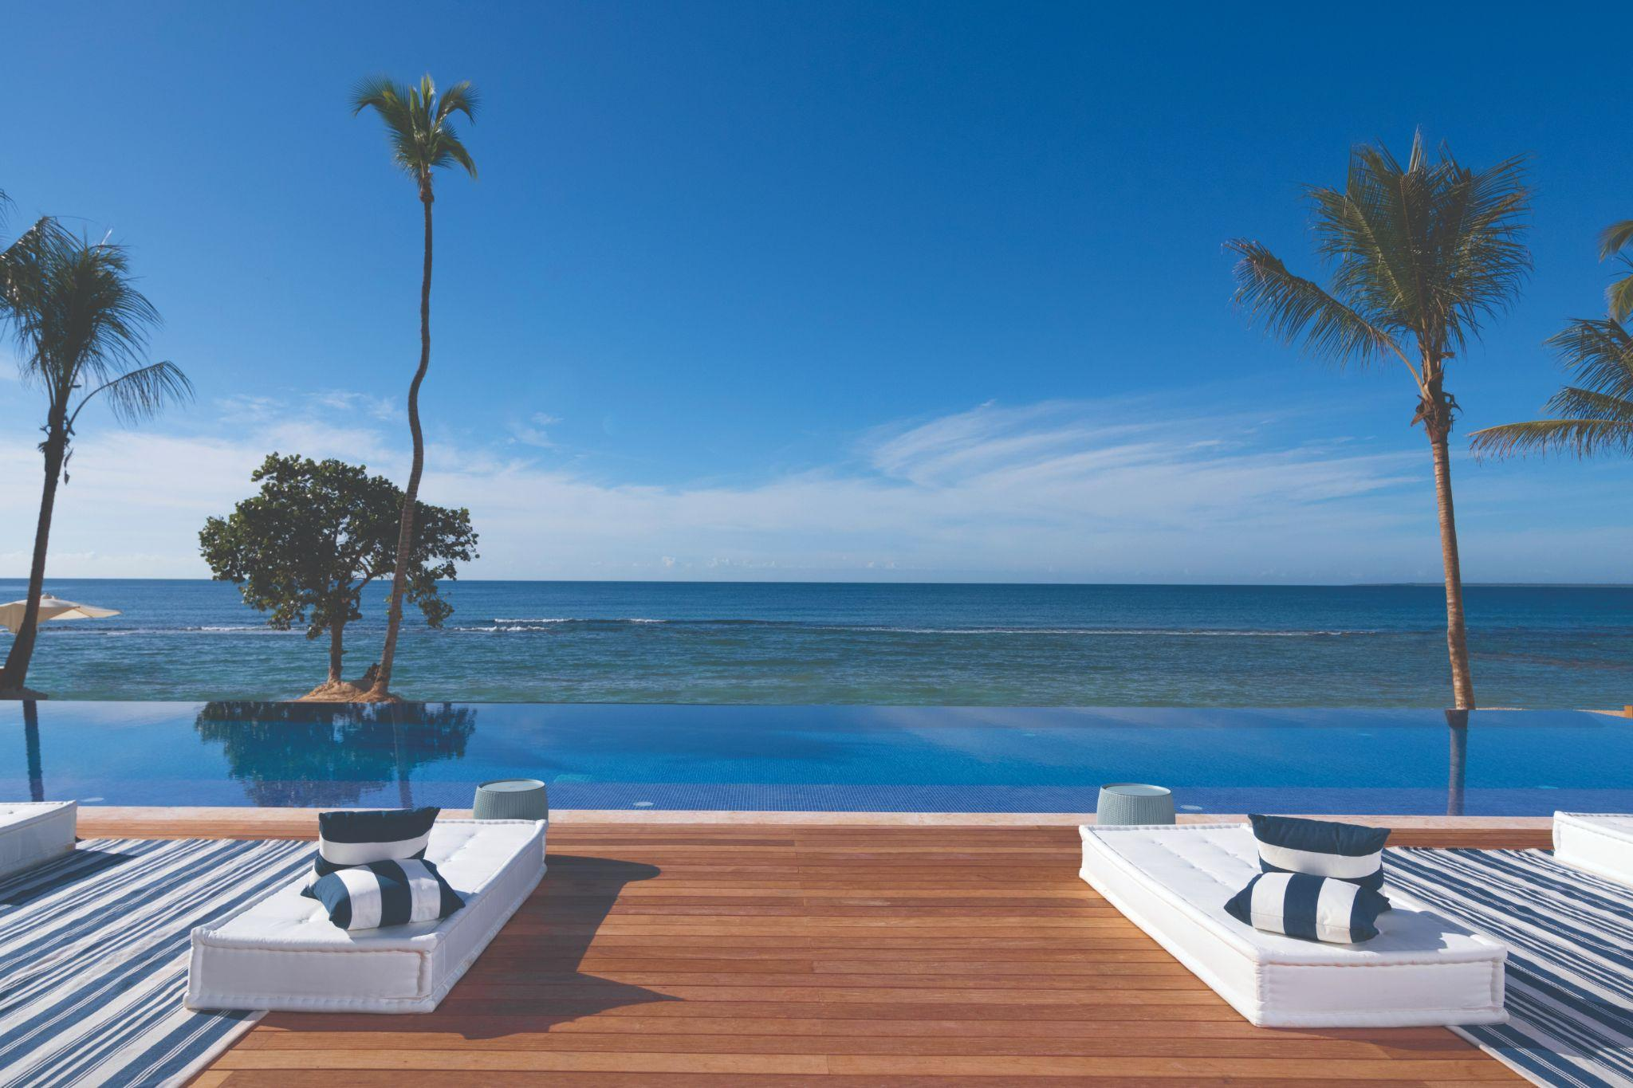

Success story: Casa De Campo
Notes:
MICHAEL/GITTI
5-7 minutes
https://naviscrm.com/case-study/casa-de-campo/
Please replace the image with this one: https://www.dropbox.com/s/730od1yzr6wwn1q/Casa-de-Campo_Minitas_BC-Pool.jpg?dl=0
Tell us about your property Casa De Campo and role at the hotel.
Before partnering with NAVIS, how heavily did you rely on the OTAs for bookings?
What direct booking strategies did you deploy with NAVIS and how did they perform?
How are you personalizing your outbound digital and voice efforts to improve conversion?
What kind of results are you seeing from these efforts?
(72% increase in bookings, to date emails have generated $1,752,344.00 in revenue, $291,525, Recaptured revenue from NAVIS Shopping Cart Abandonment

Slide 12
Q&A
Please submit any questions or comments
to the Q&A button!
Notes:
Some questions from SD (moderator)
· What’s next – how has the pandemic impacted the desire of persons to book direct vs book with a third party
· CPA vs CPC – which is better model for paying for online ads (retargeting, meta, adwords etc) and what’s the pros and cons of each
· How can independent hotels with a small budget who are dependent on tour operators get started with limited budget?
· What is the real cost of getting a direct booking vs a tour operator commission? If this cost is as high as 10-15% in some cases, are there other benefits of focusing on the book direct channel vs just allowing travel agents, OTAs, tour operators to get all the business?
For hotels new to trying to reduce their third party reliance, what are the top 3 things to focus on to increase direct bookings?
The rise of the voice channel during COVID has made us all take a 2nd look, where do you start w/ using this channel as an outbound tool?

