Slide 1
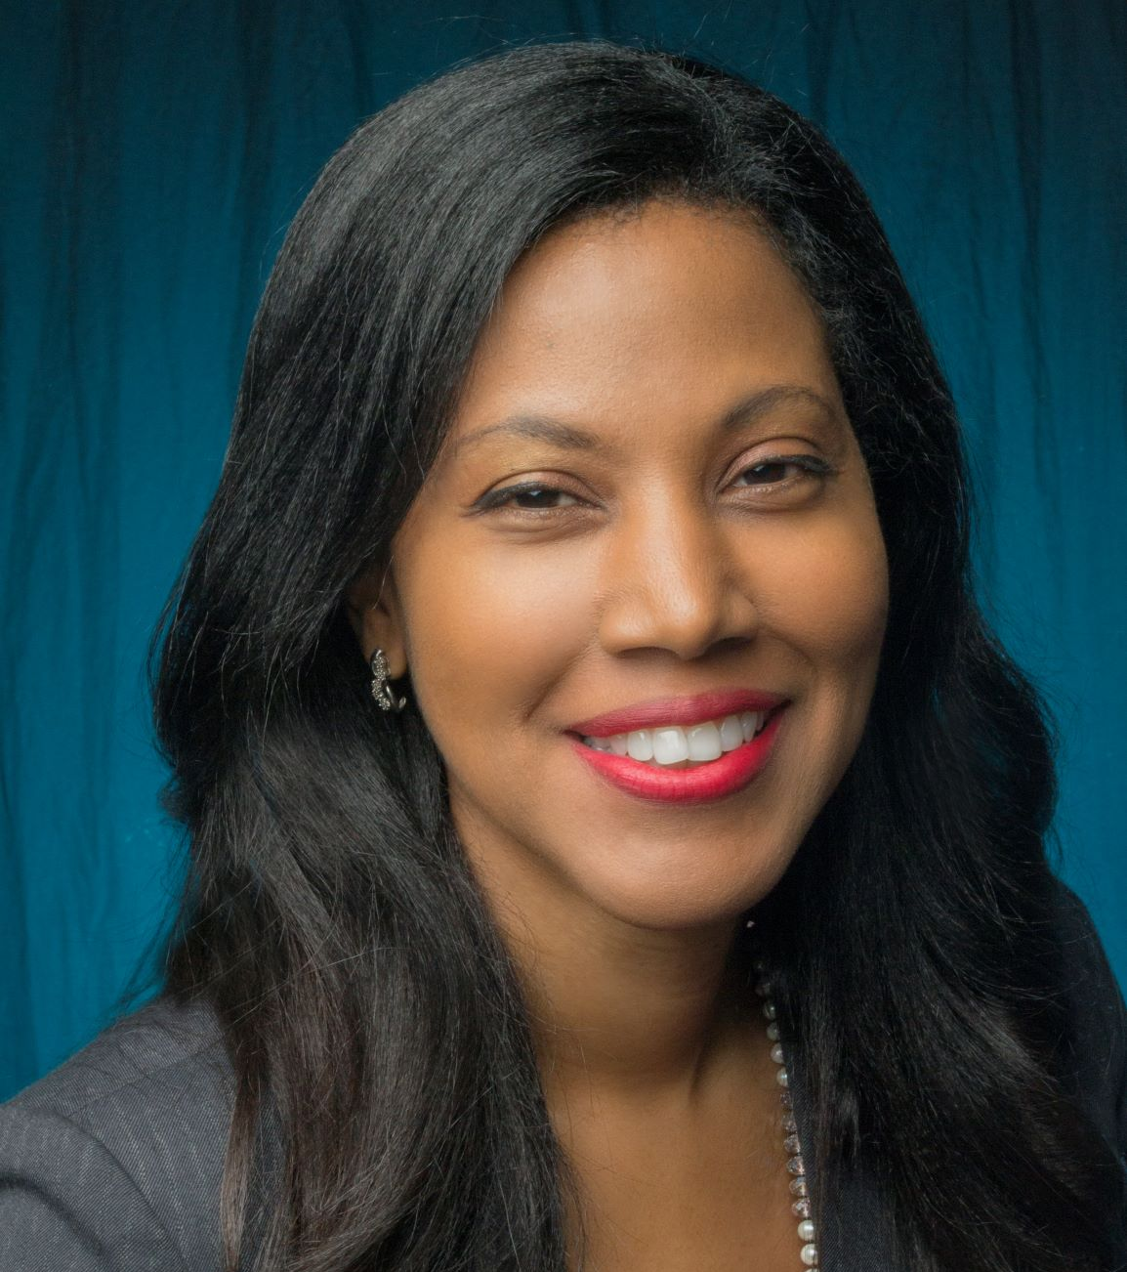
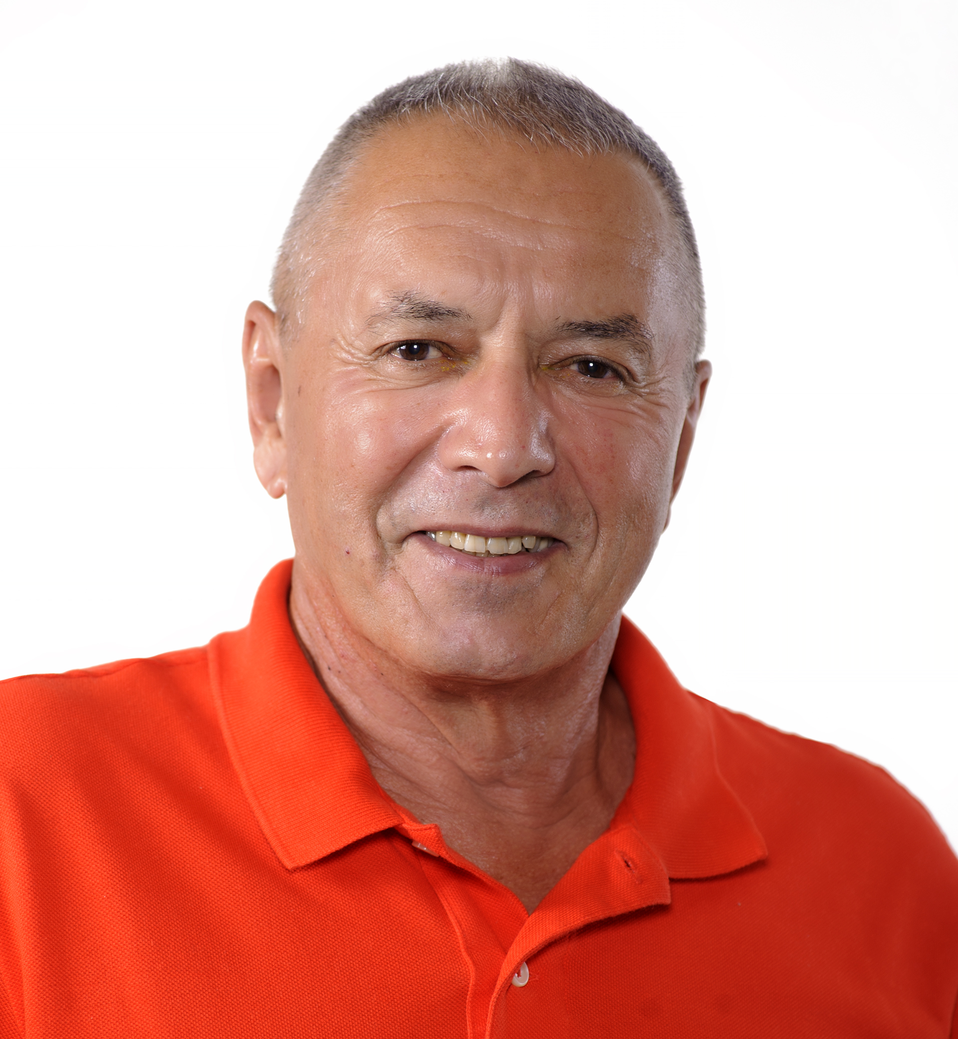
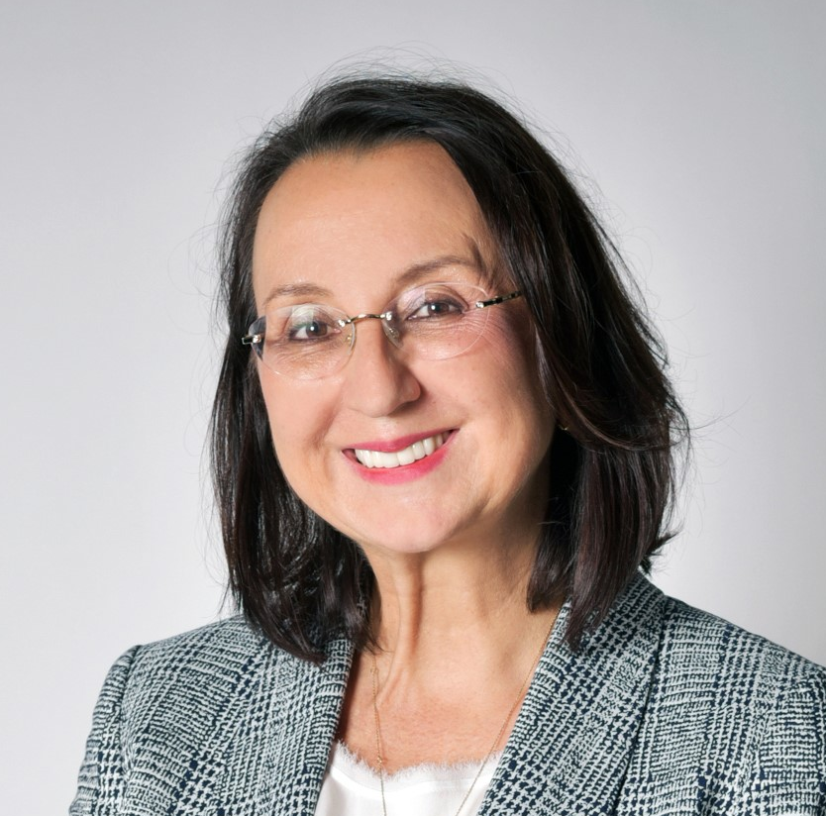
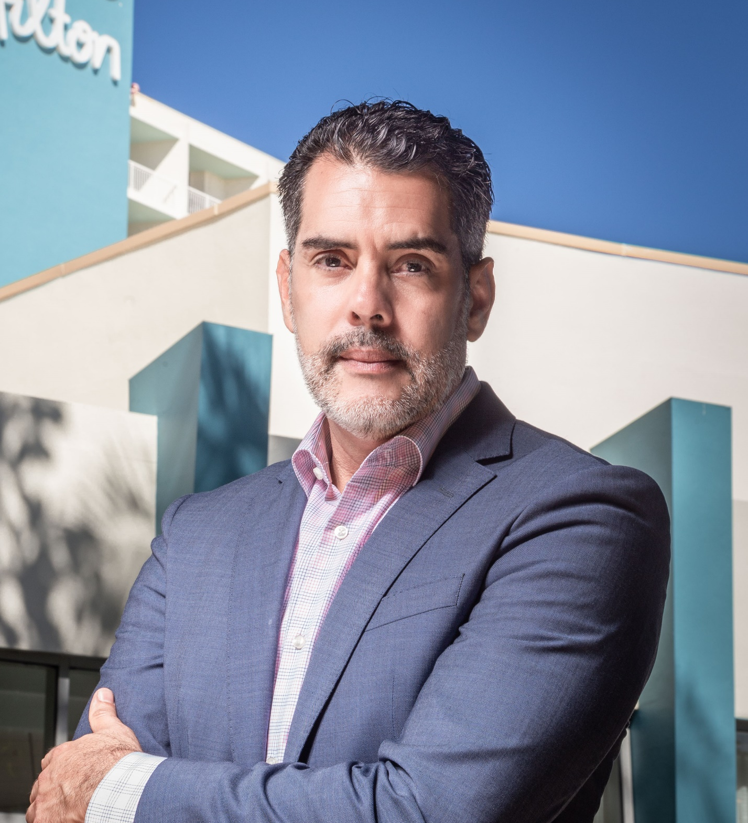
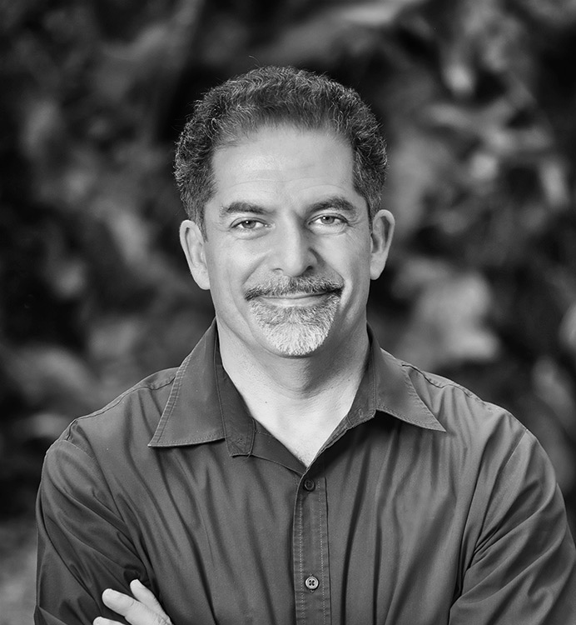
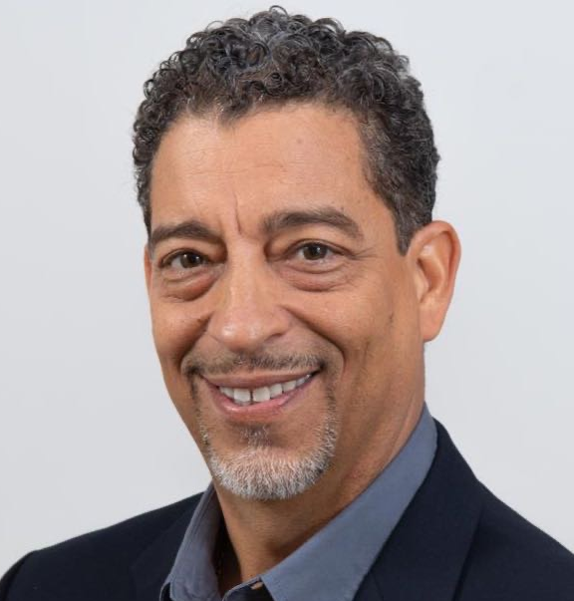
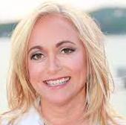
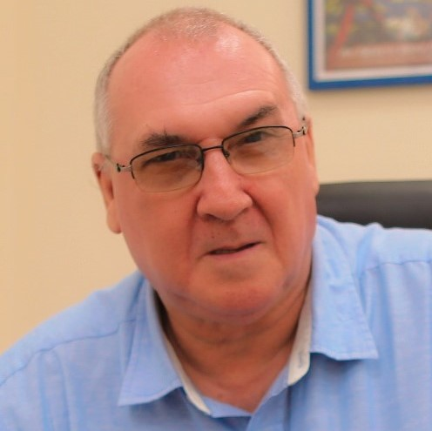
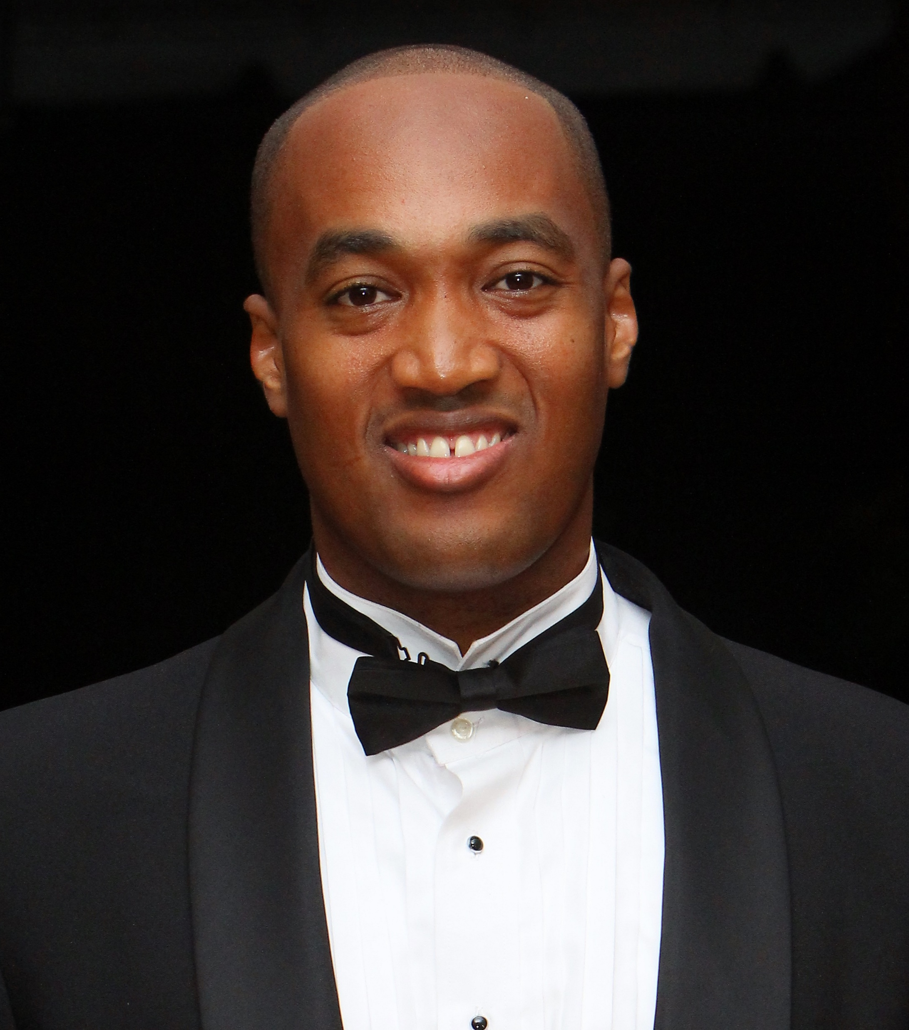
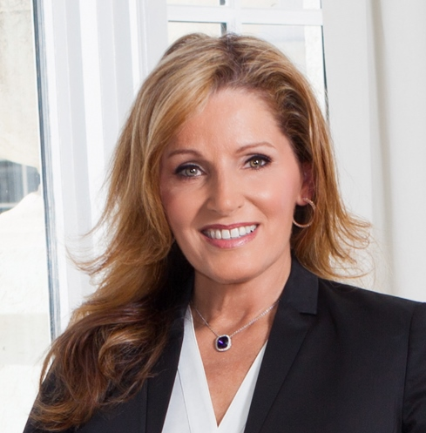
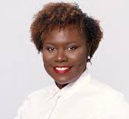

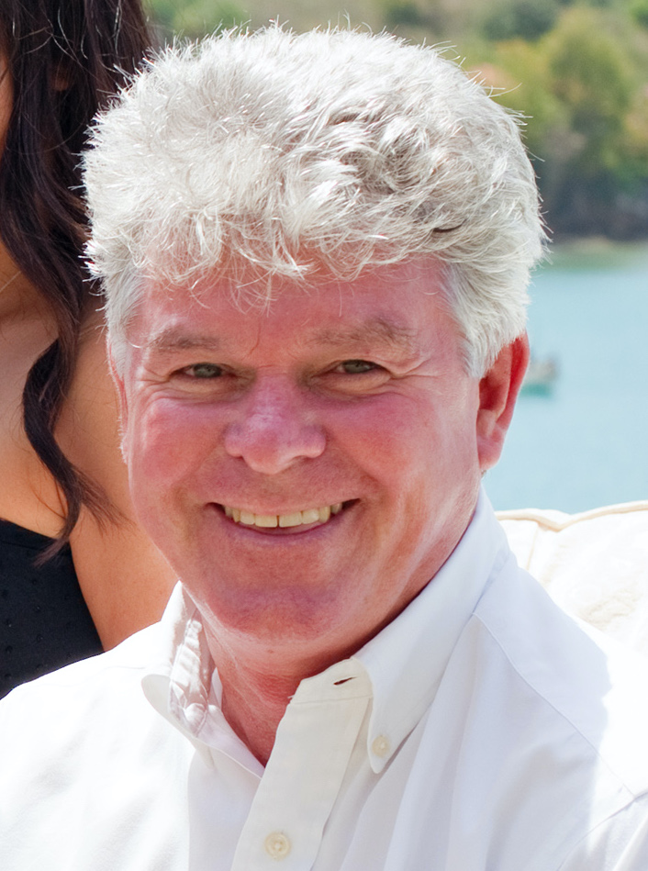
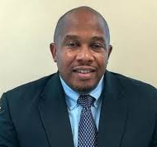
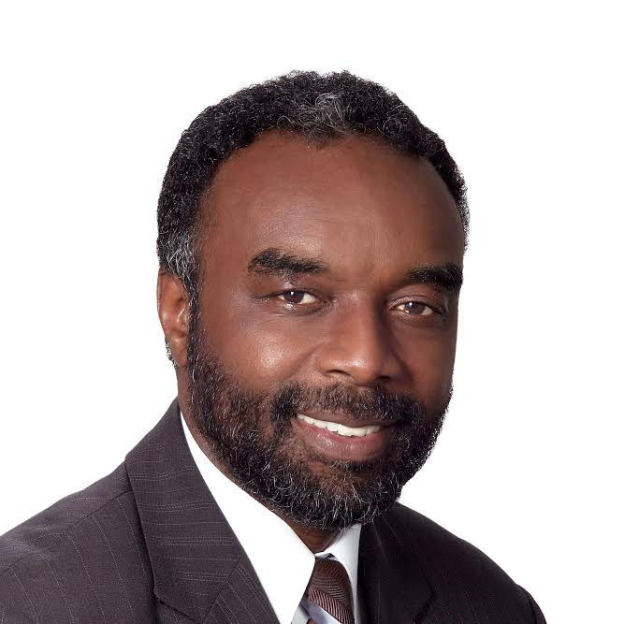
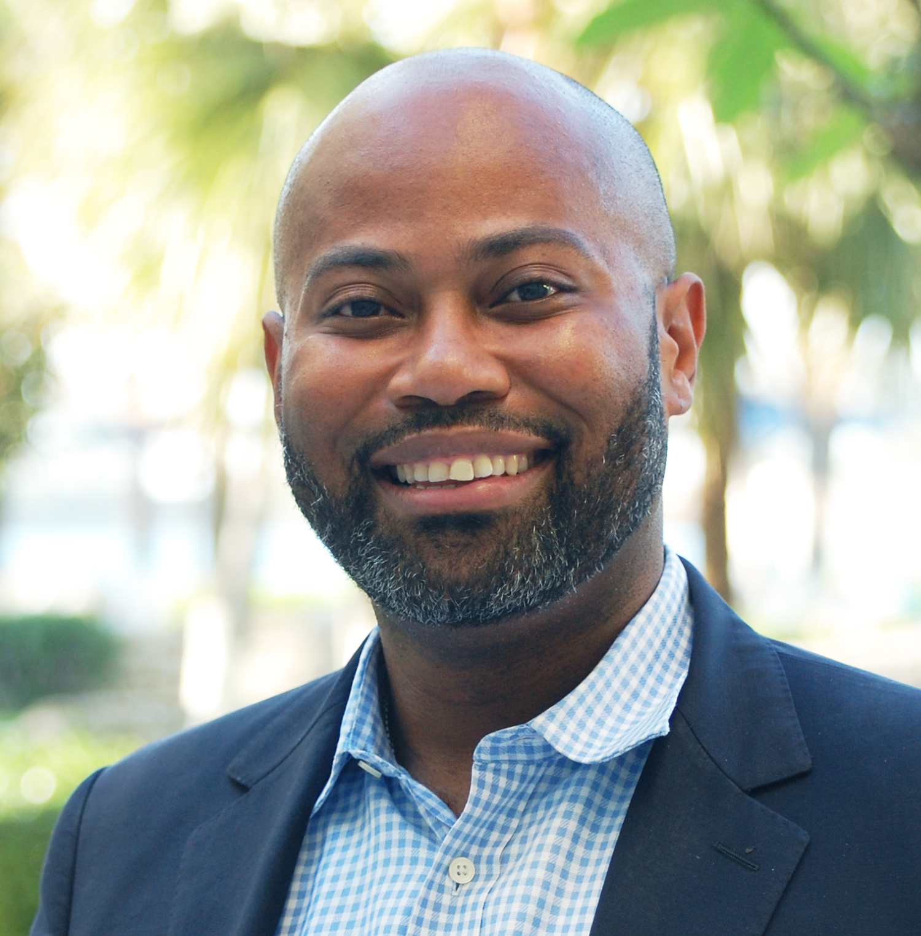
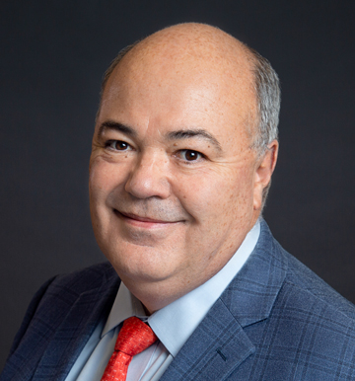
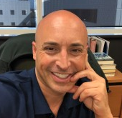
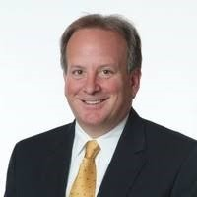
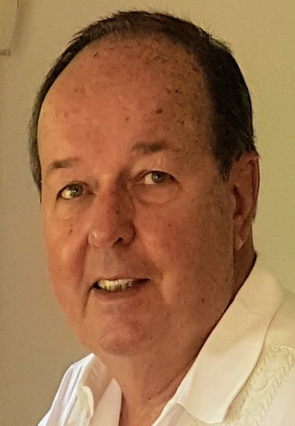
2020 – 2022 CHTA Executive Committee
Nicola Madden-Greig
President
Jamaica
Gregor Nassief
1st Vice President
Dominica
Sanovnik Destang
2nd Vice President & Chair,
Technology Task Force
St. Lucia
Leo Garbutt
3rd Vice President
Grenada
Federico Moreno-Nickerson
4th Vice President
Mexico
Bill Clegg
5th Vice President
Chair, Membership Committee
Ewald Biemans
Regional Vice President
Aruba
Jeremy Jones
Regional Vice President
Sandals Resorts International
Karen Whitt
Regional Vice President
Chair, Caribbean Travel
Marketplace Governing
Committee
Turks & Caicos
Jermaine Wright
Regional Vice President
Bahamas
Affiliate Organizations & Partners
Pablo Torres
Immediate Past President
Puerto Rico
James Hepple
Treasurer
Chairman, Finance Committee
Aruba
Paul Collymore
Chairman, People
Development Committee
St Lucia
Vincent Vanderpool-Wallace
Chair, Advocacy Committee
Bahamas
Richard Williams
Chair, Marketing Committee & Chair, CAST
St. Kitts & Nevis
Karolin Troubetzkoy
Chair, CHTA Education Foundation
St. Lucia
Lisa Hamilton
President, CSHAE
USVI
Patrice Simon
Vice President, CSHAE
Antigua & Barbuda
Neil Walters
Acting CEO & Secretary
General
CTO
Neil Kolton
Director for Strategic Partners
Interval International

