Slide 1


Slide 2

CHTA Rebrand

Slide 3

VIDEO

Slide 4
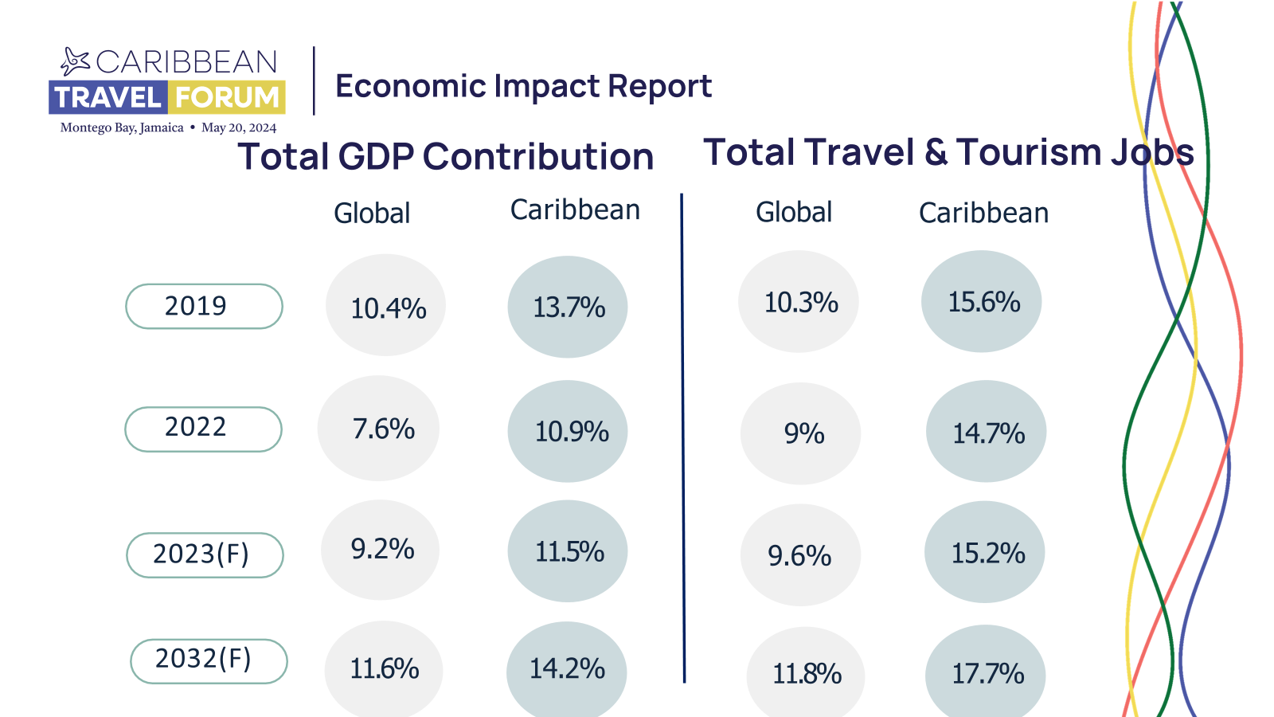

Slide 5

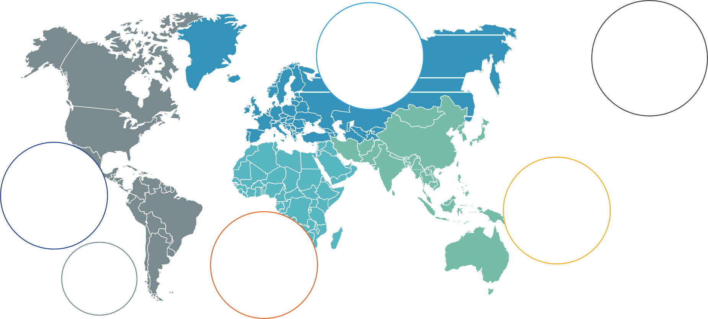



The Caribbean Led Global Recovery
INTERNATIONAL ARRIVALS IN 2023, BY GLOBAL REGION; VS 2019
Total International Inbound
-25%
Europe
-22%
Americas
-14%
Asia Pacific
-41%
Africa & Middle East
-12%
Caribbean
+3%
Source: ForwardKeys Air Ticket Data.
Notes:
Blank Slide

Slide 6
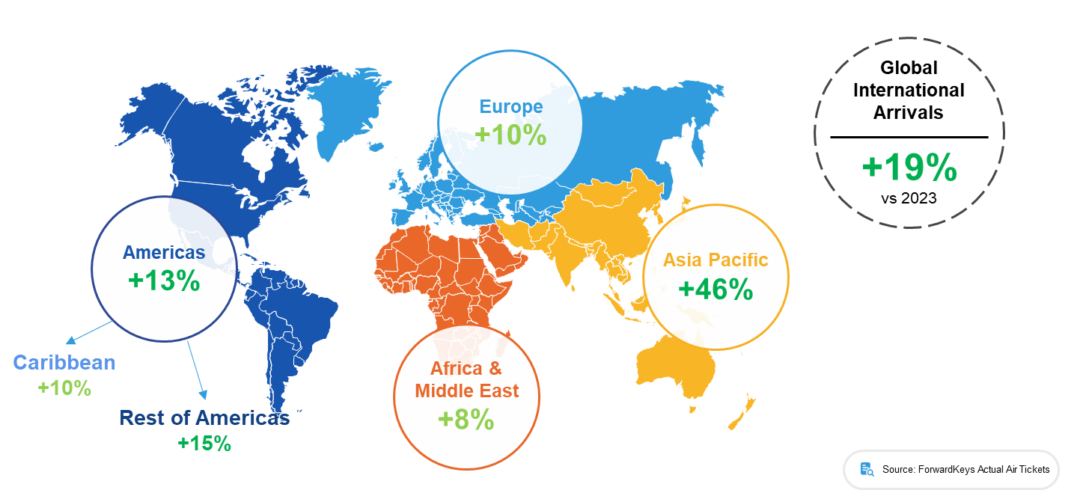
Caribbean tourism remains robust, but growth slows
International arrivals to global regions in H1 2024; % difference vs previous year
Source: ForwardKeys Air Ticket Data.
Notes:
Blank Slide

Slide 7
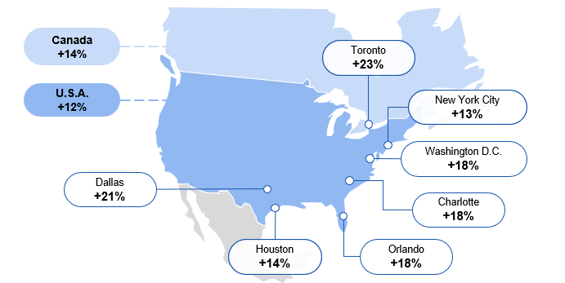
Increased North American Connectivity Reflects Growing Demand
Top performing origin markets for overseas arrivals in the Caribbean in H1 2024 vs 2023
Source: ForwardKeys Air Ticket Data.
Notes:
Blank Slide

Slide 8
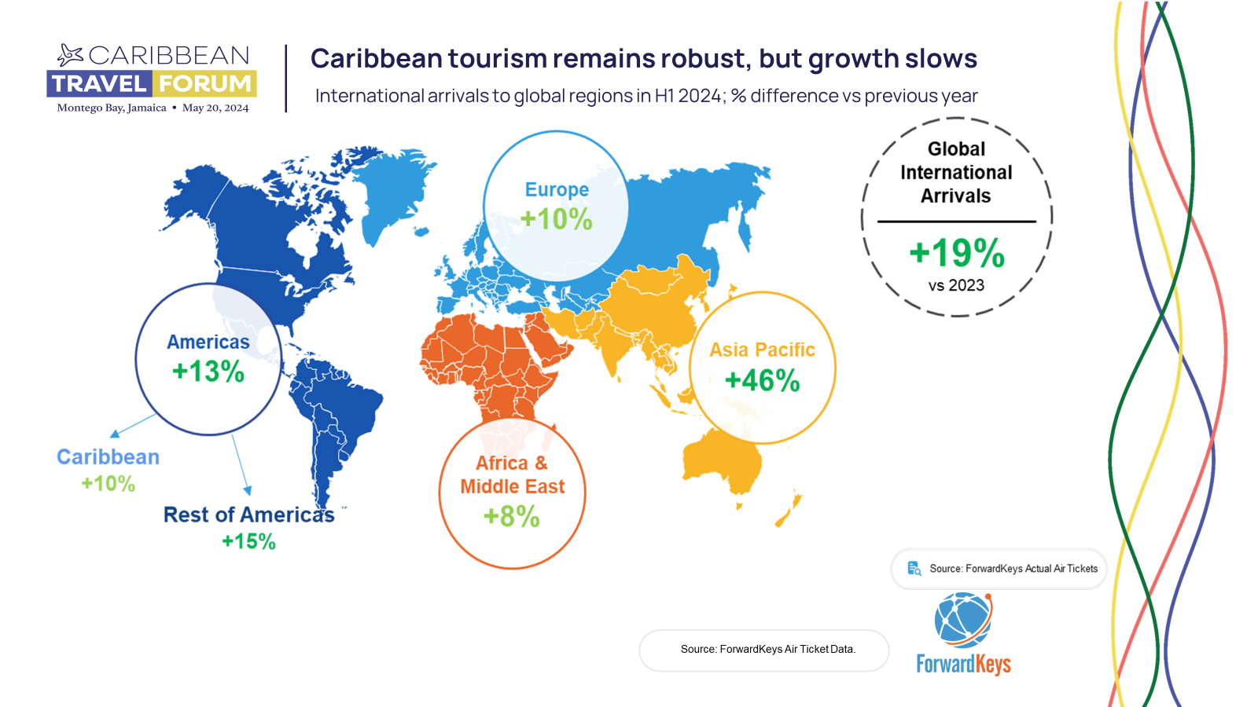
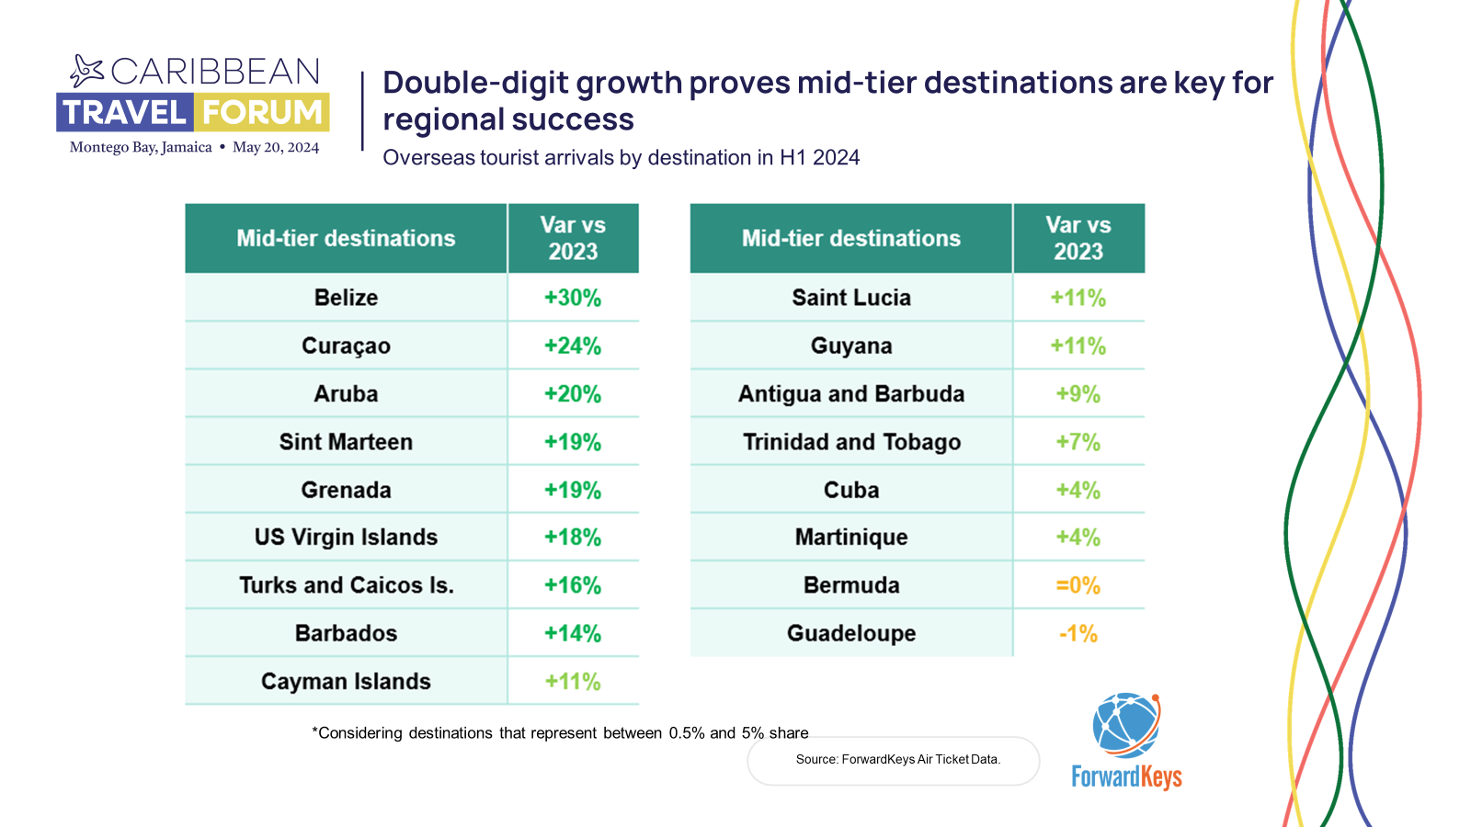
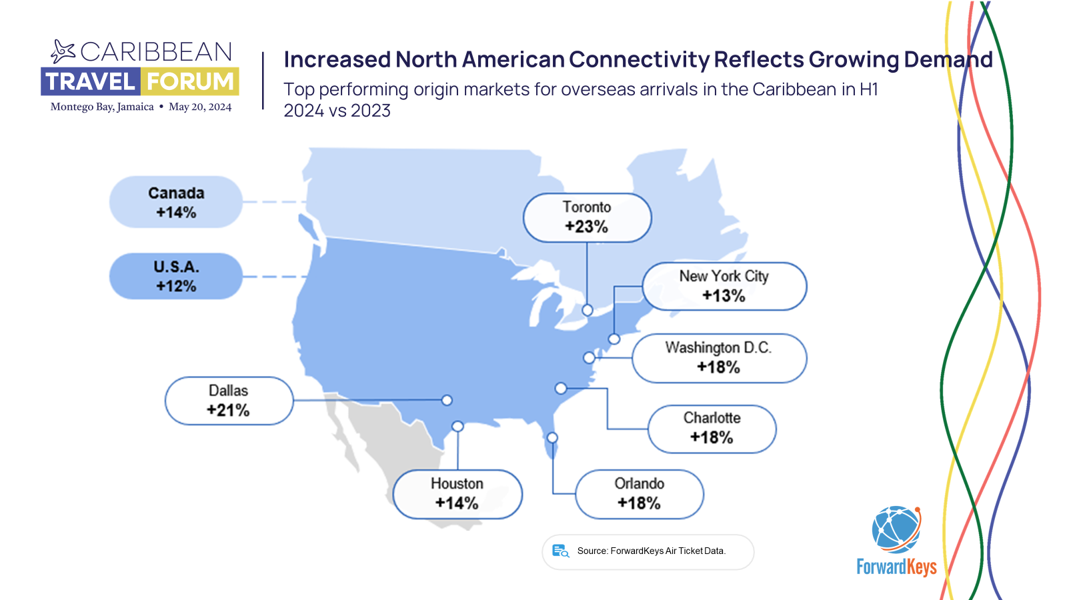
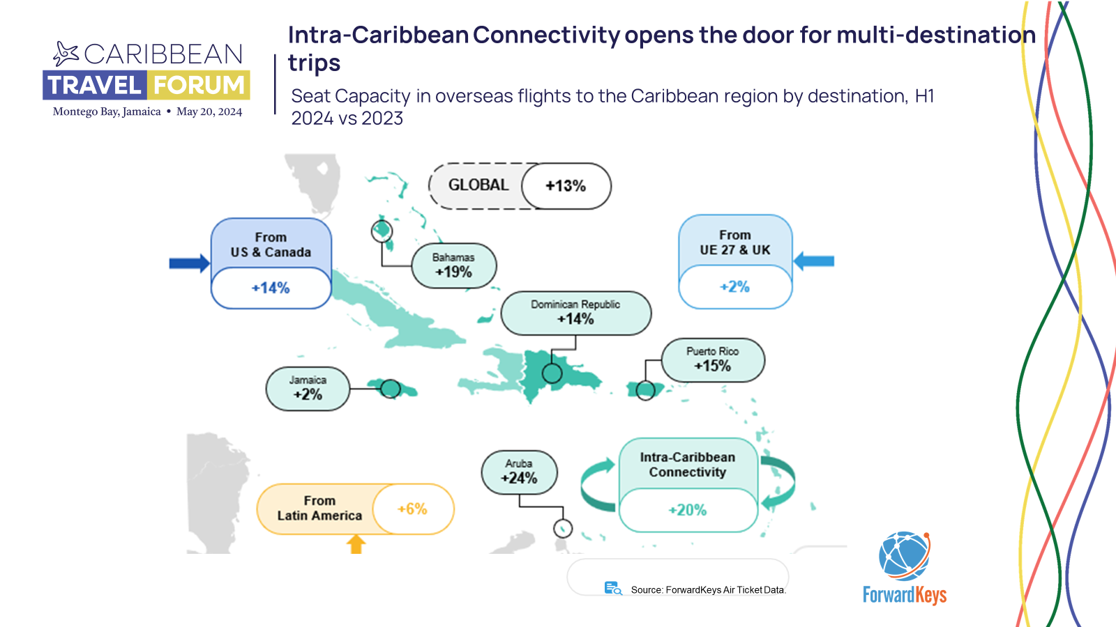

New Website

Slide 9
CHTA 2023 TOURISM INDUSTRY PERFORMANCE & 2024 OUTLOOK SURVEY RESULTS

Slide 10
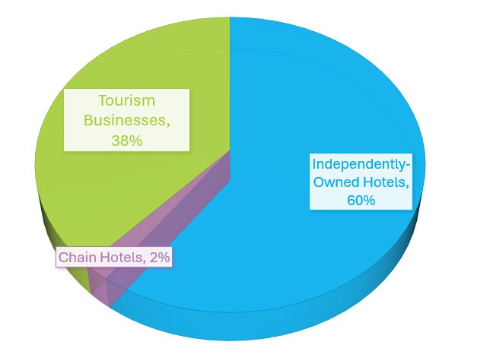

CHTA 2023 TOURISM INDUSTRY PERFORMANCE & 2024 OUTLOOK SURVEY RESULTS
60% represented independently-owned hotels; 2% represented chain hotels;
38% of respondents represented non-accommodation types of tourism-related businesses –
i.e. attractions, tour operators, restaurants, etc.
KEY TAKEAWAYS
Increased demand and Revenue Fuelled Growth in Tourism-Related Employment:
Nearly two-thirds (63%) reported increasing staff levels in 2023.
Higher Operating Costs Outpace Revenue and Profit Gains:
Despite revenue growth, escalating operational expenses posed challenges to profitability.

Slide 11
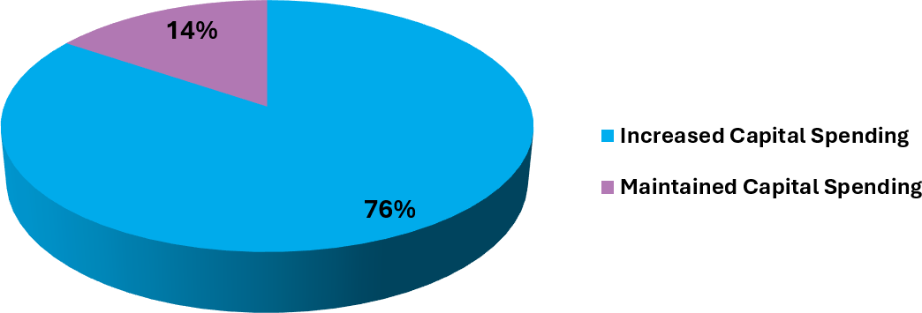
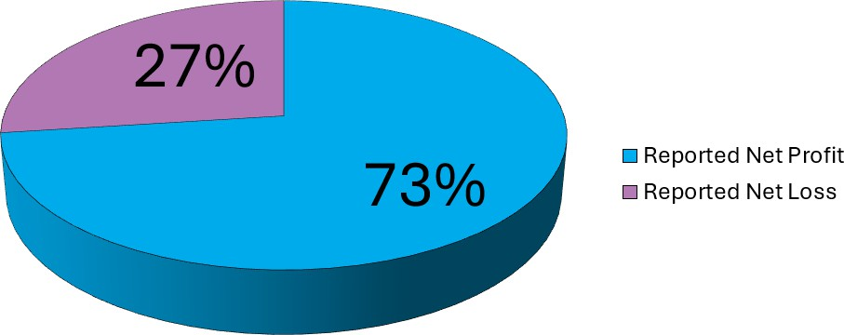
CHTA 2023 TOURISM INDUSTRY PERFORMANCE & 2024 OUTLOOK SURVEY RESULTS
76% of respondents increased capital expenditure (Capex) in 2023.
Price Increases Appeared to Have No or Little Impact on Demand:
      89% of hotels raised Average Daily Rates (ADR) by over 10% with 74% reporting higher occupancy rates.
So Far Higher Operating Costs has Tempered Increased Profits in 2024
73% of respondents forecasted a net profit, while 27% are forecasting a net loss for 2024.

Slide 12
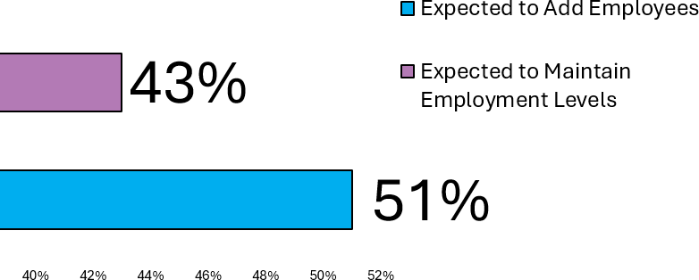
Continued Employment Growth Expected in 2024:
51% plan to recruit new hires,
and 43% aim to maintain existing employment levels.
REVENUE FORECAST:
Revenue Increases Expected Across Categories:
Anticipated rises in room, food & beverage, and other revenue streams signal overall industry
growth.
Moderate Price Increases Anticipated for 2024
68% of respondents expect to keep price increases under 10%. 18% of respondents plan to keep
prices at the same level as 2023 or slightly lower.
INVESTMENT FORECAST:
Sustained Investments in Capital Expenditures
63% of respondents plan to increase investments in capital expenditures in 2024.

Slide 13

THE LURE OF CARIBBEAN EVENTS
43% indicate that hosting regional and international events is important to their business.
40% cite the importance of Sporting events to their business.
38% point to Music festivals as important to their business.
33% indicate Carnival and Annual Cultural Festivals as important business generators.

Slide 14
MANY FIRST’S….
1ST CHTA MICE EXCHANGE
1ST MULTI-DESTINTION FAM
1ST RESPONSIBLE TOURISM DAY
1ST ARTIFICIAL INTELLIGENCE GUIDEBOOK
1ST CONSTRUCTION & PIPELINE REPORT

Slide 15

Registration Update 5-21-24
Traditional Buyers:
Total Companies: 136 (representing 25 countries)
Total Delegates: 246
Hosted buyers: 38 (Argentina, Brazil, Chile, Colombia, Ecuador, Estonia, Italy, Latvia, Mexico, Panama, Peru, Poland, Romania, Sweden, UK, USA
Other buyers
MICE buyers: 14 companies and 16 MICE Supplier delegates
Wedding specialists: 6 companies
Travel advisors: 10 companies
Suppliers
Total Companies: 206 (27 Caribbean destinations)
Total Delegates: 552
Total scheduled appointments to-date: 12,724

Slide 16

Registration Update 5-21-24
Responsible Tourism Day Activities:
Agricultural Linkages with Tourism: 20
Climate Change and Tourism: 19
Community and Tourism : 19
PLUS 50 MEDIA WILL BE ALSO BE PARTICIPATING
TOTAL PARTICIPATION: APPROX. 110 DELEGATES plus CHTA/JTB/JHTA TEAM
335 registrations
CHTA AWARDS LUNCHEON: DESTINATION RESILIENCE AWARD, HOTELIER OF THE YEAR AND PRESIDENT’S AWARD FOR EXCELLENCE IN CARIBBEAN TOURISM

Slide 17
CHTA Awards

Slide 18

CHTA Awards
Hotelier of the Year
Patricia Affonso-Dass, Group General Manager of Ocean Hotels Group in Barbados

Slide 19
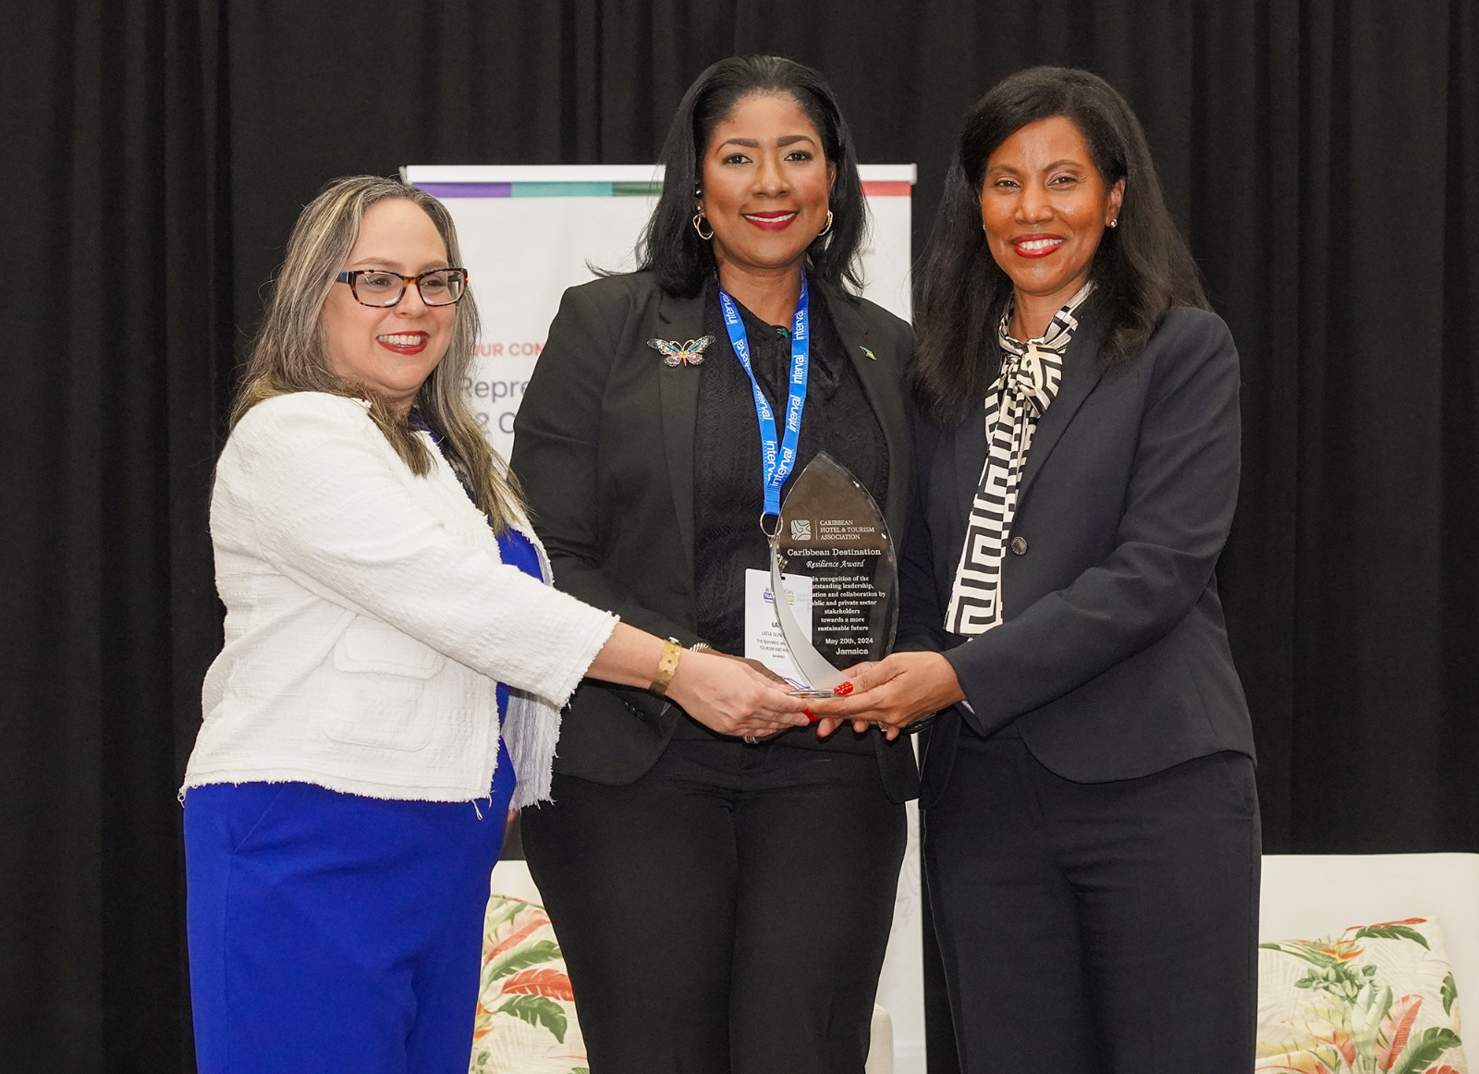
CHTA Awards
Destination Resilience Awards – Category A – The Bahamas
Bahamas

Slide 20

CHTA Awards
Destination Resilience Awards – Category B – St Lucia
St. Lucia

Slide 21

CHTA Awards
President’s Award for Caribbean Tourism Excellence
CARPHA

Slide 22

CHTA MICE EXCHANGE

Slide 23

Multi-Destination Press Trip
St. Lucia, Jamaica, Cayman Islands

Slide 24

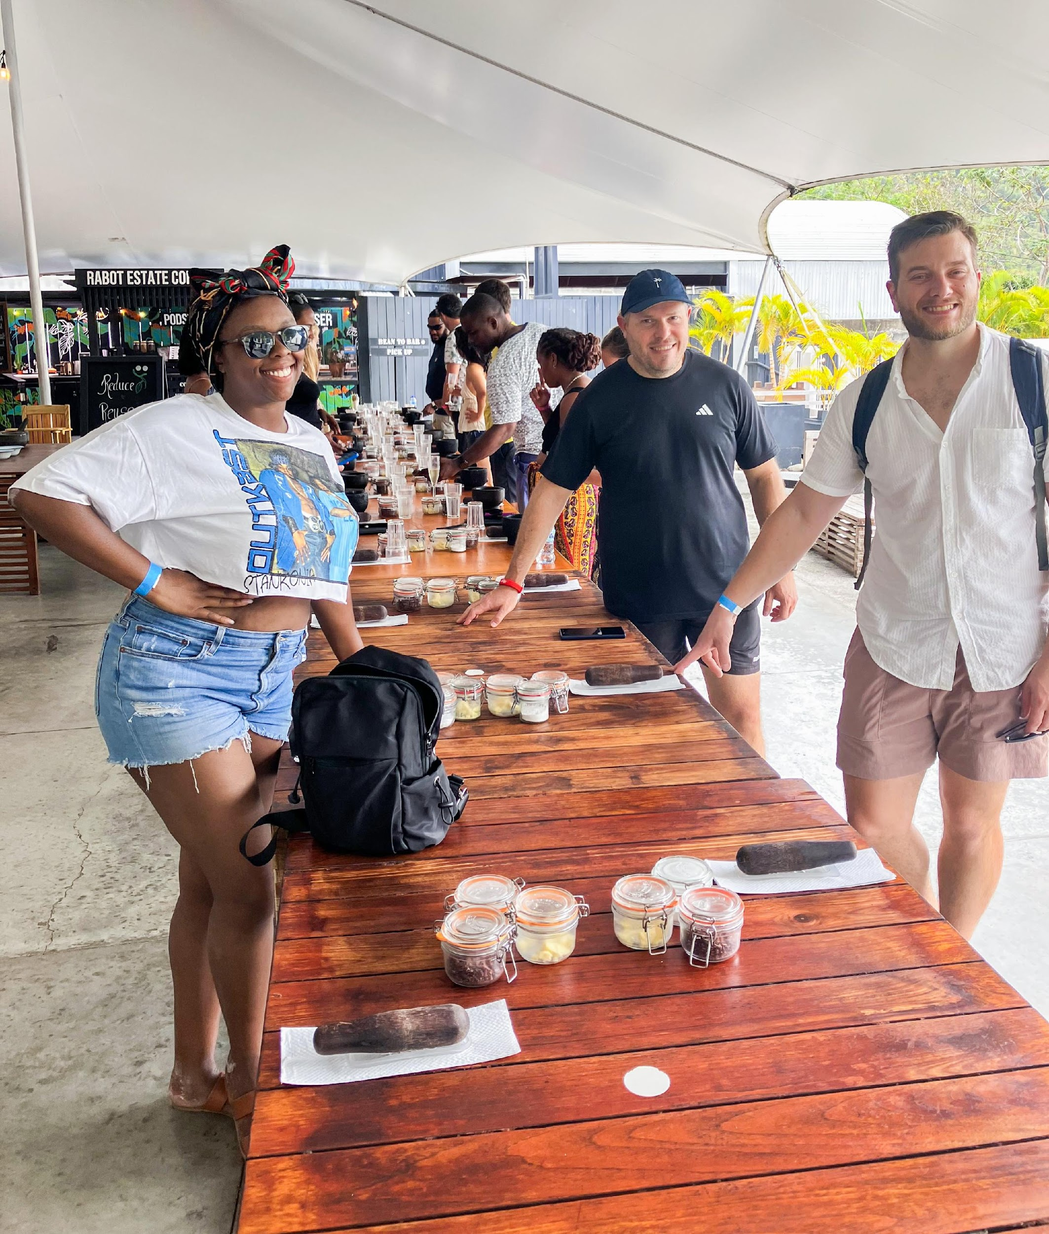
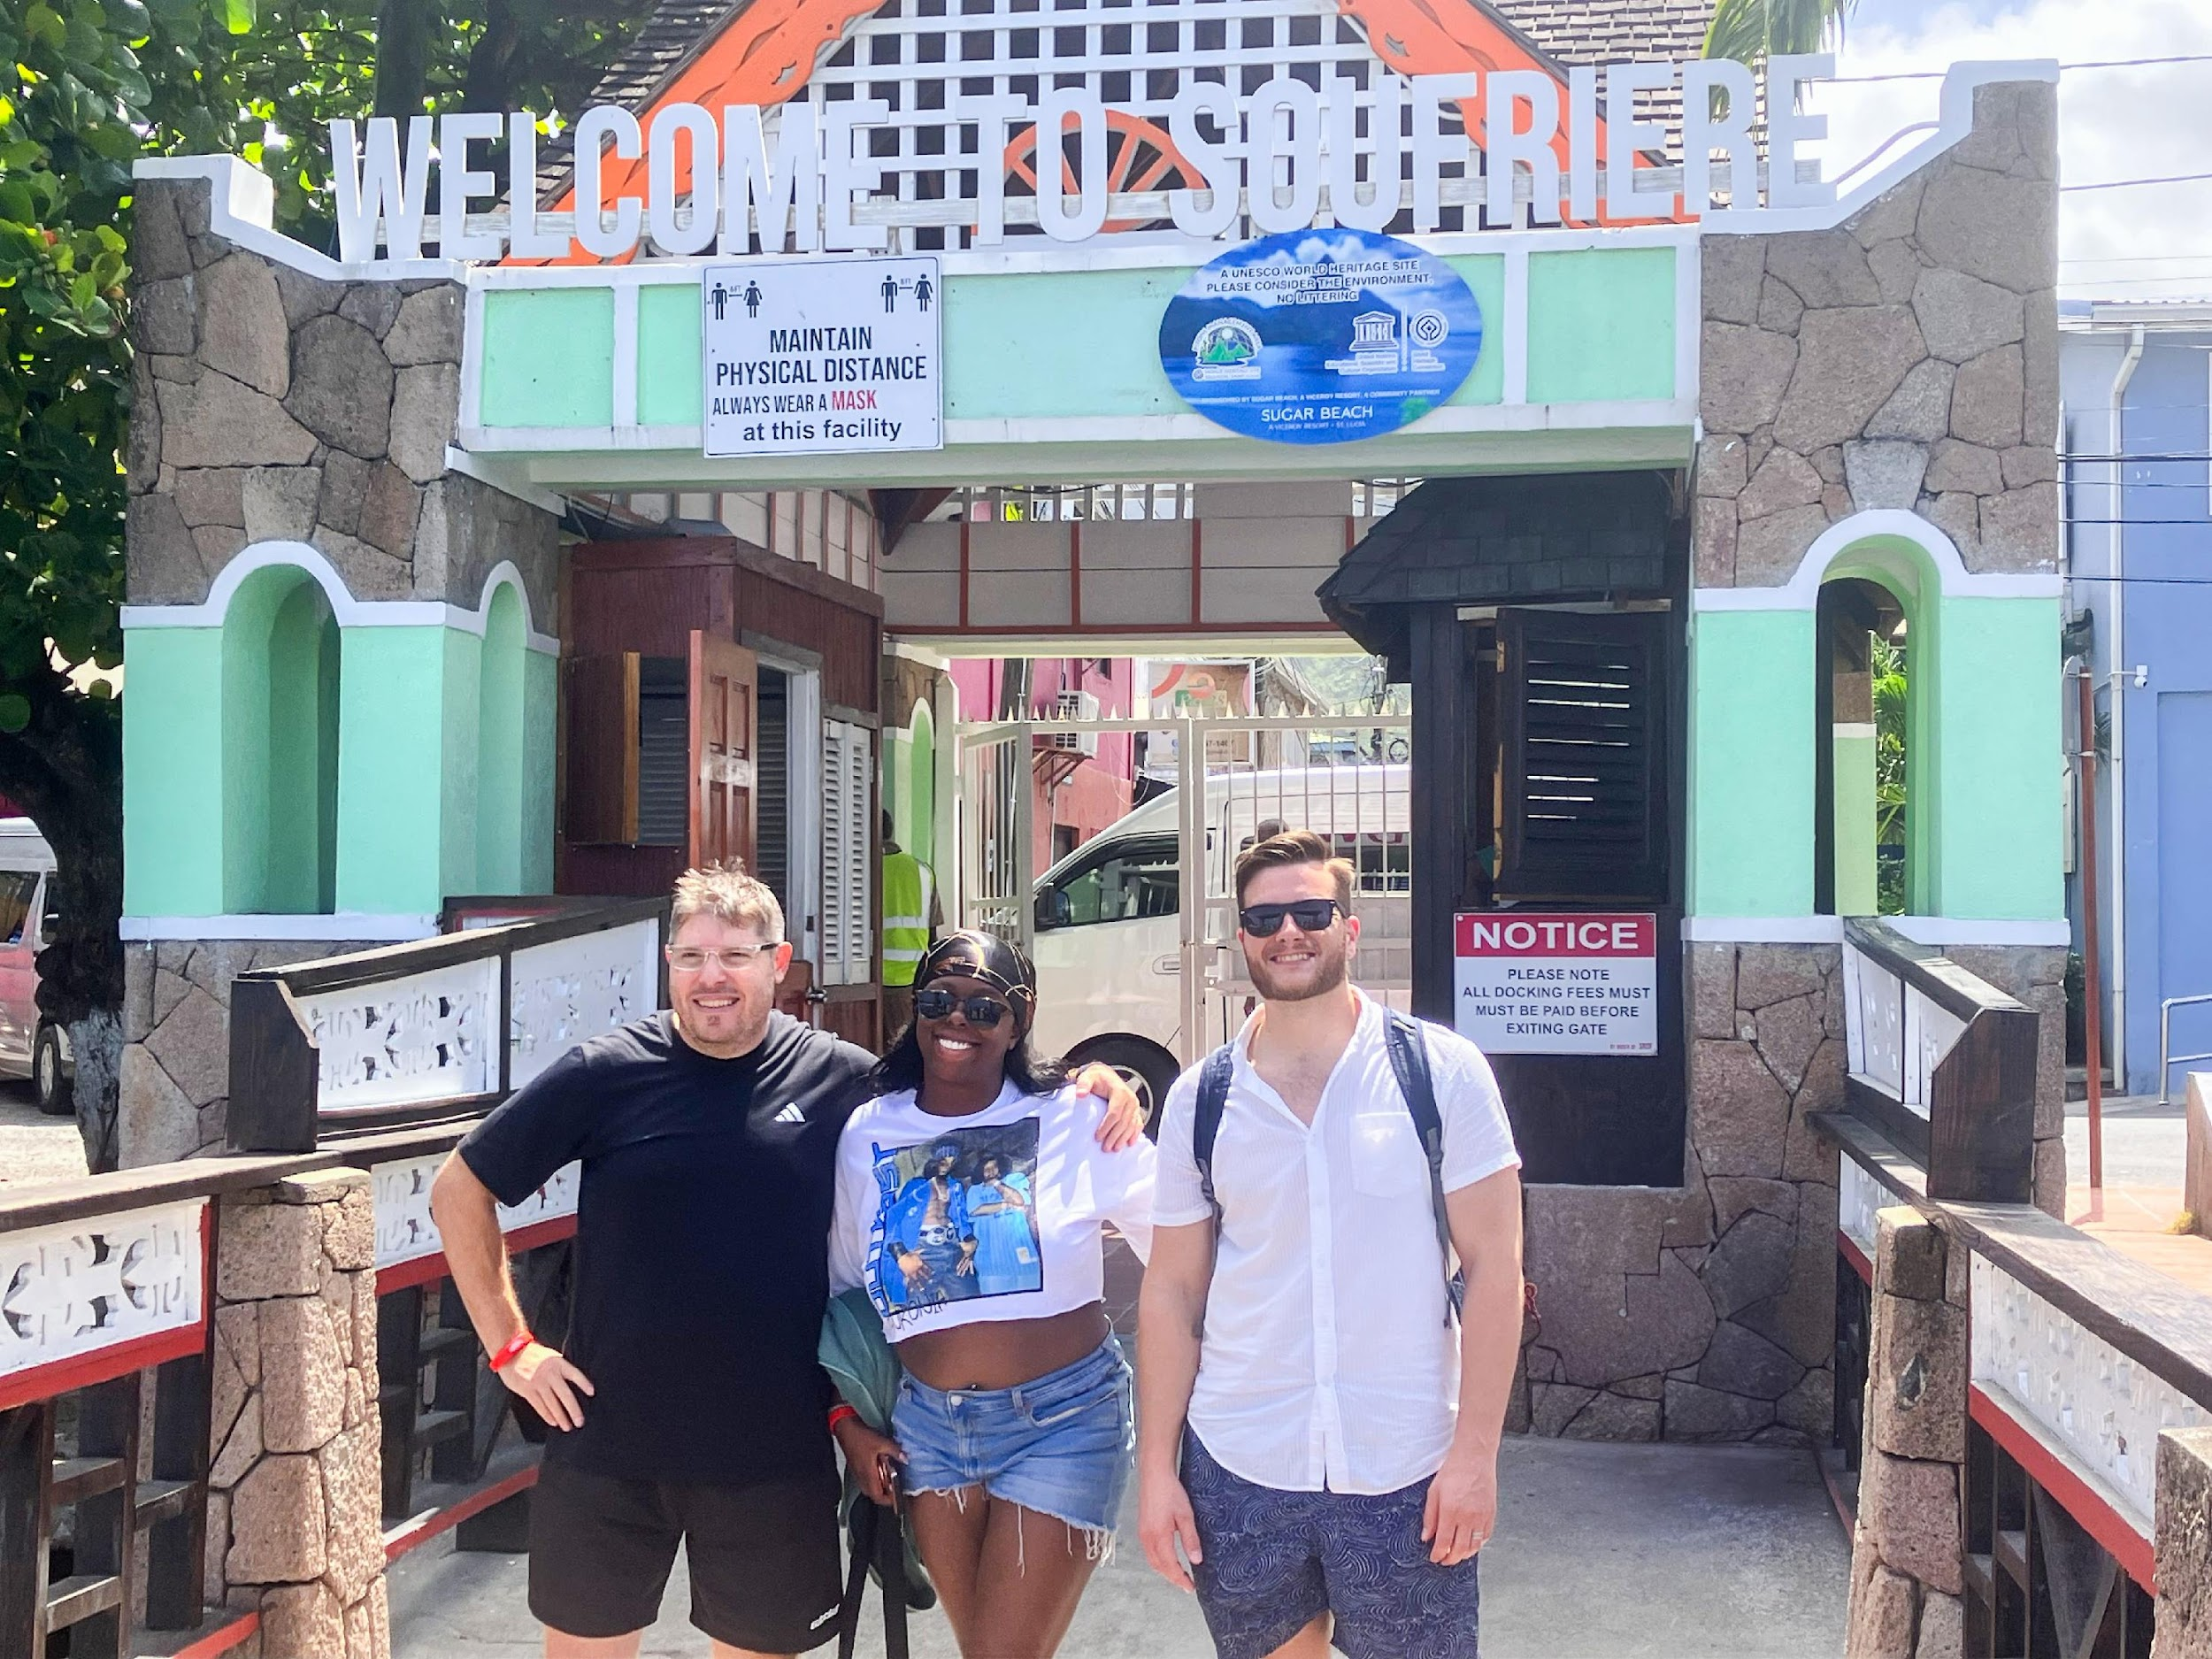
Multi-Destination Press Trip
St. Lucia, Jamaica, Cayman Islands

Slide 25
Multi-Destination Press Trip
St. Lucia, Jamaica, Cayman Islands
Journalists Tyler Fox (Travel Off Path), Simone Harvin (Bleu Magazine), and Julian Belenque (Travel2Latam) arrived in St. Lucia on Friday and kicked things off with dinner at Cap Maison, followed by the Gros Islet Friday Night Street Party experience. On Saturday, they visited the formerly French colonial capital of Soufrière, took a dip at the Sulphur Springs and Mud Baths, then got hands-on with a chocolate-making experience at Project Chocolat. An exquisite lunch at the breathtaking Jade Mountain was part of the day’s experiences. The group was escorted by St. Lucia Tourism Authority's Rondel Charlery, Francine Holder and Ernie George; and Marketplace Excellence’s Darcel Choy.

Slide 26


Artificial Intelligence Guide for Caribbean Tourism
Author: Christus Gill, with AI assistance
Objective: To provide comprehensive insights into AI applications, challenges, and prospects in the Caribbean travel and tourism industry
Focus Areas: AI applications in travel and tourism, challenges faced in AI adoption, and future prospects of AI in the industry

Slide 27
CHTA Caribbean Construction & Pipeline Report

Slide 28
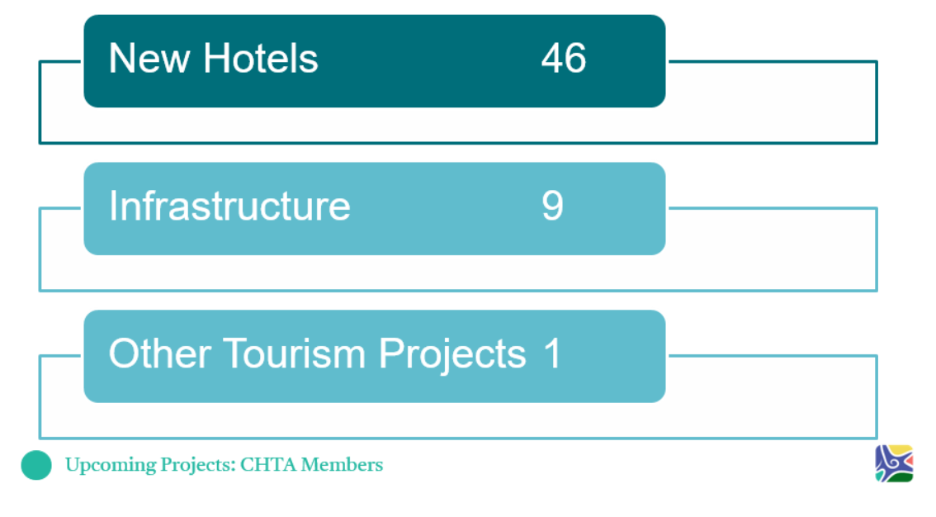
CHTA Caribbean Construction & Pipeline Report

Slide 29
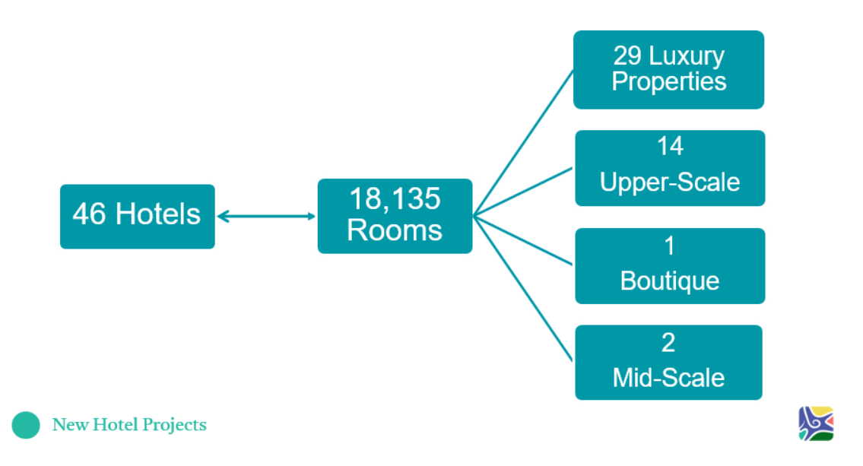
CHTA Caribbean Construction & Pipeline Report

Slide 30
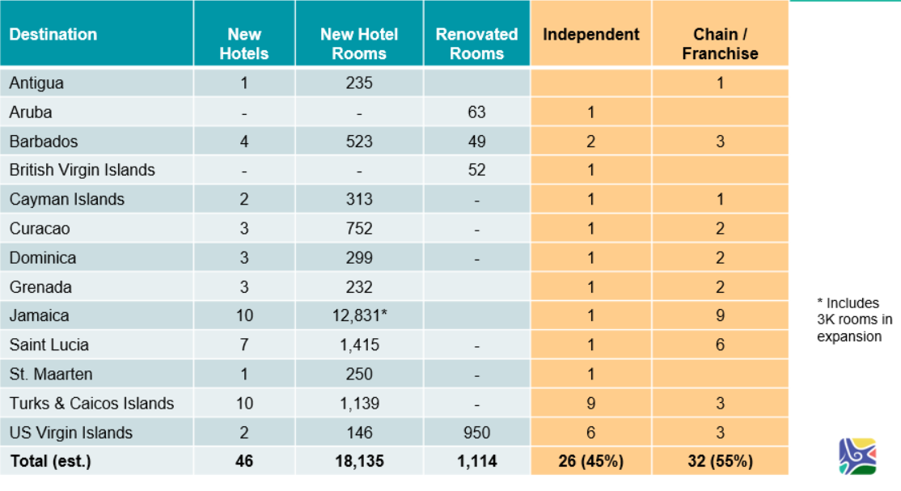

CHTA Caribbean Construction & Pipeline Report

Slide 31
Caribbean Hotel-Related Investments Surpassing Peak 2019
Aggressive and Collaborative Planning Needed to Address Robust Growth in Number of Rooms
Development Phase | 2017 | 2019 | 2024
In Construction | 6,374 | 13,033 | 14,230
Final Planning | 8,303 | 10,380 | 6,135
Planning | 3,297 | 6,290 | 9,622
Total Rooms in Pipeline | 17,974 | 29,703 | 29,987

Slide 32
Looking to the Future..
Global and Caribbean demand for travel is robust
Region continues to be highly desired by international travelers
Caribbean Tourism continues to exhibit tremendous resilience
Anticipated growth is forecasted to range between 5.0% and 10.0%, potentially welcoming between 33.8 million and 35.4 million tourists
Cruise sector will continue its upward track, with an estimated 34.2 million to 35.8 million cruise visit* expected in the Caribbean
Rapid growth in hotel and other investments requires a comprehensive look at airlift, infrastructure (especially utilities, airport and transportation capacity) to ensure sustainable growth and to keep Over-tourism in check

Slide 33

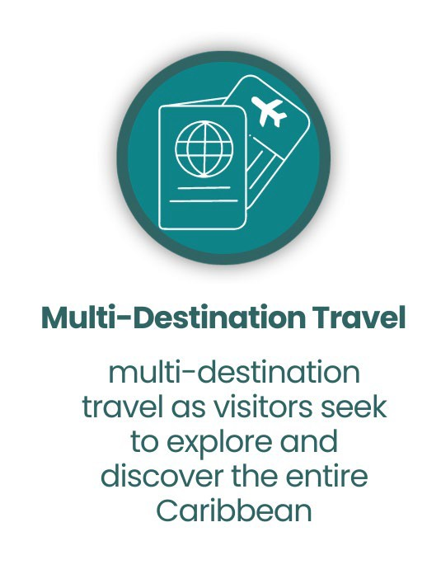


Our Caribbean Vision

Slide 34




Our Caribbean Vision

Slide 35
Thank You!
www.CaribbeanHotelandTourism.com

