Slide 1


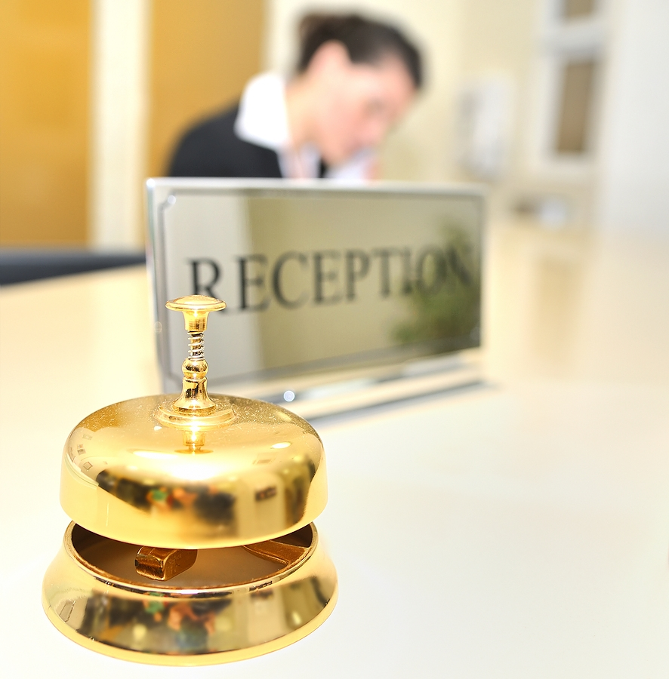
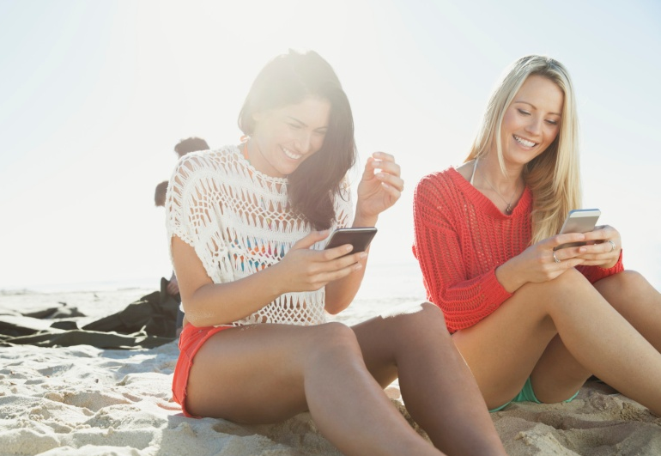
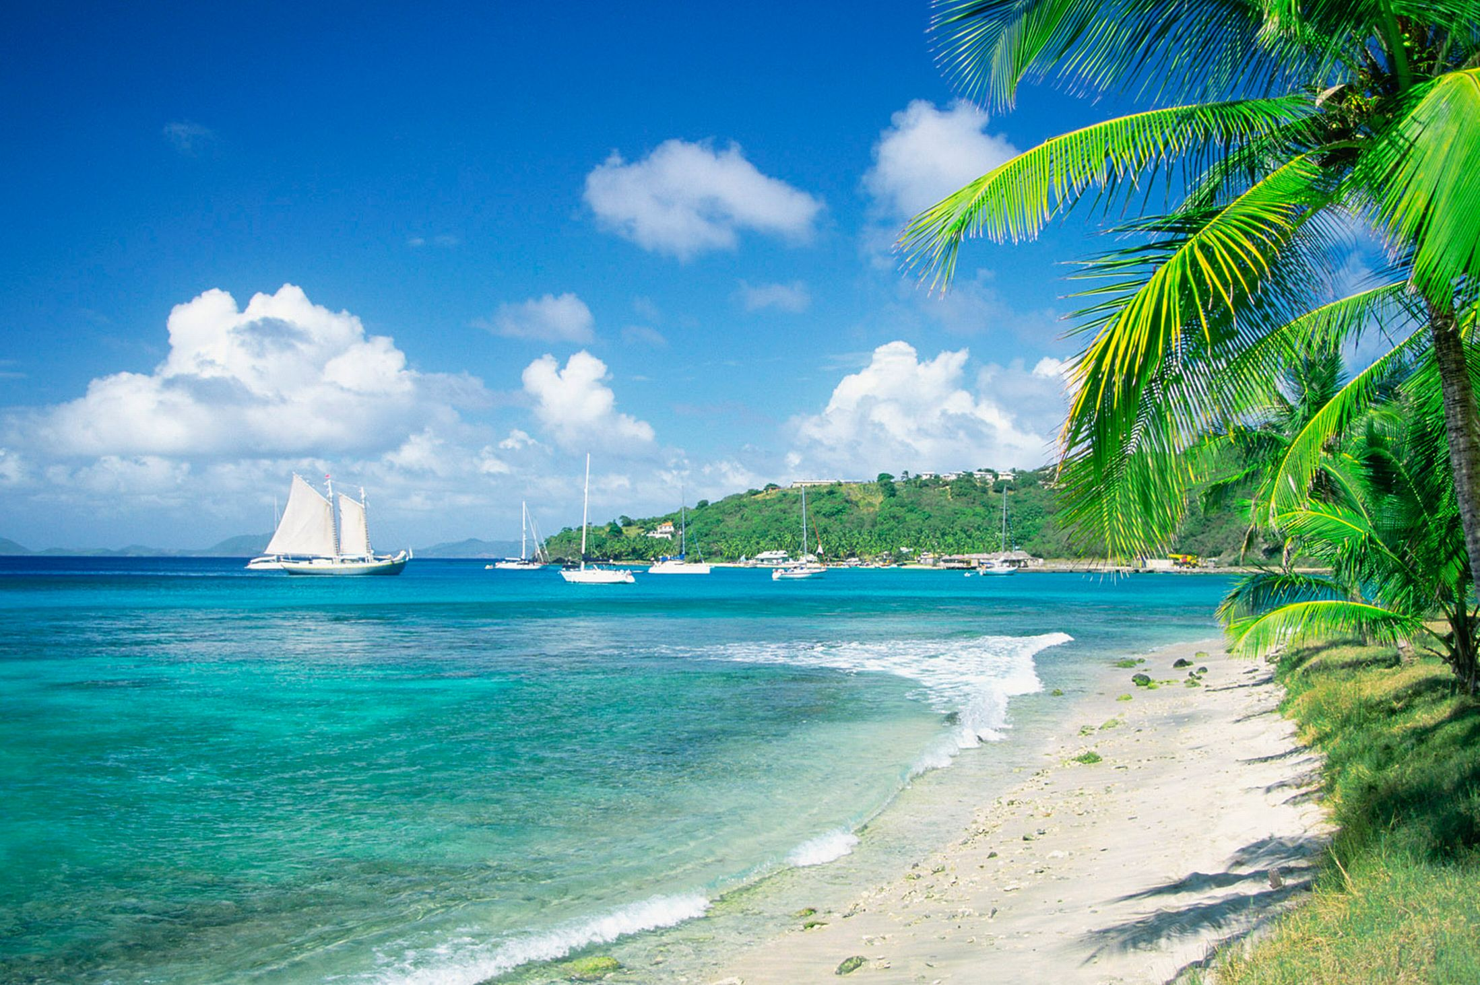

Would You Follow Me?
Driving Sales Thru Social Media
July 28, 2015

Slide 2
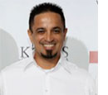
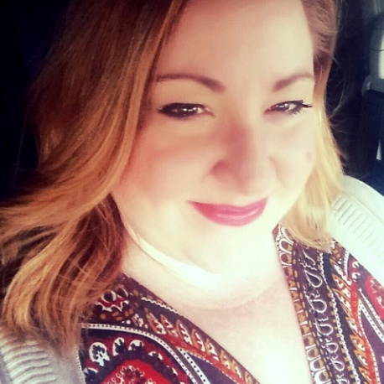
speakers
Javier Morales, Co-founder, Social Caddie
Social Caddie is a marketing strategy firm. Javier Morales has spent his 25+ year career developing relationships and learning the ins and outs of hospitality marketing. His outside-the-box strategies have been instrumental for many of his career achievements. Javier has held several positions in the hospitality industry with companies like: Air Jamaica, Doral Golf Resort, Marriott Caribbean and Mexico Resorts, Certified Vacations, Palm Beach Cruise Lines, Palm Beach Conventions and Visitors Bureau, Florida Marlins Baseball Club, Dolphin and Majesty Cruise Lines. Javier is based in South Florida but considers the entire Caribbean home.
Adriana Serna, Communications Manager, Caribbean Hotel and Tourism Association
Adriana is a communications expert and social media strategist with over 15 years of experience in working with international corporations such as Aeromexico Airlines, Tiffany, Franklin Templeton, Tampico Beverages and World Research Group. The founder of a social media training company, Blue Compass Group, she has provided specialized training for the Miami Herald and Goldman Sachs 10,000 small business program. Adriana has also been an expert speaker at Social Media Day Miami for the past three years and most recently was a moderator at Florida Social Con at Florida International University.

Slide 3
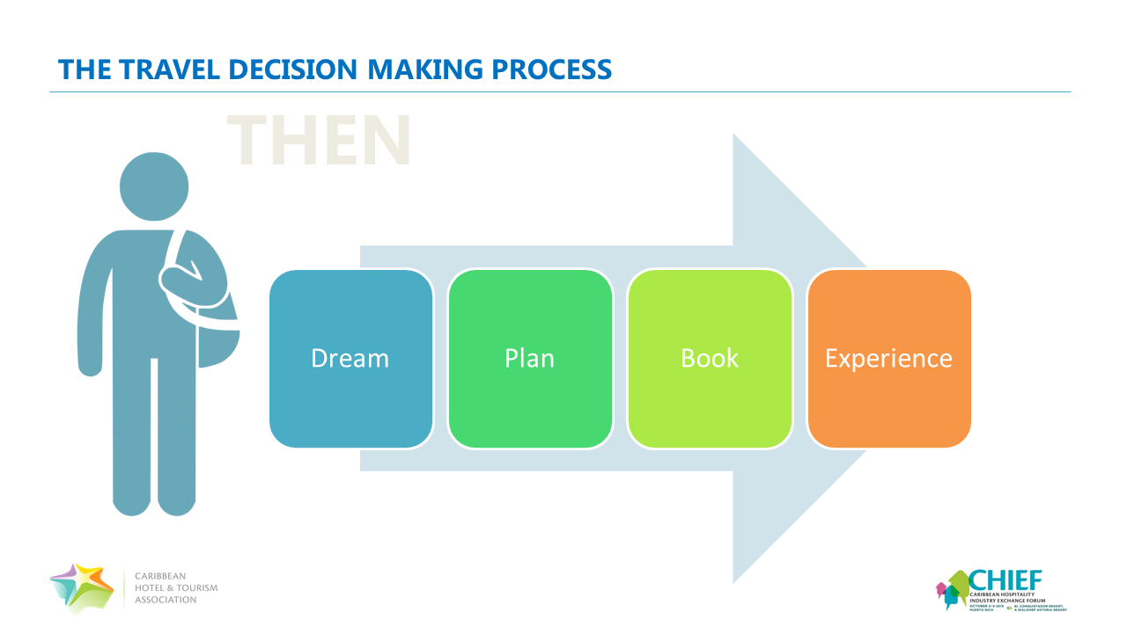

Slide 4
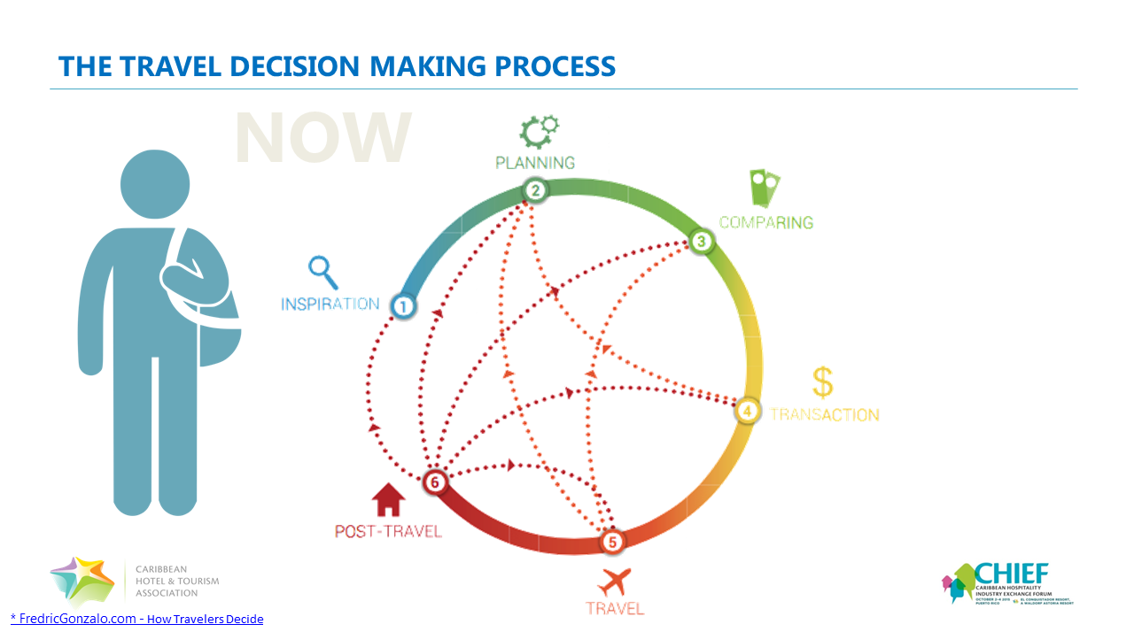

Slide 5
The trinity of digital marketing

Slide 6
The trinity of digital marketing
WEBSITE
A Website that Converts Browsers into Buyers
  Empowers your customer to purchase
  Sets the mark for online user reviews
  CHIEF SESSION: Ratings and Review: Does It Matter What They Say About You?
EMAIL
An Email and Data Collection Strategy
  Enhances your knowledge of your customer
  Enable you to make data driven marketing decisions
  CHIEF SESSION: Unleash the potential power of your customer data
SOCIAL
A Social Media Strategy
  Placed you front of mind with consumers
  Positions you as an industry leader
  CHIEF SESSION: Would You Follow Me? Driving Sales Thru Social Media

Slide 7

Social media MARKETING
TRAVEL + SOCIAL MEDIA
BEFORE TRAVEL
56%
Get travel inspiration from friends and family online
50%
Direct bookings are generated by social media
65%
Travelers turn to the web early on
in the travel process
55%
“Liked Facebook pages specific to a vacation
* Think with Google – Travelers Road to Decision 2014

Slide 8
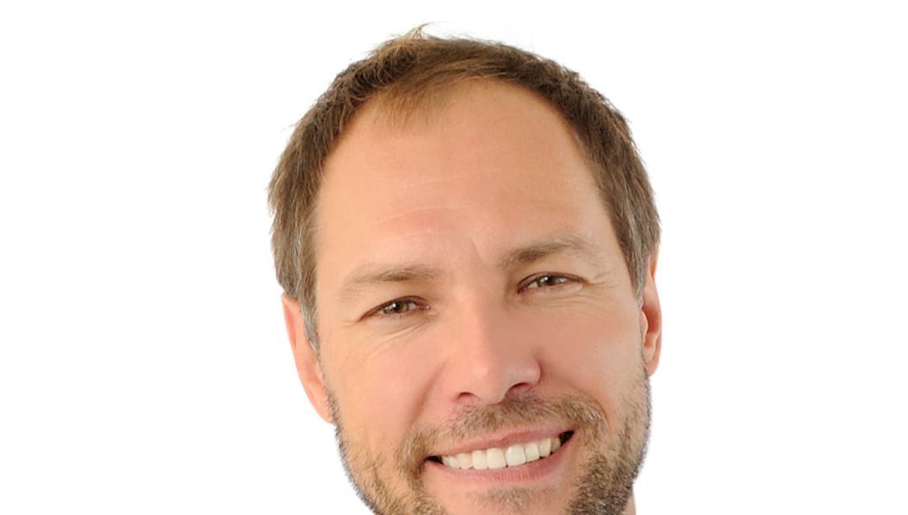
Social media MARKETING
TRAVEL + SOCIAL MEDIA
DURING TRAVEL
85%
Travelers use their smart phones while traveling
46%
Check in to a location while on vacation
40%
Post activity, restaurant and hotel reviews while traveling
70%
Updated their Facebook status while on vacation
* Think with Google – Travelers Road to Decision 2014

Slide 9
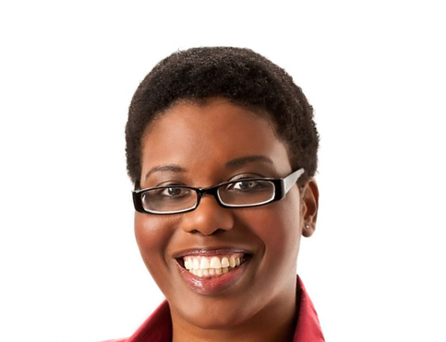
Social media MARKETING
TRAVEL + SOCIAL MEDIA
AFTER TRAVEL
46%
of travelers post hotel reviews
76%
Post photos of their trip on social media
40%
of travelers post activity or attraction reviews
55%
“Liked Facebook pages specific to a vacation
* Think with Google – Travelers Road to Decision 2014

Slide 10
Social media MARKETING
THINK STRATEGICALLY…
Play by the rules (Page vs. Profile)
Integrate social media into your overall marketing
Leverage your employees, vendors & associations
Acknowledge new media: bloggers
Learn how to provide customer service online
…BUT DON’T FORGET TO BE SOCIAL.
Provide value, not just advertising
  Entertainment
  Education
  Engagement
Give them what they need to know to buy
Build a relationship with your followers
Listen

Slide 11
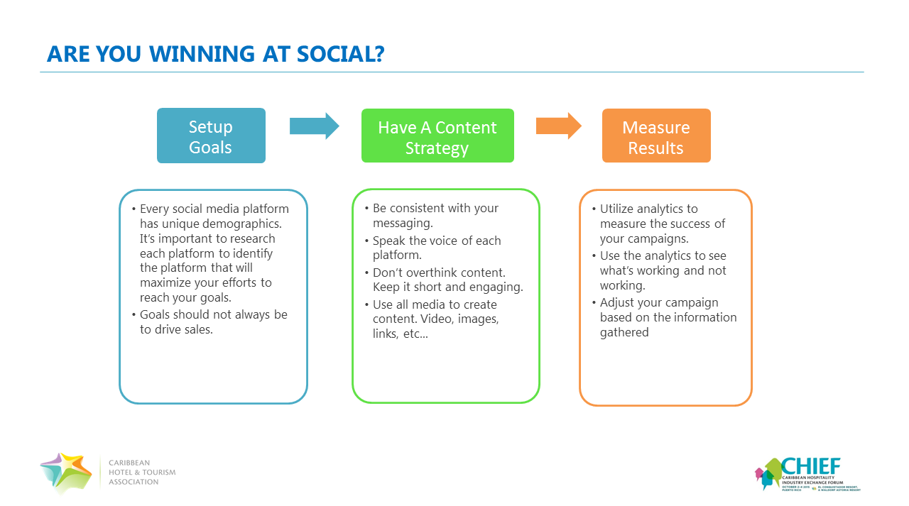

Slide 12
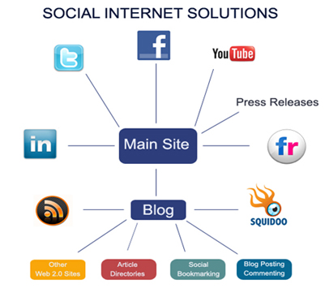
Are you winning at social?
The Social Internet brings all the online platforms together to increase the site authority.
The stronger the authority, the more opportunity for higher ranking in search results.

Slide 13

Best practices – Social Media OVERALL
Have unique content for the about sections
Include link to main site
Have a Posting Strategy
Be Engaging
Be Human
Monitor Page Insights
Use links on your posts to drive traffic back to core site
Optimize your posts by using Keywords

Slide 14


Best practices - facebook
Create an eye catching cover image
Add a call to action button
Monitor Page Insights to determine frequency of posting
Post images
Post video and utilize call to action
Utilize hashtags that are relevant
Respond to messages and comments to increase engagement
Join groups that are relevant to your business
Case Study: Avanti Resort in Orlando

Slide 15

Best practices - instagram
Hashtags are the life blood of Instagram. Use lots of them, but chose them wisely. Iconosquare
The main focus is the image. Make sure it is clear and eye catching
User Generated Content (UGC) produces the most engagement, more than paid photography
Use pictures to associate ideas and feelings with the brand
Carefully, use meme and pop culture centered images
Behind the scenes images
Case Study: Comodo Restaurant in New York

Slide 16


Best practices - twitter
Customize page and include company branding
Keep it short
Follow people that you would like to target
Monitor Page Insights to determine frequency of posting
Research hashtags to identify active conversations
Use # throughout tweet. But, make it flow
Post images
Retweet good tweets
Utilize @ to mention people in your Tweets
Case Study: Virgin America Fly Forward, Give Back

Slide 17


Best practices - pinterest
Brand your account
Create your initial pinboards
Seed your initial pinboards
Get your partners involved
Create Fan-curated Boards
Add a Pin It button to your website
Case Study: Four Seasons Hotels and Resorts Pin.Pack.Go

Slide 18
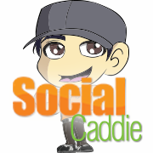

CONTACT INFORMATION
Javier Morales
Co-founder
Social Caddie
Phone: (954) 828-0614
Email: Javier@socailcaddie.com
Website: www.socialcaddie.com
Adriana Serna
Communications Manager
Caribbean Hotel and Tourism Association
Phone: (786) 476.8622
Email: adriana@caribbeanhotelandtourism.com
Webiste: www.caribbeanhotelandtourism.com
Thank you for your kind attention – Questions or Comments?

